Slide 1
The path to a better election
November 23, 2023

Slide 2
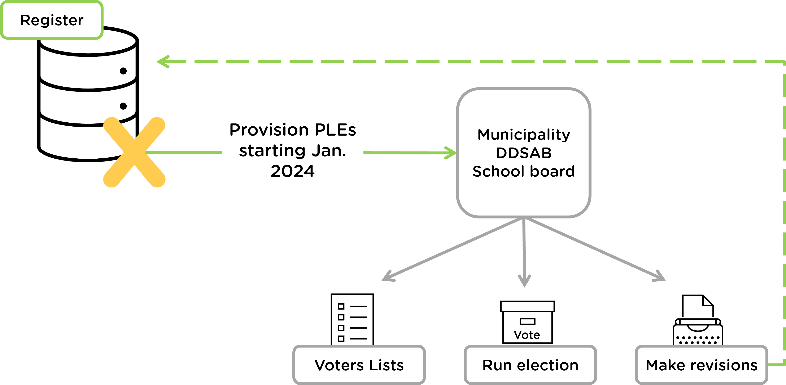
Transition
Responsibility to provision PLEs for municipal elections transfers to Elections Ontario from MPAC on January 1, 2024

Slide 3




How do we improve the PLE?
Dedicated
Register Team
Single Register
Targeted
Registration
Election Portal

Slide 4



Single Register
Combining provincial and municipal eligibilities
Provincial
Single Register
Municipal
4

Slide 5

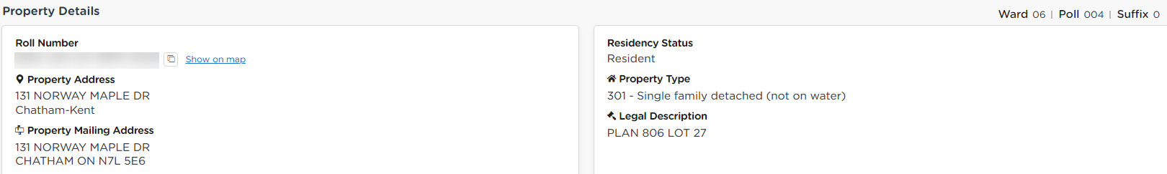
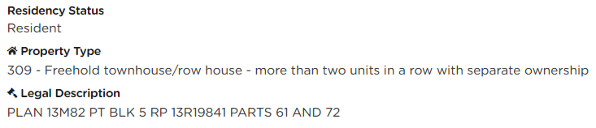
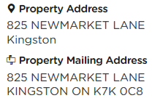
Single Register – accurate address maintenance
2
1
Source: Ontario Road Network or municipal preference

Slide 6








Single Register – improved data sources
Data integration

Slide 7
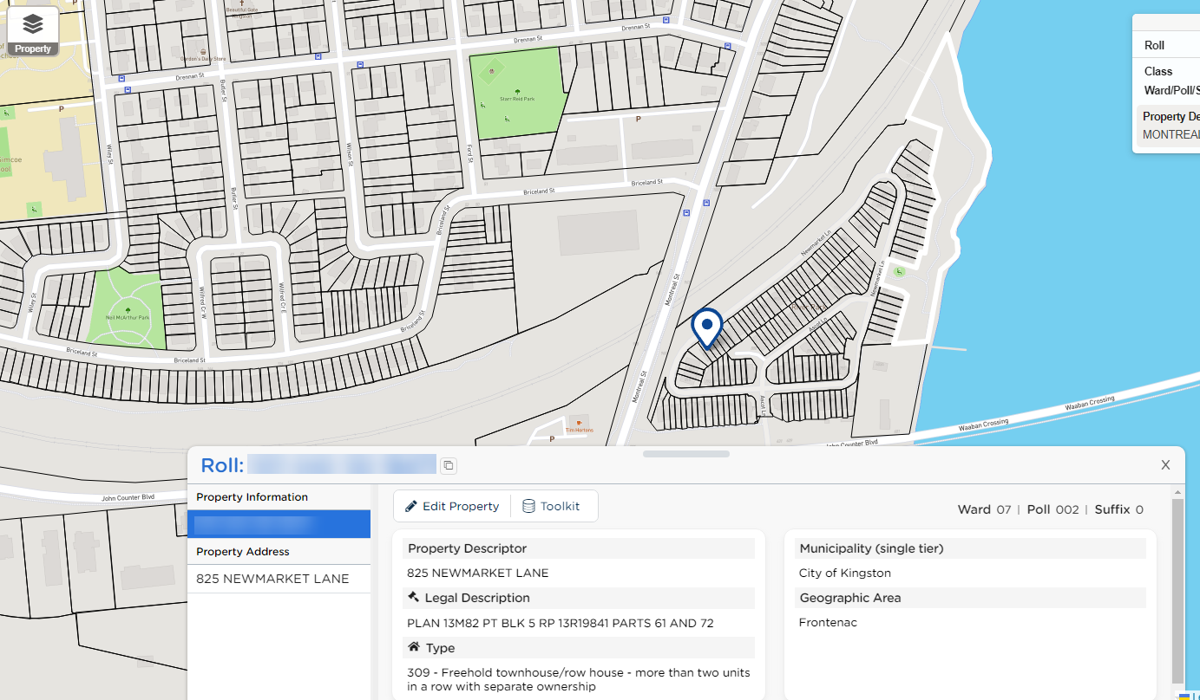
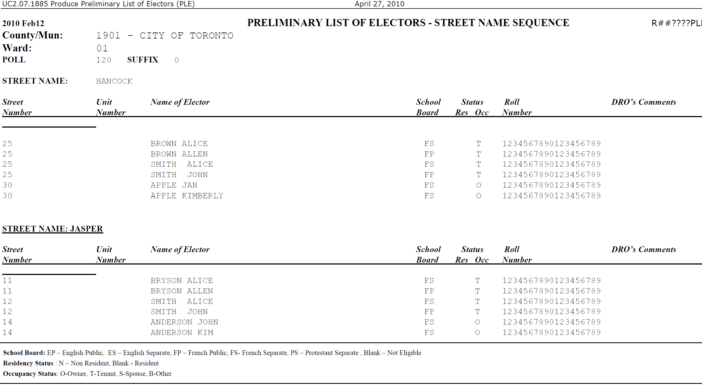
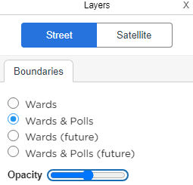
Election Portal – a new online tool
Geography
Sample PLE
Current & Future
7

Slide 8
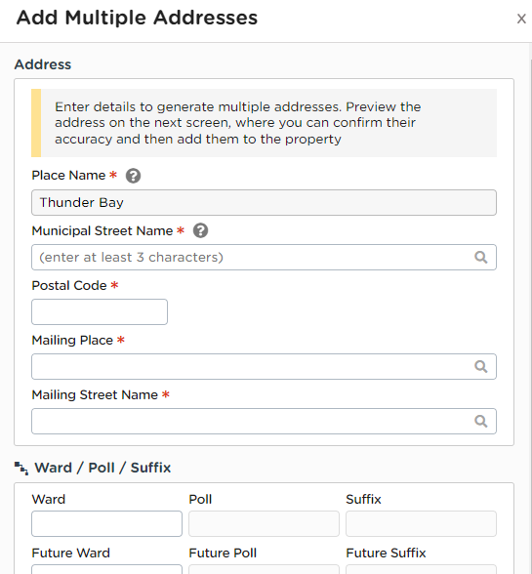

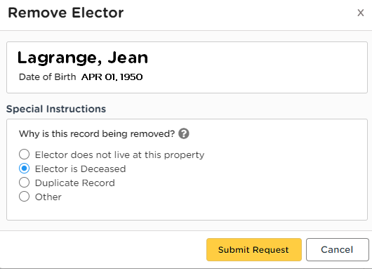
Election Portal – ongoing access to the Register
Remove deceased electors
Add new subdivisions
Flag addressing errors

Slide 9
Dedicated Register Division
Information Management | Municipal Stakeholder Relations
Manage the Register, Review change requests, Extract PLEs and other products and, Resolve contradictions from external sources. | Support Stakeholders, Develop communications tools, Train and, Troubleshoot issues.

Slide 10


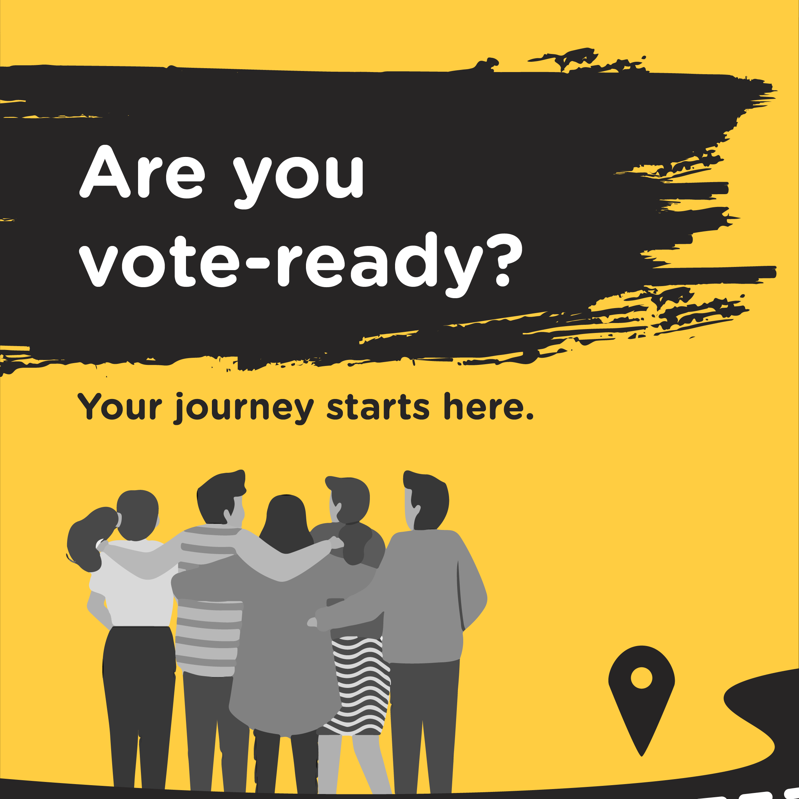
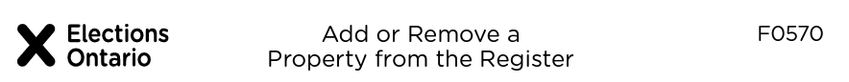
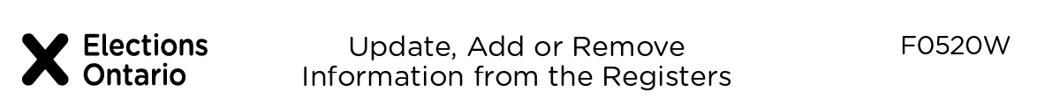
Targeted Outreach
Registration forms

Slide 11
Next steps

Slide 12
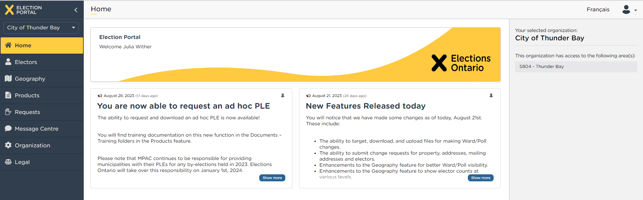

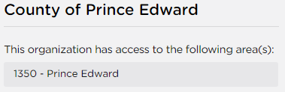
Election Portal onboarding
Onboarding for Zone 6 are happening in November – if you were unable to book your session, email voterslist@elections.on.ca
Do you have feedback? Share it with us!

Slide 13



New registration site
VoterLookup is retiring – update your websites in December
  Look out for our communications toolkit
Shut down on October 30th

Slide 14
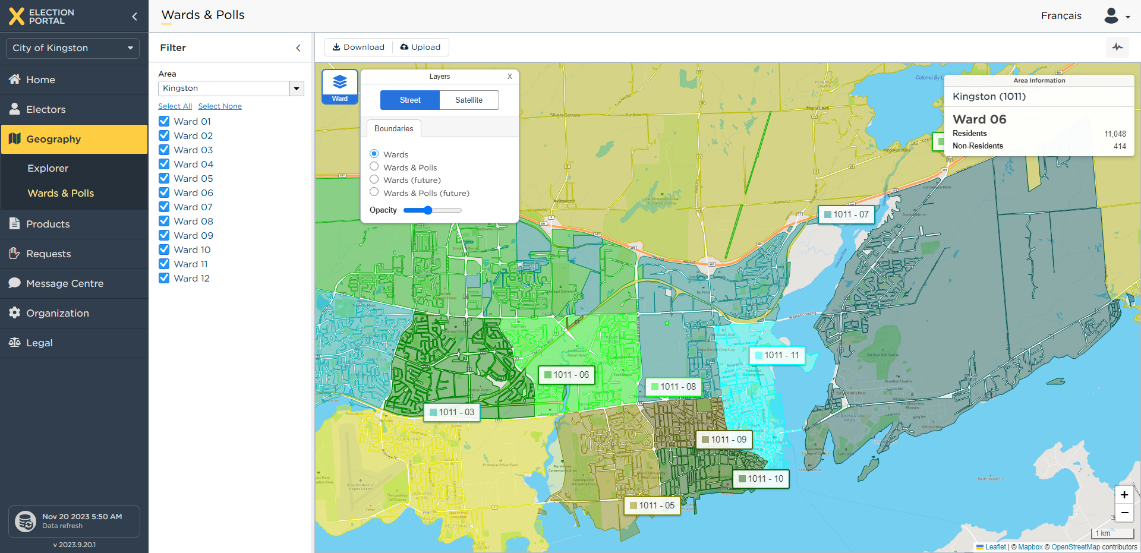
Upcoming events
Upcoming by-elections or ward boundary reviews? Let us know!

Slide 15
Summary
Elections Ontario responsible for PLEs beginning January 1, 2024
Four tools to improve PLE quality:
  Single Register
  Election Portal
  Dedicated Register team
  Targeted outreach
Next steps:
  Onboard to the Election Portal and share your feedback
  Update your website
  Tell us of upcoming by-elections and ward boundary reviews

Slide 16

Questions?
Ask now or email us at voterslist@elections.on.ca!

