Slide 1
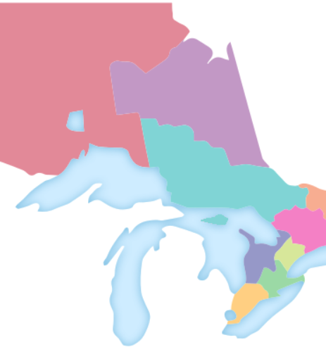
2024 Spring Zone Meetings
Association Update
Notes:
Hello everyone
Thank you very much for inviting us here today
My name is (Introduce self)
Today I am joined by (Introduce Board/AMCTO Staff
We are so pleased to join you and provide you with an update on the work being done on your behalf at AMCTO.

Slide 2



Organizational Updates
Accomplishments
Recent & Ongoing Work
Looking Ahead
2023 Budget Results
While final budget numbers will be available following the audit, AMCTO has projected a surplus for the 2023 financial year.
2024-2025 Board of Directors
With no contested nominations this spring, all available board positions were filled through acclimation
New Board Members/Positions:
  Danielle Manton, VP
  Amanda Fusco, Zone 3
  Kathryn Scott, Zone 7
  Joey Anderson, Director at Large
2022-2026 Strategic Plan Implementation
Completion of strategic initiatives including:
  New Committee Structure for 2025 including Board “Discovery” Opportunities
2023 State of the Membership Survey
Member satisfied/very satisfied up to 80%
Membership getting younger
Increasingly seen as management and leadership organization
Continued challenges with membership diversity
2023 Annual Report and 2024 AGM
Career Development Packages Launch
DEI Audit
Helpful Resources
Board of Directors and Management Committee materials
Notes:
First I would like to provide you with a few points related to the organization and the Board of Directors
The unaudited financial reports are complete for the 2023 year and we are pleased to indicate that the Association was in a moderate surplus position
This was primarily due to improved financial market conditions in Q4 as well as higher than anticipated registrations in PD programming.
With no contested nominations for the Board of Directors this year, 8 available positions were acclaimed for the incoming 2024-2025 AMCTO Board
Along with returning members from Zone 1, 5 and 9, we have current Zone 3 Director Danielle Manton assuming the role of Vice President.
We also have 3 new Board members in Amanda Fusco from the City of Kitchener as Zone 3 Director, Katie Scott from Blind River as Zone 7 Director and Joey Anderson from the City of Ottawa as a new Director at Large
Congratulations to our new and returning Board
On a related topic, the AMCTO Board has been moving forward with the implementation of our Association’s Strategic Plan
One of those items was to build more valuable opportunities for membership to engage with their association and other professionals
To this end, I am excited to say that the Board has endorsed two exciting initiatives that will be rolled out later in 2024 and 2025.
The first is what we are calling Board “Discovery” Opportunities
This will allow those interested to learn more about the association through direct and structured connection with Board Executives and the AMCTO Executive Director
Those interest in the discovery will also be invited to attend an AMCTO Board meeting to help get a better understanding of the association and the work of the Board and staff.
The goal will be to give members an “insiders” look to the association and encourage more active involvement by membership
Second, in 2025, AMCTO will be bring forward a new committee structure that is focussed on key aspects of the Association such as education, PD, advocacy, membership, communications, accreditation
The new committees will provide members with greater opportunity for input into their association and provide staff with enhanced connection to its members.
AMCTO released the results of the 2023 State of The Membership Survey at our February Board meeting.
A few key points are that member satisfaction rates have gone up to 80%, up 2% from 2021:
AMCTO Membership is getting younger with key growth in full memberships, new professionals and students, which is key for our long-term success as an Associations
Members increasingly see AMCTO as a management and leadership organization and helping with their leadership journey
One area of continued interest for the Board is the lack of diversity with AMCTO’s membership.
I will speak to some action we are taking to address this in just a moment
I encourage you all to review the results of the survey through the Board documents section (February 2024 Board of Directors Agenda Package)
Looking ahead, we will have the 2023 Annual Report released along with the 2024 AGM package
AGM taking place on June 12 at the Conference. There will be a tremendous breakfast again so be there
Also at the conference, staff are working towards the launch of AMCTO’s Career Development Packages
Without spoiling the launch too much, the career development packages are designed bundles of education, professional development, accreditation and other service.
These bundles will be offered at a significant discount to members and will greatly assist both members and their staff grow within their municipality.
Stay tuned at the conference and through the summer for more information!
And lastly, to address the earlier point related to association diversity, AMCTO has embarked on an important first step, with the initiation of a Diversity, Equity and Inclusion Audit.
This audit, which will be developed along with the Board, staff and membership, will highlight gaps in our association and provide recommendations to ensure AMCTO meets one of its five guiding principles
“Bring a lens of accessibility and inclusion to everything AMCTO does to eliminate barriers to participation at all levels of the Association.”
Work on the audit will continue through the summer and fall, with recommendations coming to the Board in November
A reminder, that if you want to know more about what is happening with the Association, all members have access to the Board and Management Committee agenda packages and minutes on the AMCTO website.

Slide 3
Membership Updates
Accomplishments
Recent & Ongoing Work
Looking Ahead
New Members (as of February 2024)
Since September 1, 2023, there has been a total of 221 new members joining the association.
Membership by the numbers
Full Members........................1607
New Professional Member…...............................213
Associate Members…………..…..66
Retired Members………………...263
Member in Transition……………………………...21
Student Members………………….91
Honourary Members………….….15
New Member Promotion
Half-price membership for first year of Association membership (remainder of 2023 + all of 2024) offered to all non-members enrolled in Fall 2023 education and professional development programs
Resulted in 56 new AMCTO members
New CAO Membership Promotion
Resulted in 22 new CAO members with AMCTO
Mentorship Program
AMCTO “Road Show”
Accreditation Process Improvements
Notes:
We are pleased to continue to report that AMCTO’s overall membership continues to grow!
Since September 2023, AMCTO has attracted 221 new members which is an increase of 104 more members over same period.
As mentioned during the State of the Membership section, the majority of growth is occurring in full members, new professionals and students.
We are also seeing great uptake of our special membership offers, with 56 new members through the education and PD promotions and 22 through the CAO promotion.
Staff are also seeing great return rates for members initially signed up under a discount.
This means that new members are finding value in their membership and returning when regular rates are applied.
Looking ahead, the AMCTO mentorship program will open up again this Spring.
We strongly encourage all AMCTO members to participate, either as a mentor or mentee.
Our mentorship program has grown by 300% since 2021 and we would like that to continue!
Planning is underway for our first AMCTO “Road Show” in the fall.
This is a targeted trip to municipalities who are currently underrepresented as far as membership.
Staff will be visiting those municipalities to promote AMCTO program and services, armed with swag and special promotions.
Lastly, we are working with our accreditation working group to modernize the AMCTO Accreditation processes, using our education platform AMCTO Connect.
We anticipate implementing these changes in late in 2024/early 2025.

Slide 4
Policy & Government Relations Updates
Accomplishments
Recent & Ongoing Work
Looking Ahead
MEA Submission
Approved by the Board. Final stages of revisions and design.
Submission to government this spring
Toolkit for members
2024 Pre-Budget Submission
AMO Economic and Social Prosperity Review Support
WOSN Campaign Support
Collaboration with AMO, MLEOA and World Animal Protection calling for better rules on Roadside Zoos and Exotic Animals.
ROMA Conference Delegations
Successful ROMA conference delegations with Ministries of MMAH, PBSD, Red Tape Reduction, NDP, Liberal and Green Parties
MFIPPA Submission
Provided to minister; Member toolkit launched
Strong Mayor Transition Supports Continues
Established information portal and facilitated joint meetings to help affected municipalities adapt to strong mayor regulations
Ongoing Tracking & Analysis
Legislation, regulations, consultations and opportunities to engage government
AMO Conference
Delegations with government and Ministers
Single Register of Electors Transition
Monitoring municipal by-elections for quality of voters list data
Notes:
Never a dull moment on the advocacy front with AMCTO
We had a very active ROMA conference with 6 delegations
One of those delegation was with the Minister of Public and Business Service Delivery Todd McCarthy
We presented Minister McCarthy with our AMCTO MFIPPA Submission, a comprehensive list of suggestions for long overdue legislatives amendments.
To emphasize to the Minister how dated the MFIPPA legislation is, we present the submission to him and his staff on a CD ROM.
AMCTO Staff continue to meet regularly with those challenged with strong mayor implementation
The AMCTO Board has approved series of recommended amendments to the Municipal Elections Act.
This MEA Submission is going to be submitted to the government this spring.
Thank you to our MEA working group for all of their hard work in creating the submission.
AMCTO 2024 Pre-Budget recommendations were submitted, with strong focus on the continuous financial challenges being faced by our sector.
We also took the opportunity to support AMO’s call for the province to participate in an economic and social prosperity review.
Will the 2024 Budget chose not to address this call for a review, some housing related infrastructure funds were included.
In February, the AMCTO Board endorsed the Women of Ontario Say No campaign, that has been calling for stricter penalties for municipal politicians who participate in harassment of their colleagues and/or staff
World Animal Protection is asking municipalities to support and adopt the resolution to urge the Ontario government to stop downloading responsibilities to municipalities and instead restrict the possession, breeding, and use of non-native (“exotic”) wild animals and license zoos to support municipalities and guarantee the fair and consistent application of policy for the safety of Ontario’s citizens and the captive wild animal population.
AMCTO is supporting this call and have provided a briefing note and council resolution, on our website, that members can use to brief their councils to gather support.
Looking ahead, we continue to track all municipally related government activity and prepare for the AMO conference in August.
Since we are now transitioning to Elections Ontario as the single register for municipal elections, wWe are also monitoring municipal by-elections in 2024 to get member feedback on the quality of election list.
Thank you to our Legislative and Policy Advisory Committee for all their hard work throughout the term.

Slide 5
Education Updates
Accomplishments
Recent & Ongoing Work
Looking Ahead
Launched all Winter/Spring 2024 programs in Zoom and correspondence formats
Municipal Administration Program (MAP)
Municipal Accounting & Finance (MAFP)
Municipal Law Program (MLP)
Employment Law & HR (HR)
Parliamentary Meeting Protocol Course (PMPC)
OACA’s Primer on Planning (POP)
Municipal Clerks Institute (MCI)
Executive Diploma in Municipal Management (EDMM)
Total of 1,000+ enrollments
Zoom-based MAP, MAFP, HR, and EDMM classes reached max capacity
Continuing recruiting and onboarding of new instructors, markers, moderators to fill vacancies and increase capacity
6 new instructors, 2 new markers, and 2 new moderators joined the roster in Winter/Spring 2024
Updating course materials
MLP, PMPC, HR, MCI, EDMM update work taking place throughout the year; OACA working on POP
Congratulating 2023 Graduates
In June we will acknowledge:
51 Diploma in Municipal Administration (DMA) graduates (second largest number ever; largest was 56 in 2022)
30 EDMM graduates
Operational changes
Association management platform upgrades forthcoming; planning for big changes and improvements in how student records are managed
Notes:
The AMCTO Education train continues down the track
We have seen over 1,000 registrants for our 2024 Winter/Spring offerings
The Association also is continuing its focus on updating education materials to ensure they are accurate and relevant.
At the June conference, we will be recognizing 51 new DMA graduates, our 2nd largest cohort ever, as well as 30 new EDMM graduates.

Slide 6
Professional Development Updates
Accomplishments
Recent & Ongoing Work
Looking Ahead
2024 Spring Forums
Municipal Finance – February 29
Information, Access and Privacy – March 28
Municipal Leaders – April 11
Workshops Offered:
  Records Management
  Civil Marriages
  Cemetary & Cremation Approvals and Operations
2024 Conference and AGM close to sell out! Largest number + largest gala held by the association!
2026-2029 Conference locations selected
Fall 2024 Forums
Municipal and Indigenous Communities – September 26
Clerks Forum – October 17 (Hybrid)
Licensing & Law Enforcement Forum – November 7 (Hybrid)
Upcoming Workshops & Webinars
Commissioner of Oaths – April 8 + 25
Offensive Customers and Comments – April 16
Enhanced Internal Customer Service – May 7
The Procedure By-Law – May 17
AMCTO Conference
June 9-12, 2024 (Blue Mountains and Virtual)
Fall Professional Development Planning
Seeking volunteers for the 2025 conference planning as well as fall forum focus group members
Looking for volunteers to be part of the Election Working Group for the 2026 Elections Programming.
Notes:
For professional development, our spring forum program is complete
The 2024 Conference and AGM, to be held June 9-12 in The Blue Mountains, is almost sold out
We are predicting it will be our largest conference and largest gala event in the history of AMCTO
So don’t miss your chance to be part of history!
Through an open RFP process, the locations have been selected for the 2026-2029 Conferences.
Under strict orders, I am not permitted to announce those locations but I can say they will be at spots we know our members love going to.
On the slide we have included our upcoming fall forum dates, including our first ever municipal and indigenous communities forum as well as two hybrid forums.
Looking ahead, we will be looking for volunteers to help develop our fall forums
I know it is hard to imagine but planning is already underway for 2026 Elections Training!
To that end, we will also be looking for volunteers for our Election Working Group to help develop the content for the elections training program.

Slide 7

Show Your Pride with AMCTO Merch
amcto.com/shop
Have questions about an order? Contact donna.ferron@proforma.ca
Notes:
Just a quick reminder about AMCTO’s new online store
The AMCTO on-line store has a number of AMCTO and “Local Gov Love” branded short and long sleeved t-shirts, hoodies and polos
We saw a lot of members wearing the Local Gov Love shirts during Local Government Week!
In the near future we will be adding AMCTO socks and certificate frames to display your education certificates or diplomas
To access the store, go to amcto.com and find the “Shop AMCTO” link under the Network and Community drop down menu

Slide 8
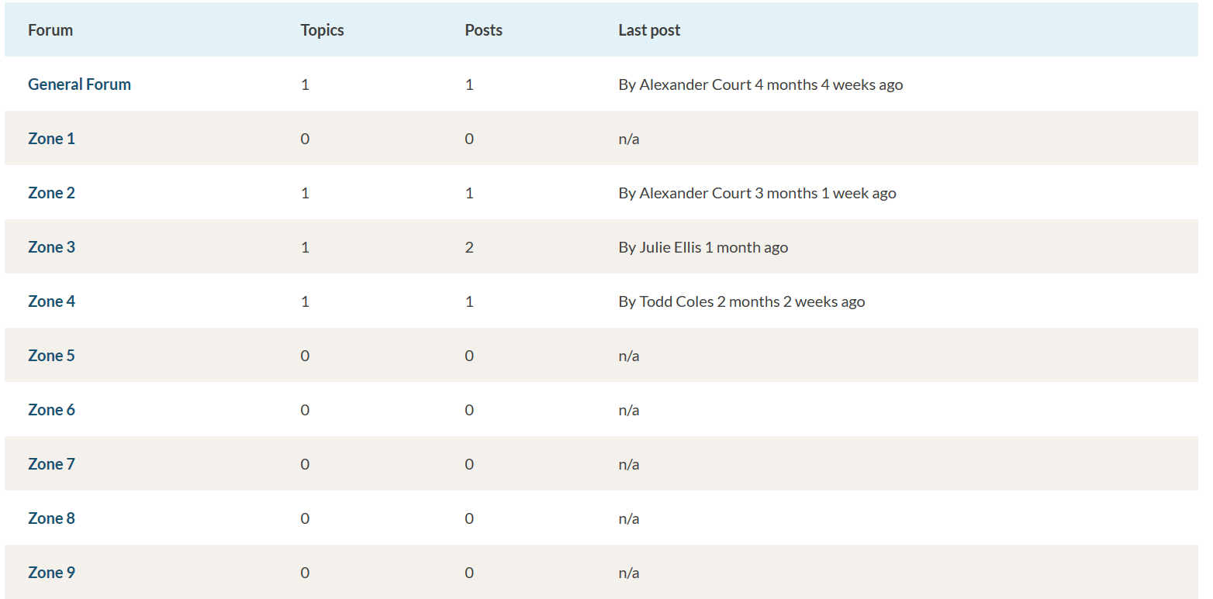

Connect with Your Zone
Discussion forums are a great way to stay connected with each other in between Zone meetings and our annual conference
Post about the latest happenings in your Zone
Ask questions, share resources, tools, templates and other tips with your fellow members in our General Forum or Zone-specific Forums
Available exclusively to AMCTO members as a space to continue conversations and virtual networking
More module updates and announcements in the works
amcto.com/forum
Connect with Us
facebook.com/municipal.experts
linkedin.com/company/amcto-policy
@amcto_policy on Instagram and X (formerly Twitter)
Notes:
Since we launched our new website, we have notice increased use of the discussion forums section
We often here from members that they are looking for connect and network with other members, either in their zone or more generally across the province.
The discussion forms section is an excellent way to ask questions, share resources, tools, templates and other tips with your fellow members in our General Forum or Zone-specific Forums
It is a dedicated space available exclusively to AMCTO members as a space to continue conversations and virtual networking
Also a reminder to engage in our social media channels
The more you follow and engage with our platforms, the stronger our Association becomes.

Slide 9

Questions?
Thank You
Notes:
Thank you again for inviting us to provide this update today.
How are we doing? Can we do more? How can we better support you as municipal professionals.
We would very much welcome questions or comments like this or anything else you might have on your mind.

