Slide 1

Frontenac County
Creating a Public Utility to Support Communal Services
AMCTO Zone 6 Meeting – May 23rd, 2024

Slide 2
Frontenac
Why We Did This (7 years of work)
Three Community Projects Ready to Go
Municipal Service Corporation / Regional Utility up and running
Where we are in 2024.

Slide 3
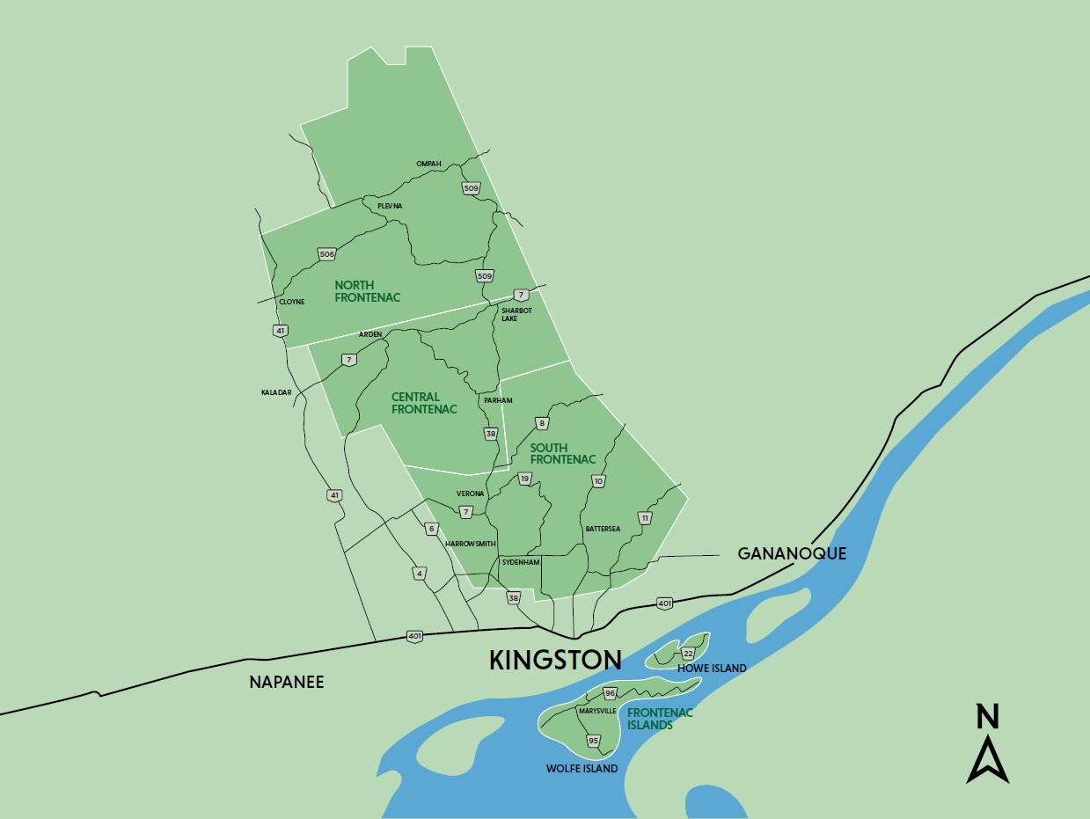
Notes:
2 HOUR DRIVE SOUTH to NORTH
VERY RURAL
1000s LAKES
ONLY HAMLETS AND VILLAGES

Slide 4
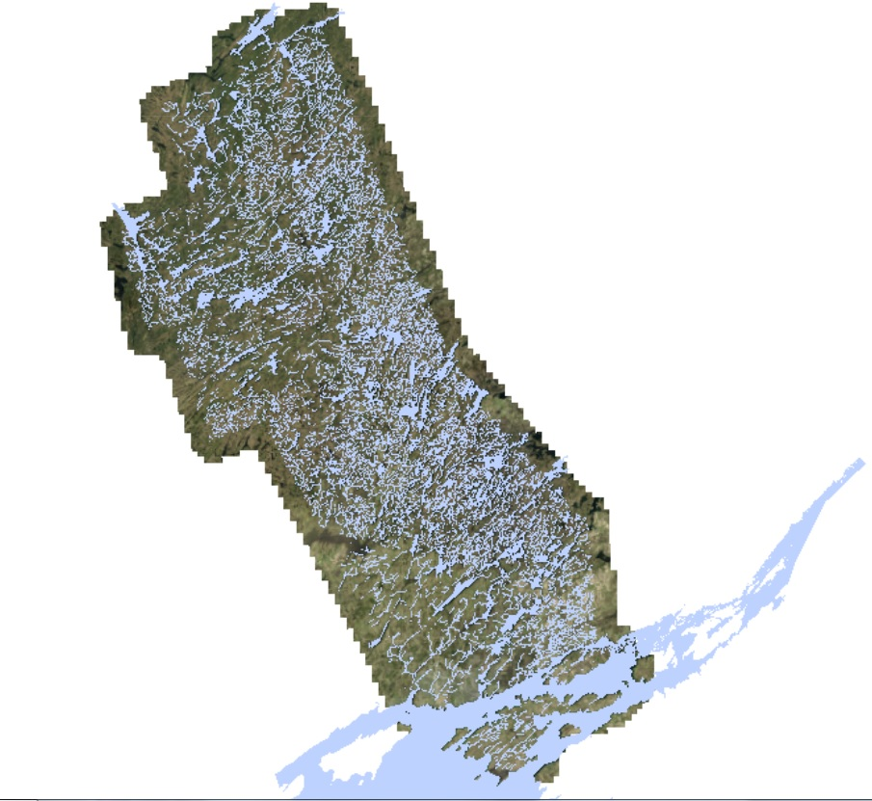

Slide 5
Communal Services
Why We Did This

Slide 6
Frontenac – Villages and Hamlets
No municipal water or sewer services
Historical settlement areas -- building lots in village cores too small.
Significant Public Infrastructure Investment
Majority of Commercial Assessment

Slide 7
Frontenac – Villages and Hamlets
“Lack of municipal services in our villages challenges future community viability.”
Source: Frontenac County Official Plan (2016)

Slide 8
There is a Need to Think Differently
About How We Sustainably Address
Servicing in Rural Areas of Ontario

Slide 9
What Will Rural Ontario Look Like 100 Years From Now?
How do we build and maintain sustainable communities?

Slide 10
The Communal Systems Roadblock
The Municipal Responsibility Agreement (MRA)
Province requires a municipality to take over a system if an independent owner defaults
Many municipalities are not willing to take that responsibility and for many reasons:
  small municipalities have limited financial resources to fund a plant type wastewater system
  small municipalities do not have staff who could run a small plant
  concern that by the time an owner defaults, a system has fallen into poor repair and will need major repairs or replacement.
Almost all municipalities will only support a MRA if the developer posts securities equal to the cost of the facility – essentially doubling the cost to build.

Slide 11
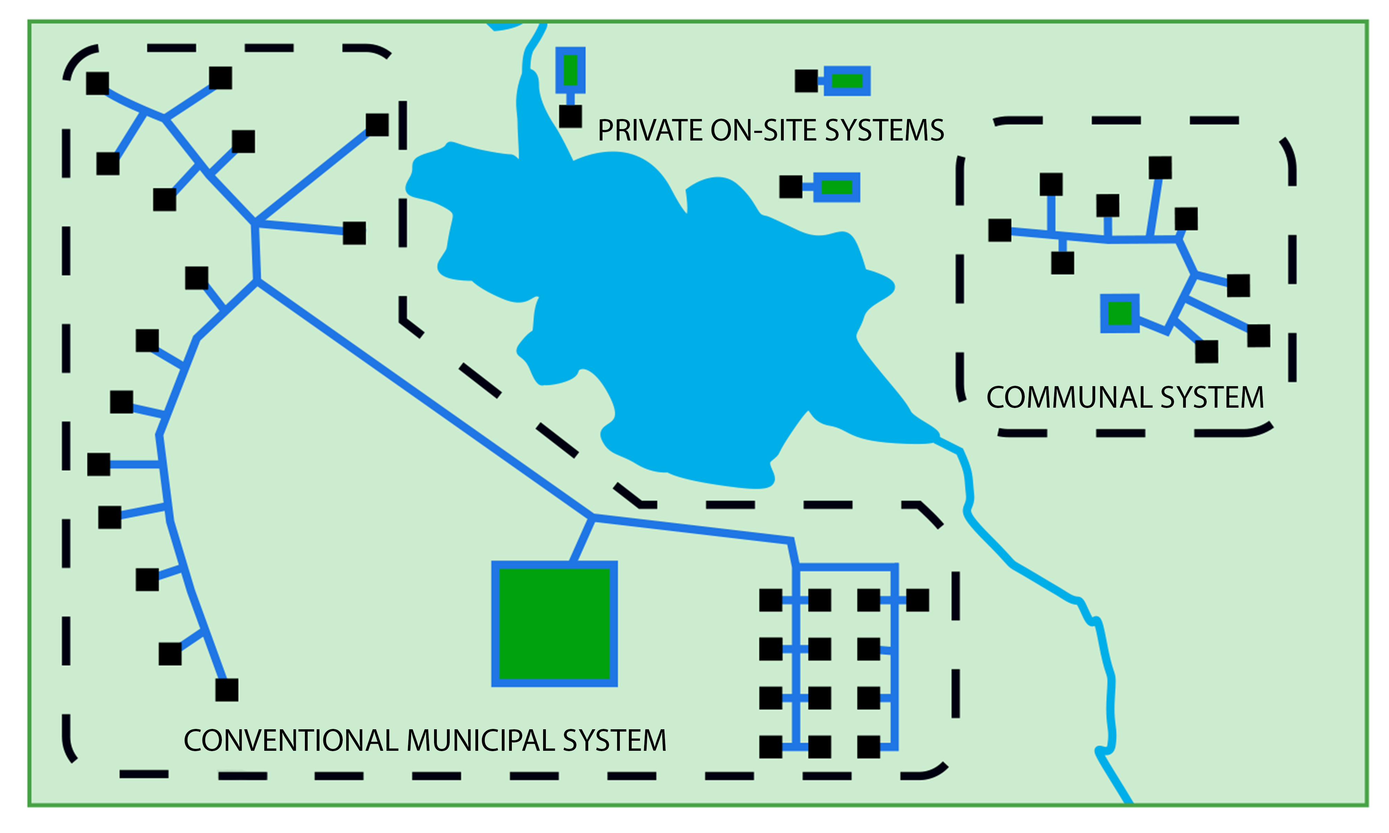

Slide 12
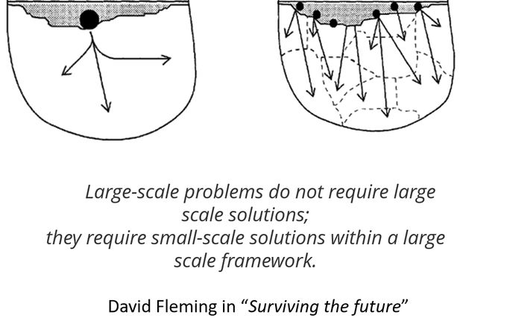

Slide 13
Community Planning Advantages
Smaller lots = better fit into village/hamlet
Strengthen local economy and community infrastructure (e.g., schools)
“walkable communities”
More housing choices

Slide 14
Environmental Advantages
Better environmental protection and public health than private on-site services
  Fewer malfunctions, longer life
  Regular maintenance – measure performance, monitor impact, fix problems early

Slide 15
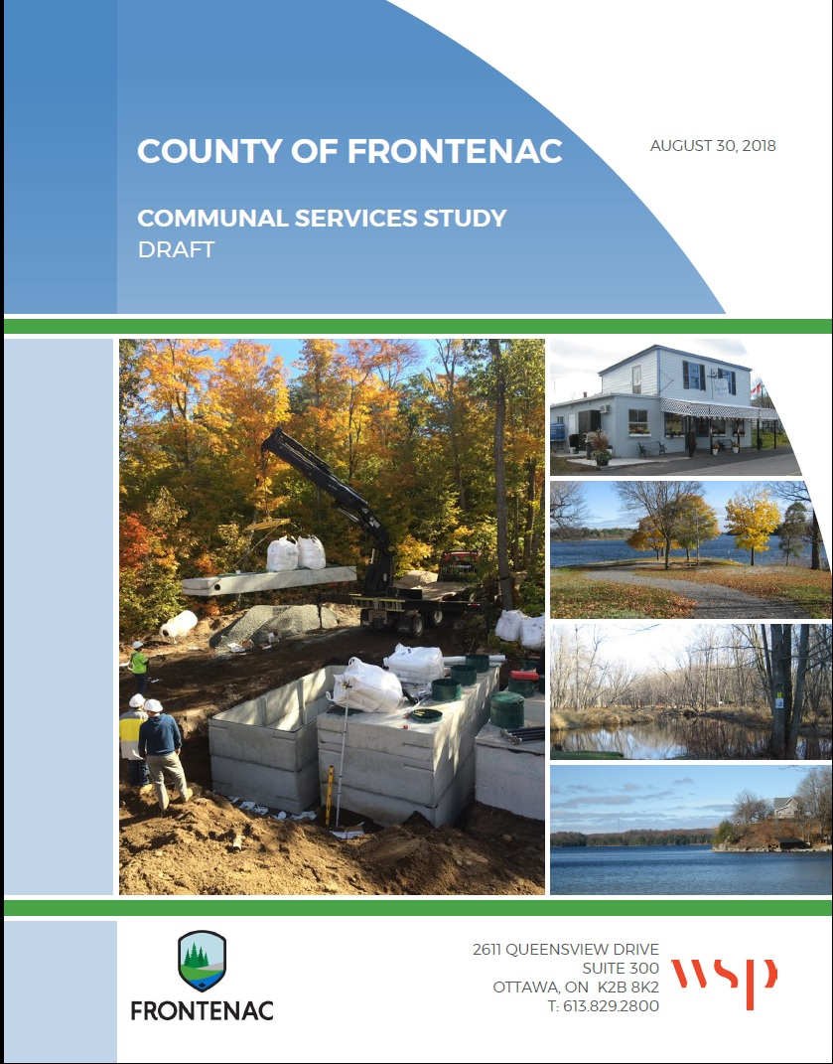

Slide 16
“There Are No Real Obstacles to Support the Use of
Communal Water and
Wastewater Systems in Rural Communities”

Slide 17
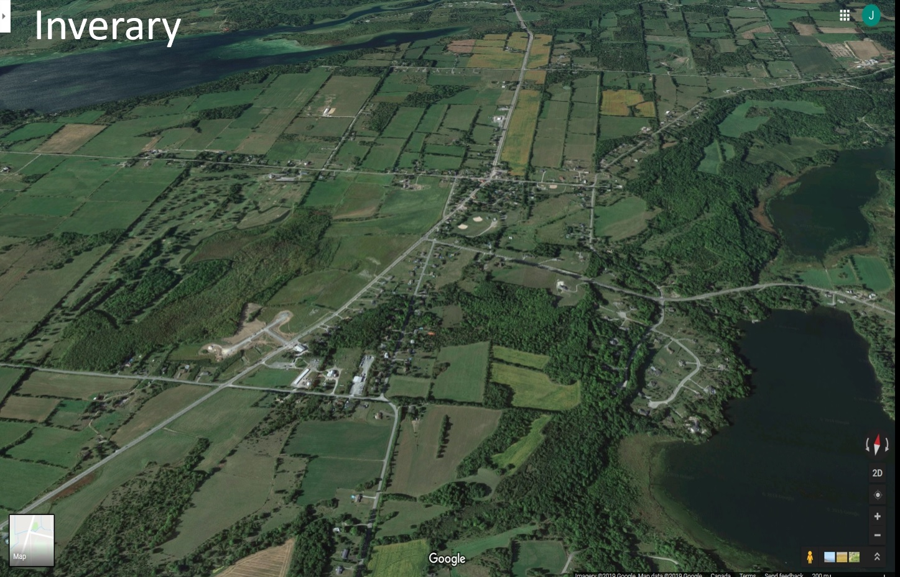

Slide 18
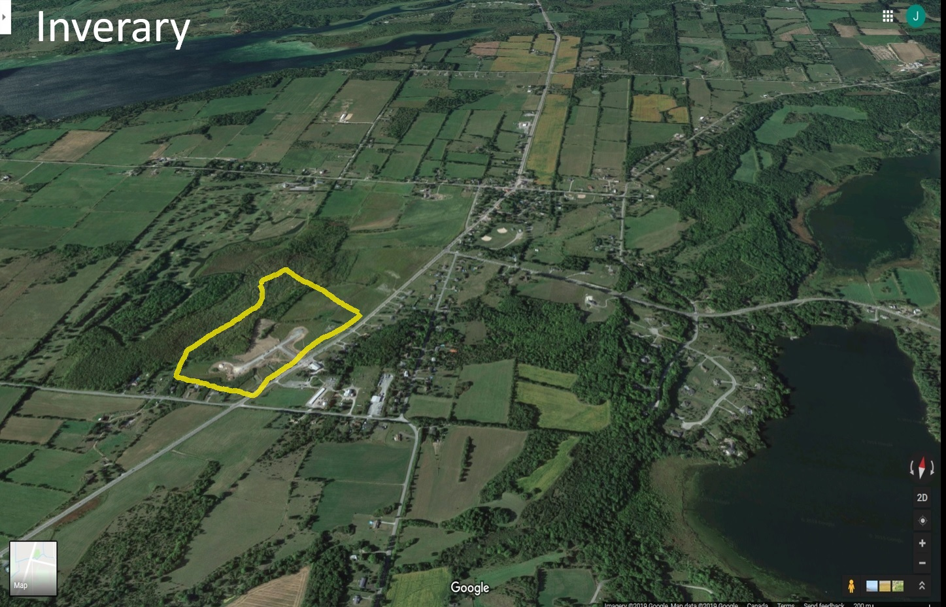

Slide 19
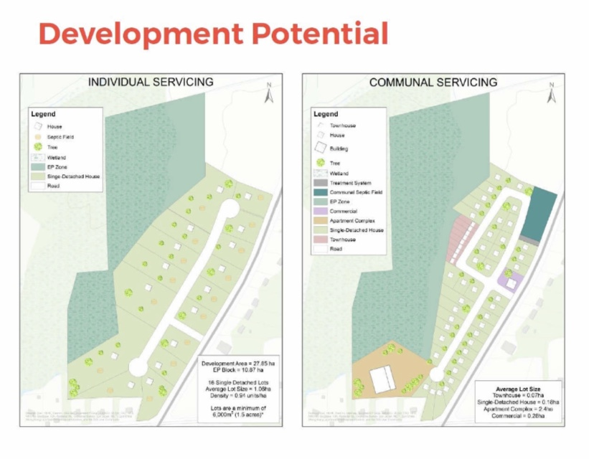

Slide 20
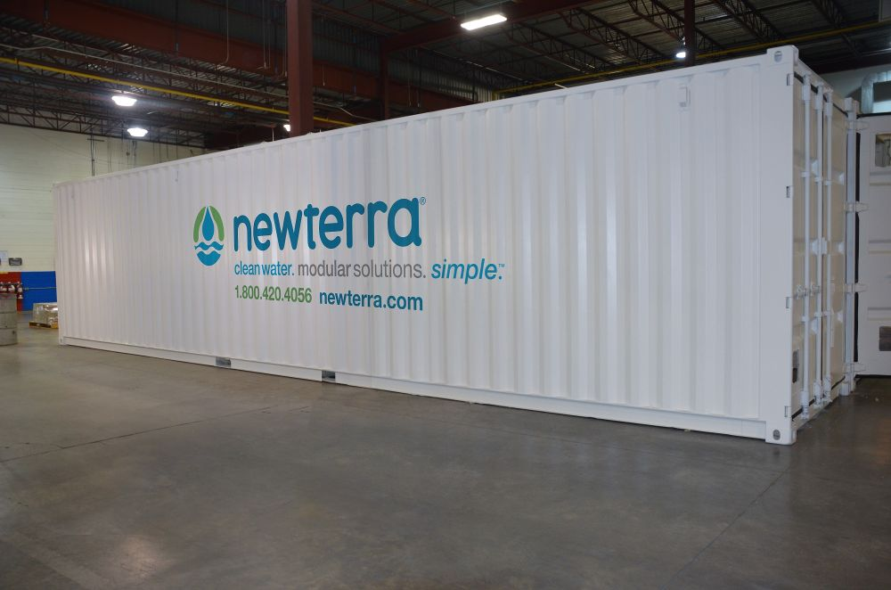

Slide 21
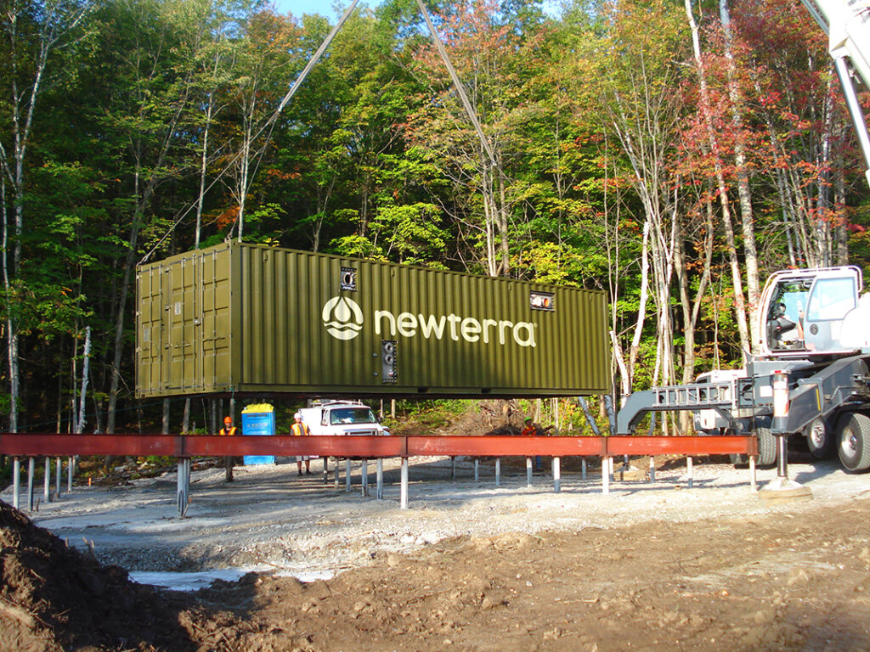

Slide 22
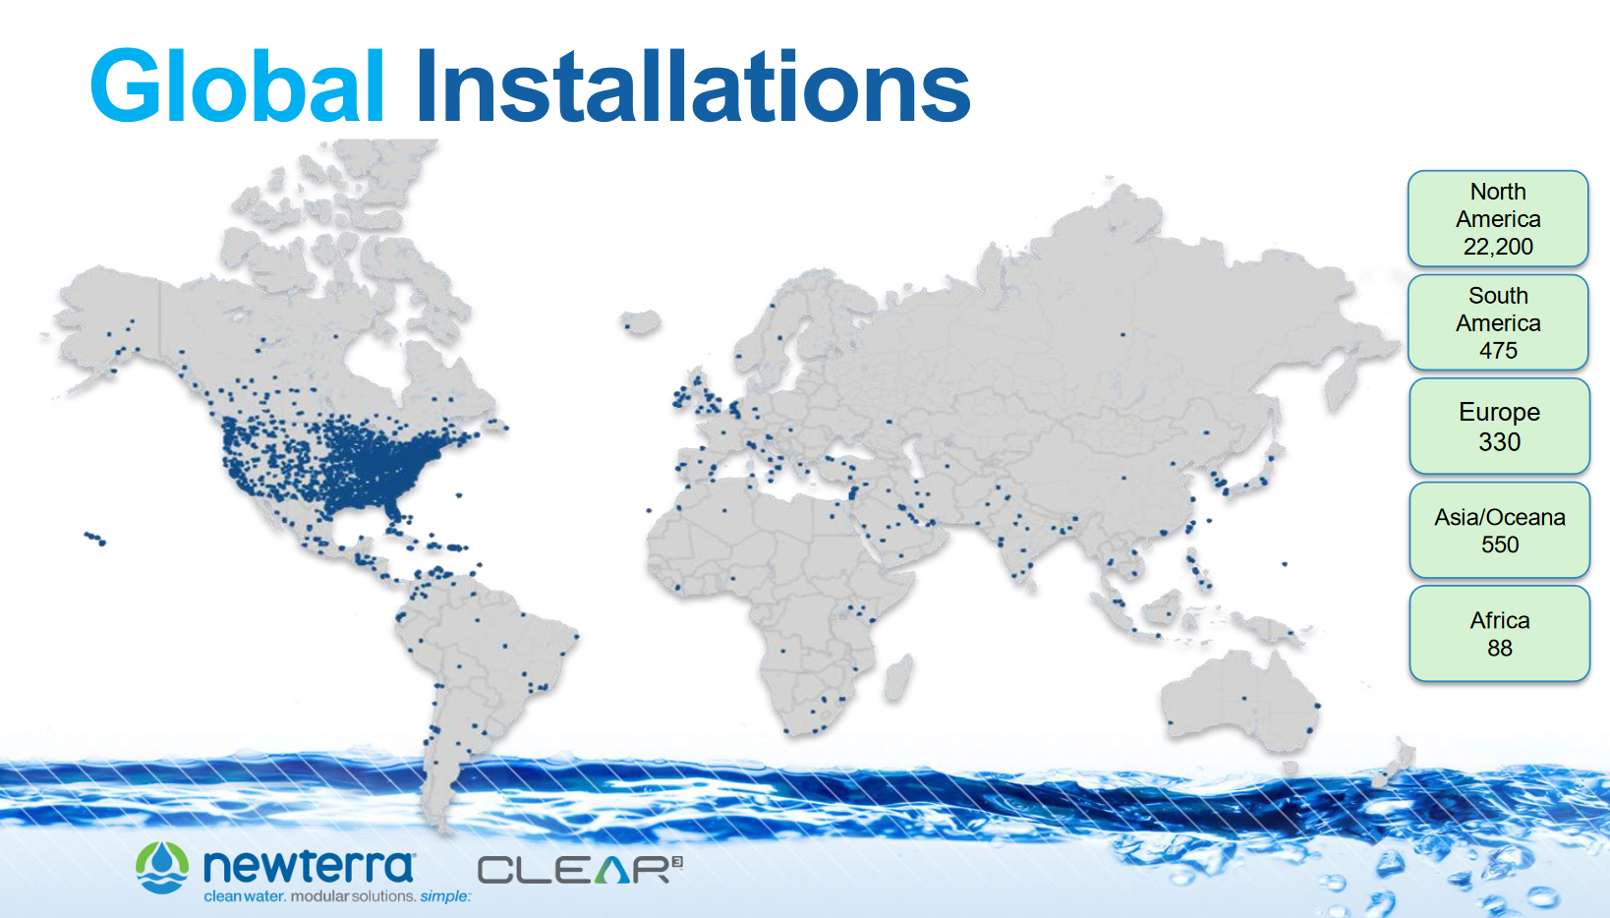

Slide 23
In Ontario,
Provincial Approvals and
Land Use Policy
Need to Catch Up with Engineering Technology

Slide 24
Communal Services
3 Projects Ready to Go

Slide 25
Sharbot Lake
Communal Services Feasibility Study
2021 - current

Slide 26
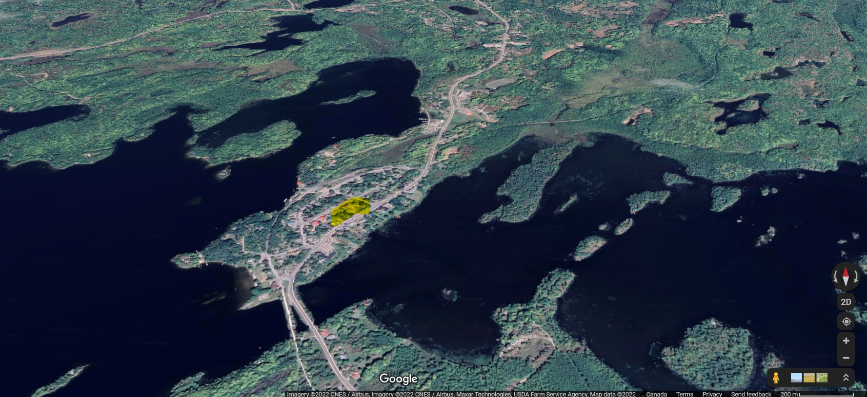

Slide 27
Communal Service Feasibility Study (2022)
mixed housing
potential for two 3-story apartment buildings
40 – 50 units
surface water (Sharbot Lake) for drinking water and septage
additional potential to ‘hook up’ other nearby uses (e.g., village community hall)
2024 – start Municipal Class Environmental Assessment, planning approvals

Slide 28
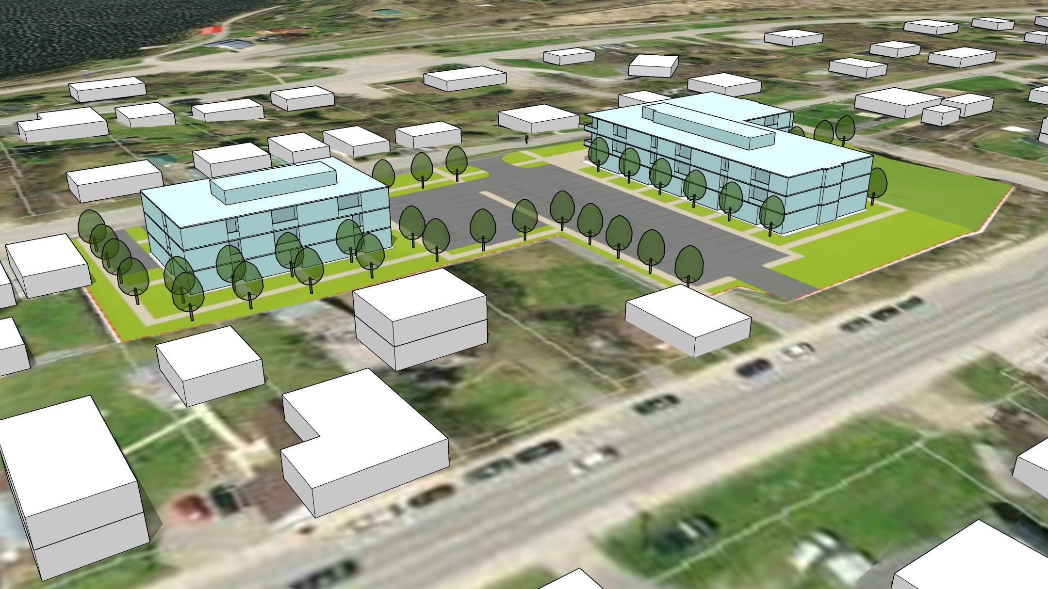
Modelling: Fotenn Consultants

Slide 29
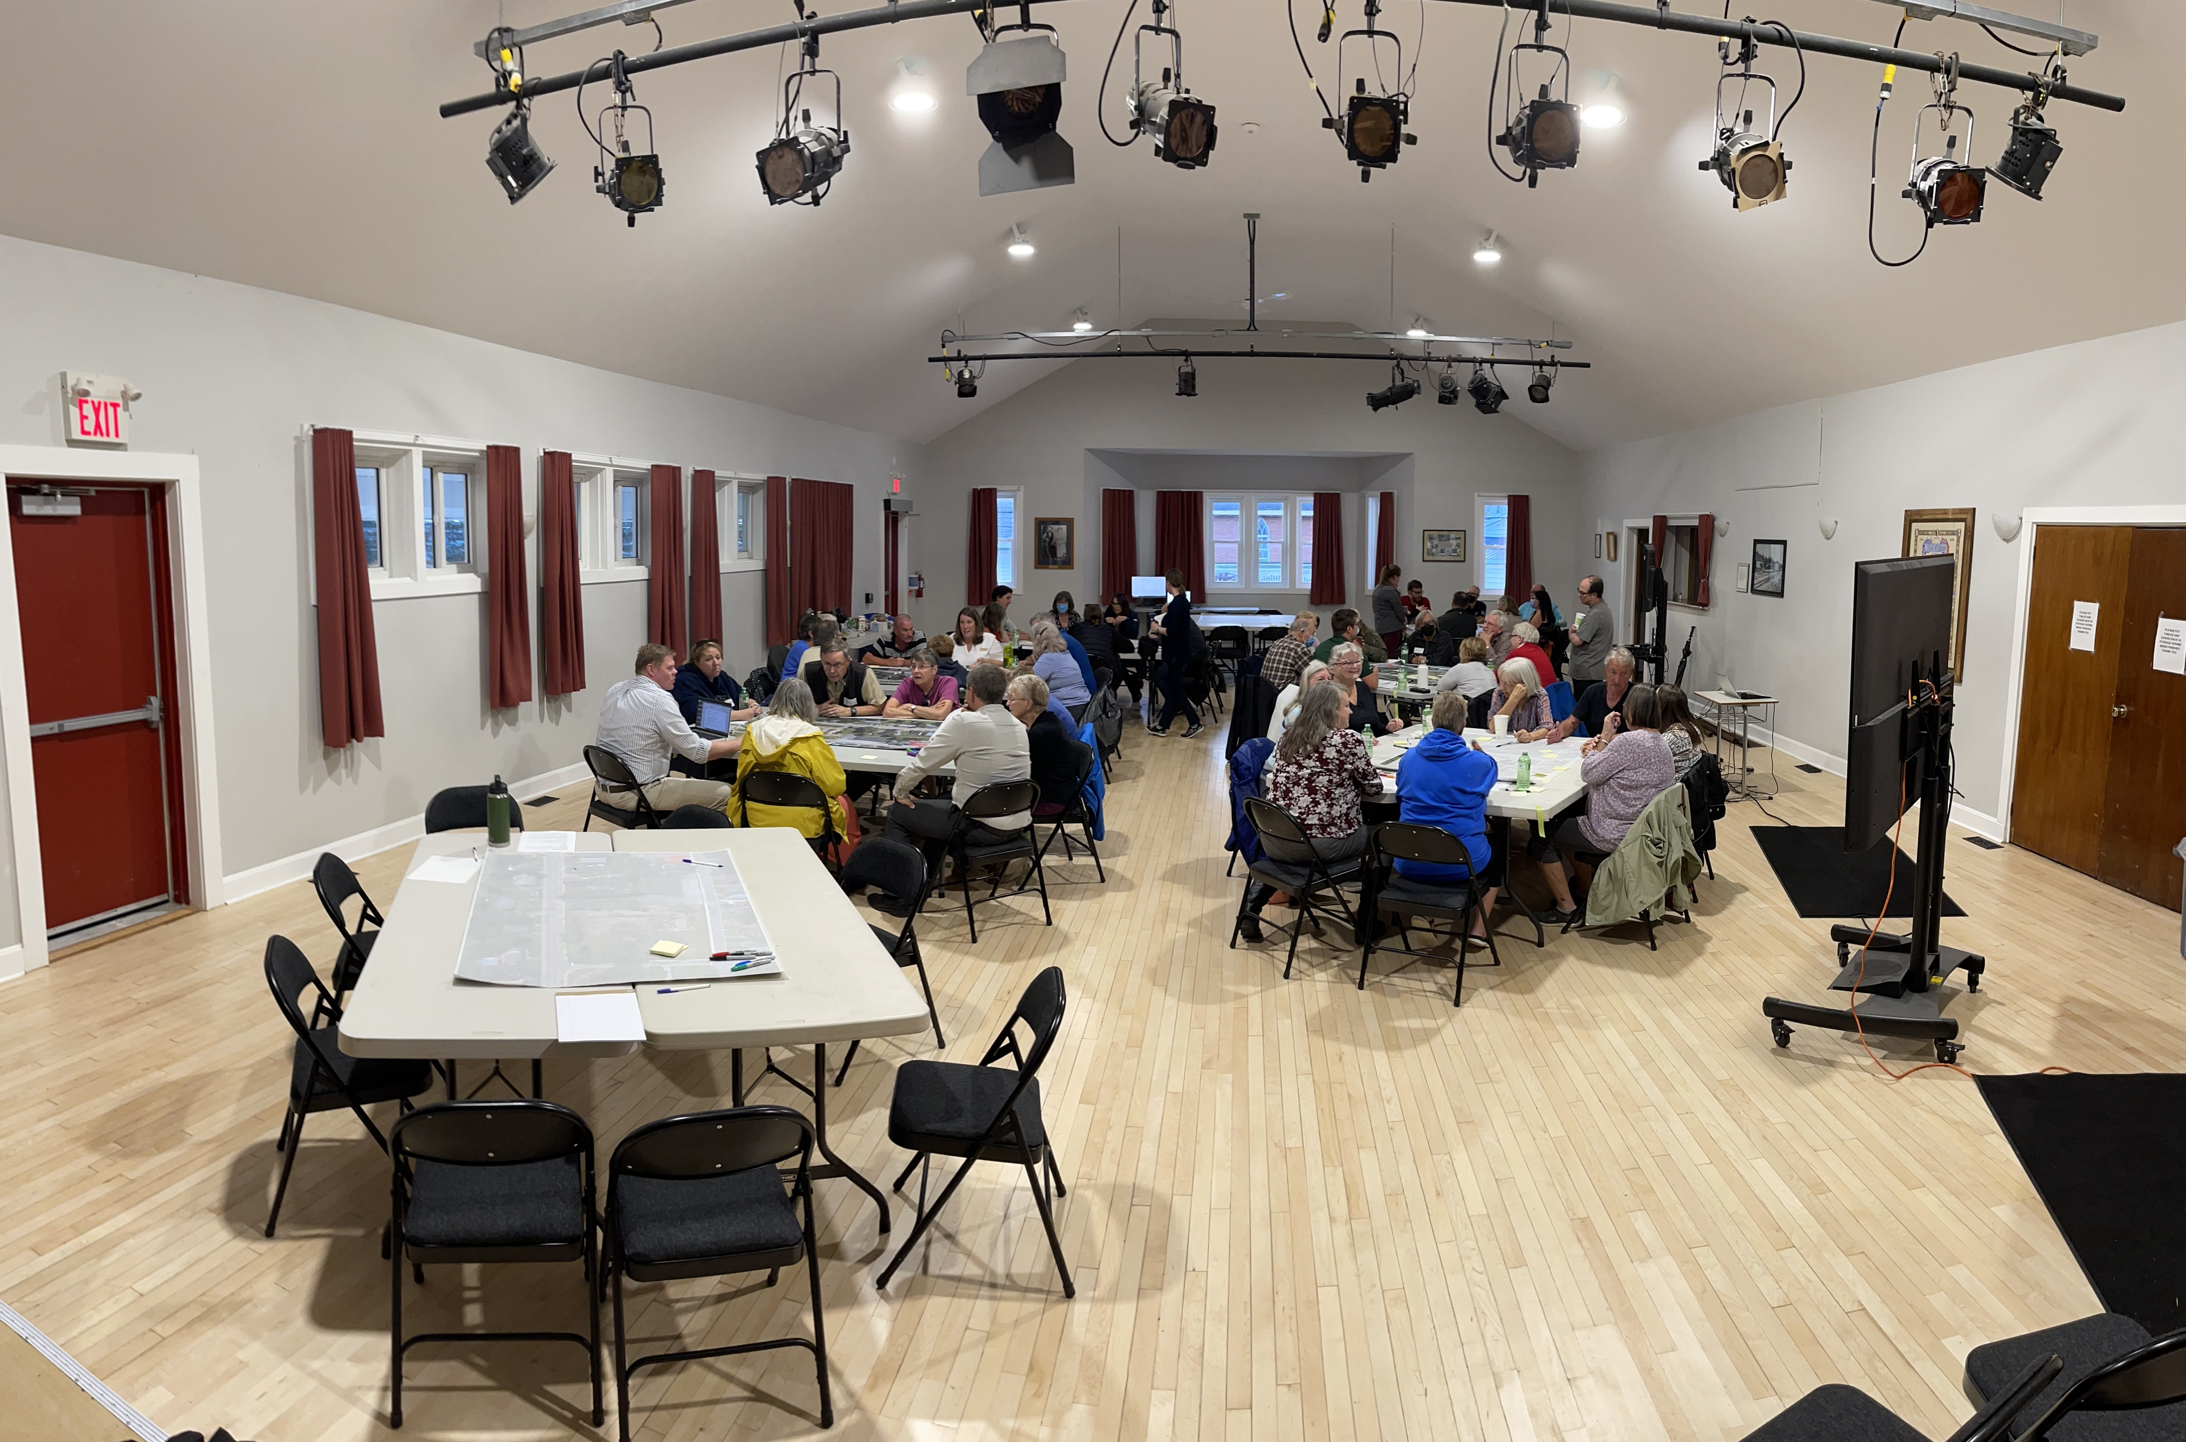
Public Site Design Session – Sharbot Lake - 18 September 2023

Slide 30
Village of Verona
Housing Master Plan
2021 - current

Slide 31


Slide 32
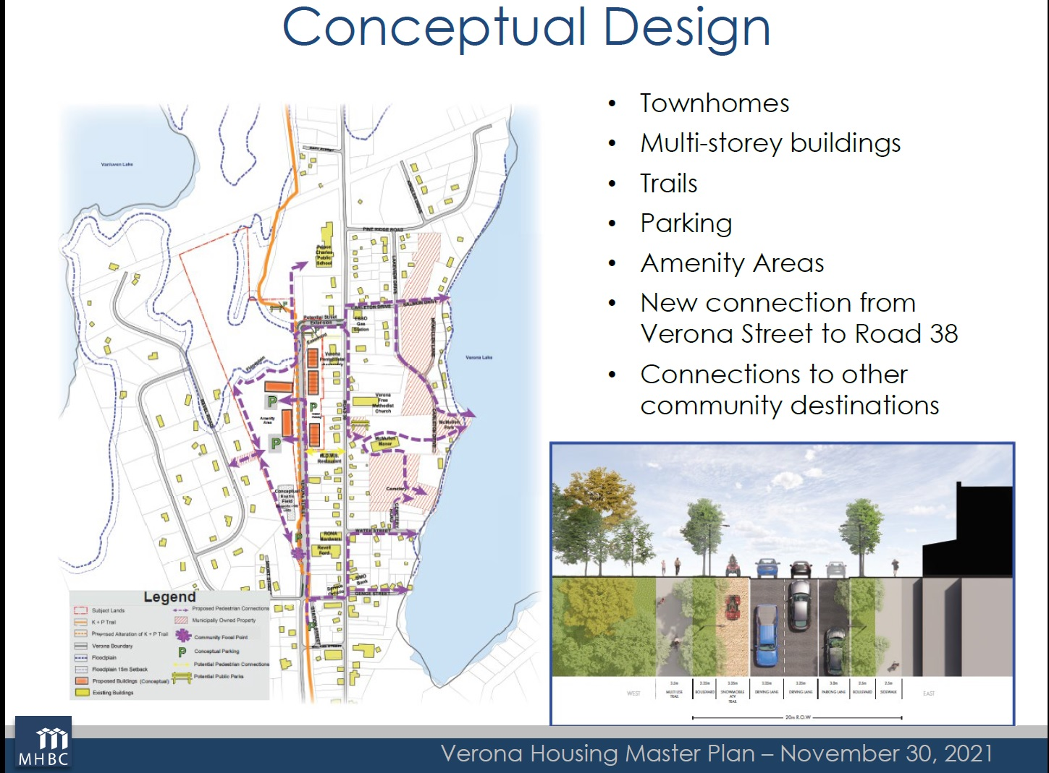

Slide 33
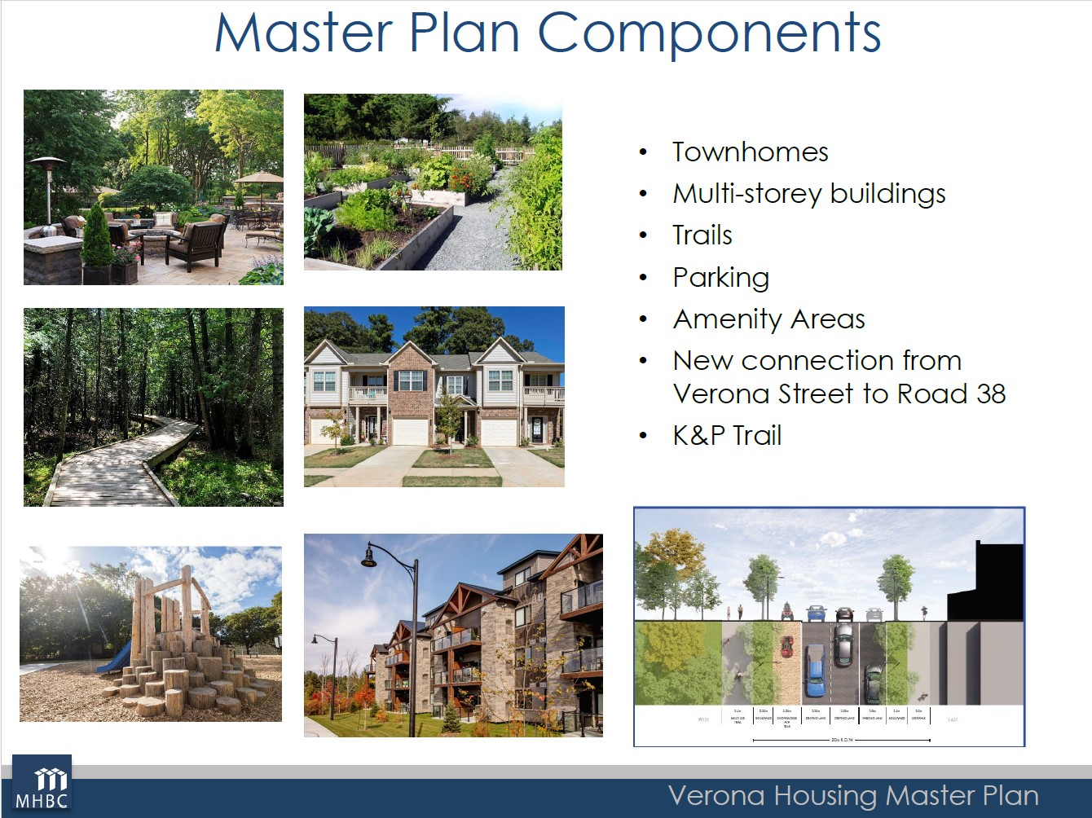

Slide 35
Village of Marysville
Wolfe Island
Secondary Plan
2019 - 2022

Slide 36


Slide 37


Slide 38
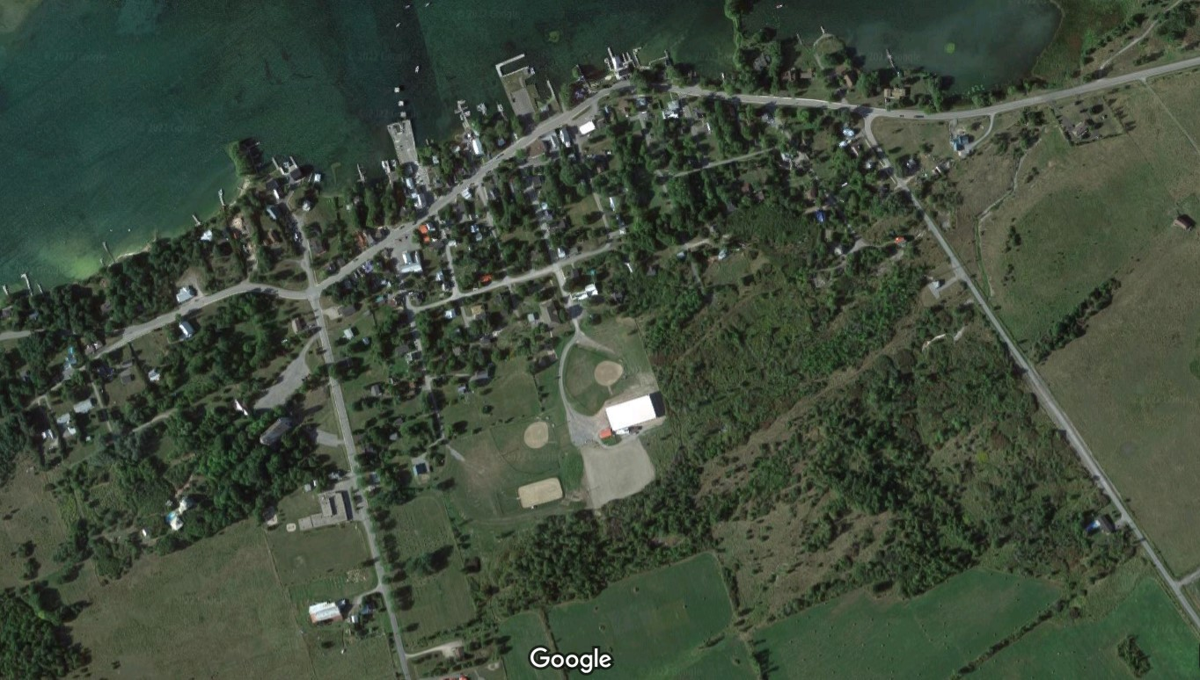

Slide 39
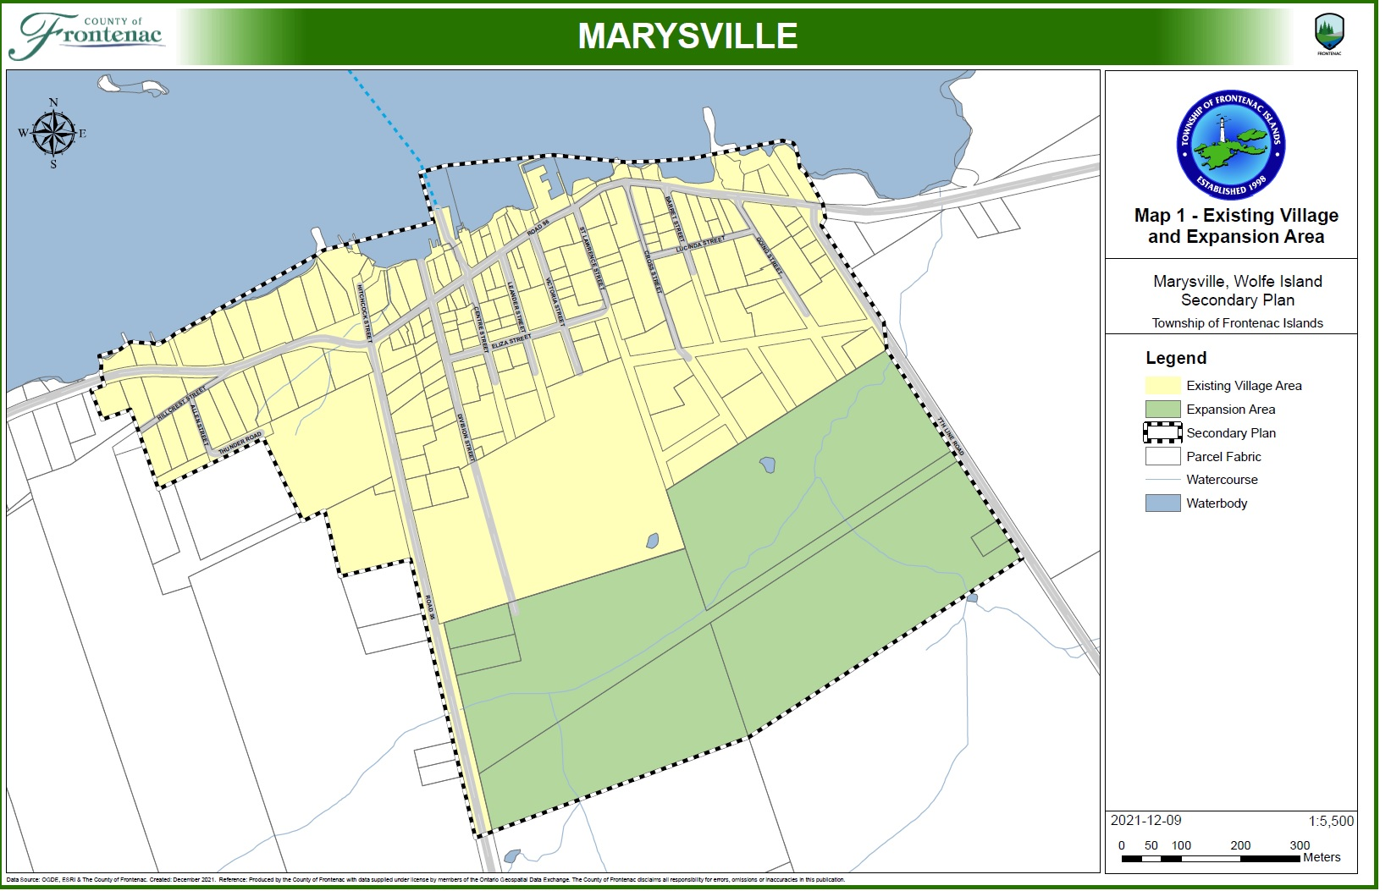

Slide 40
Marysville
“To accommodate the planned growth through to the year 2046, the Village boundary requires an expansion.
Based on the population projections prepared by the County, the village is to accommodate an additional 353 residents, representing an additional 157 residential units.”
Source: Marysville Secondary Plan

Slide 41
Marysville
“All new development within the Expansion Area shall be serviced by a . . . communal system (or systems), to the satisfaction of the Township.
Applicants proposing new development within the Expansion Area on … communal water and/or sanitary sewer systems are directed to the County of Frontenac’s Communal Services Study (2019) and are encouraged to apply the principles contained therein …”
Source: Marysville Secondary Plan

Slide 42
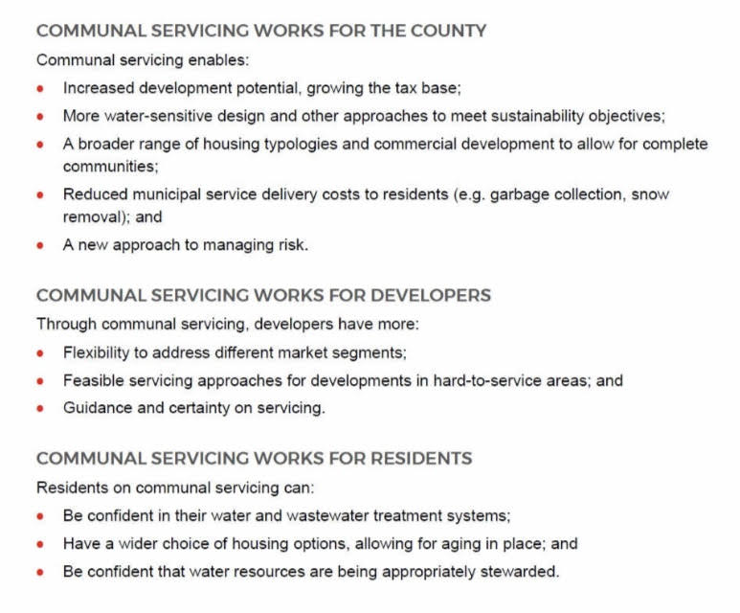

Slide 43

Municipal Service Corporation
(Regional Utility)

Slide 44
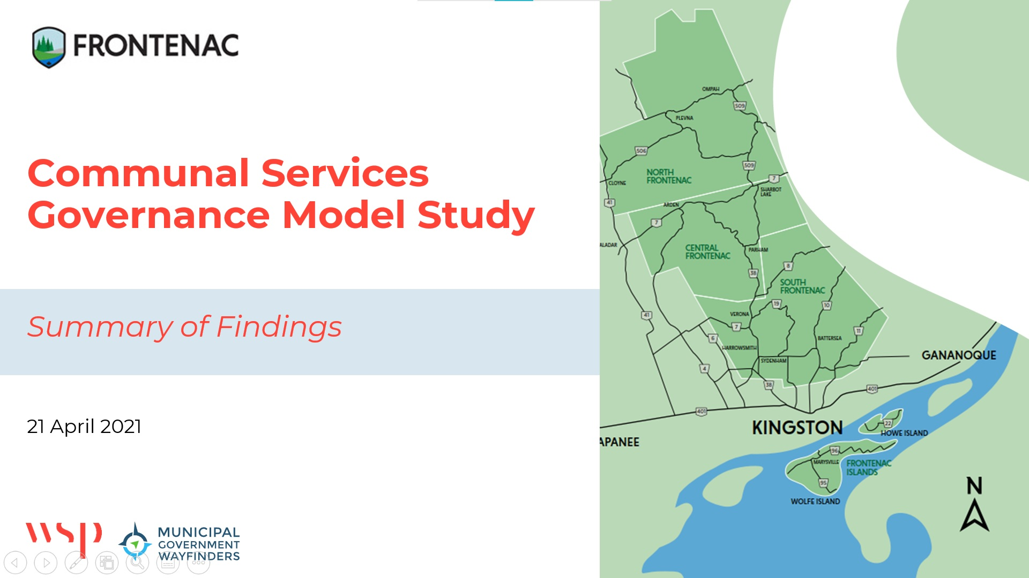

Slide 45
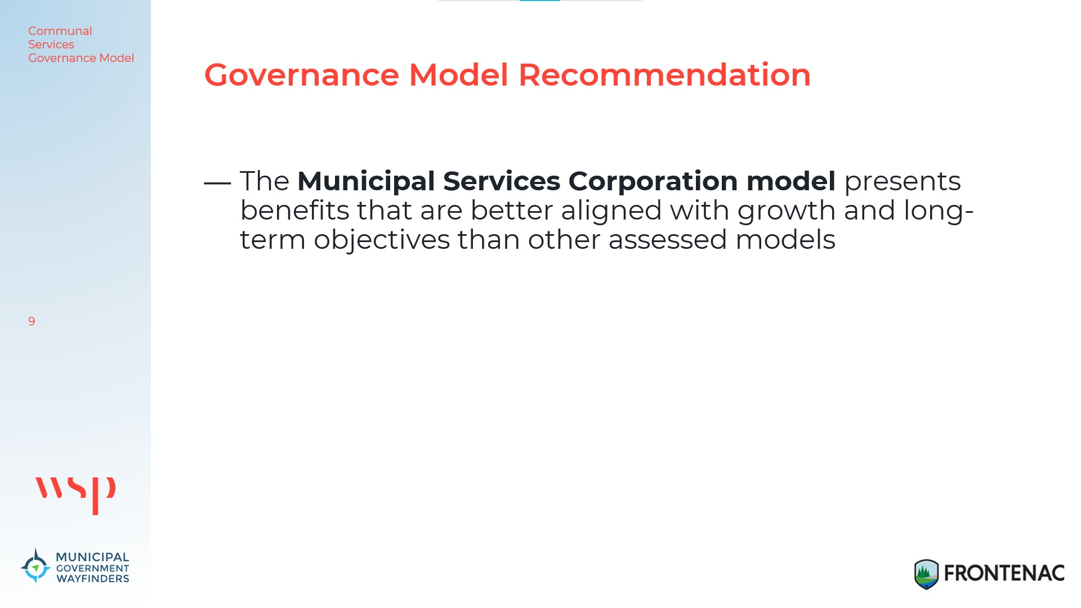

Slide 46
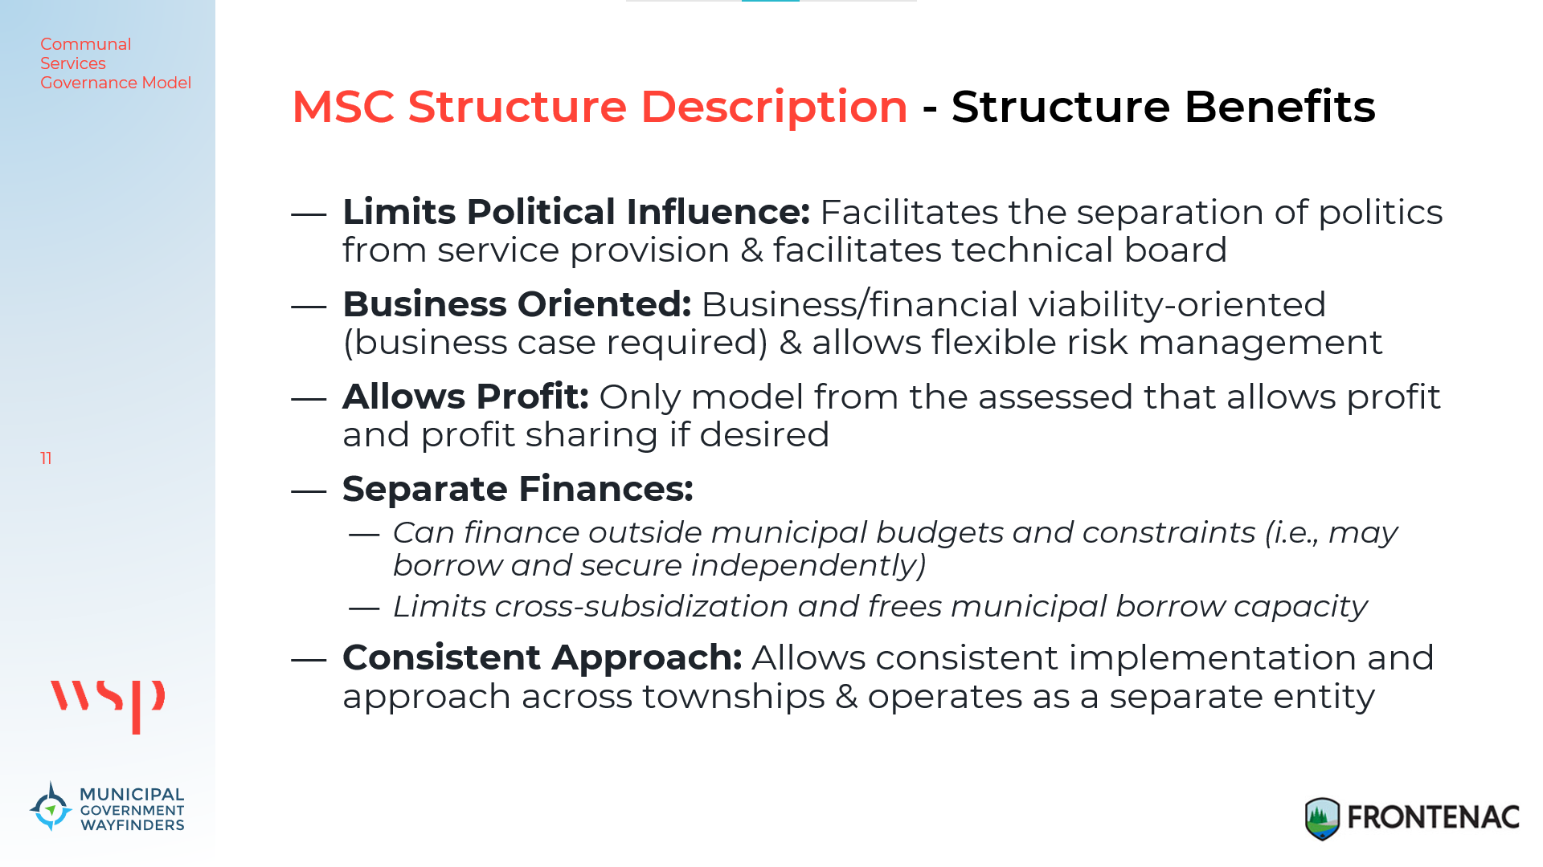

Slide 47
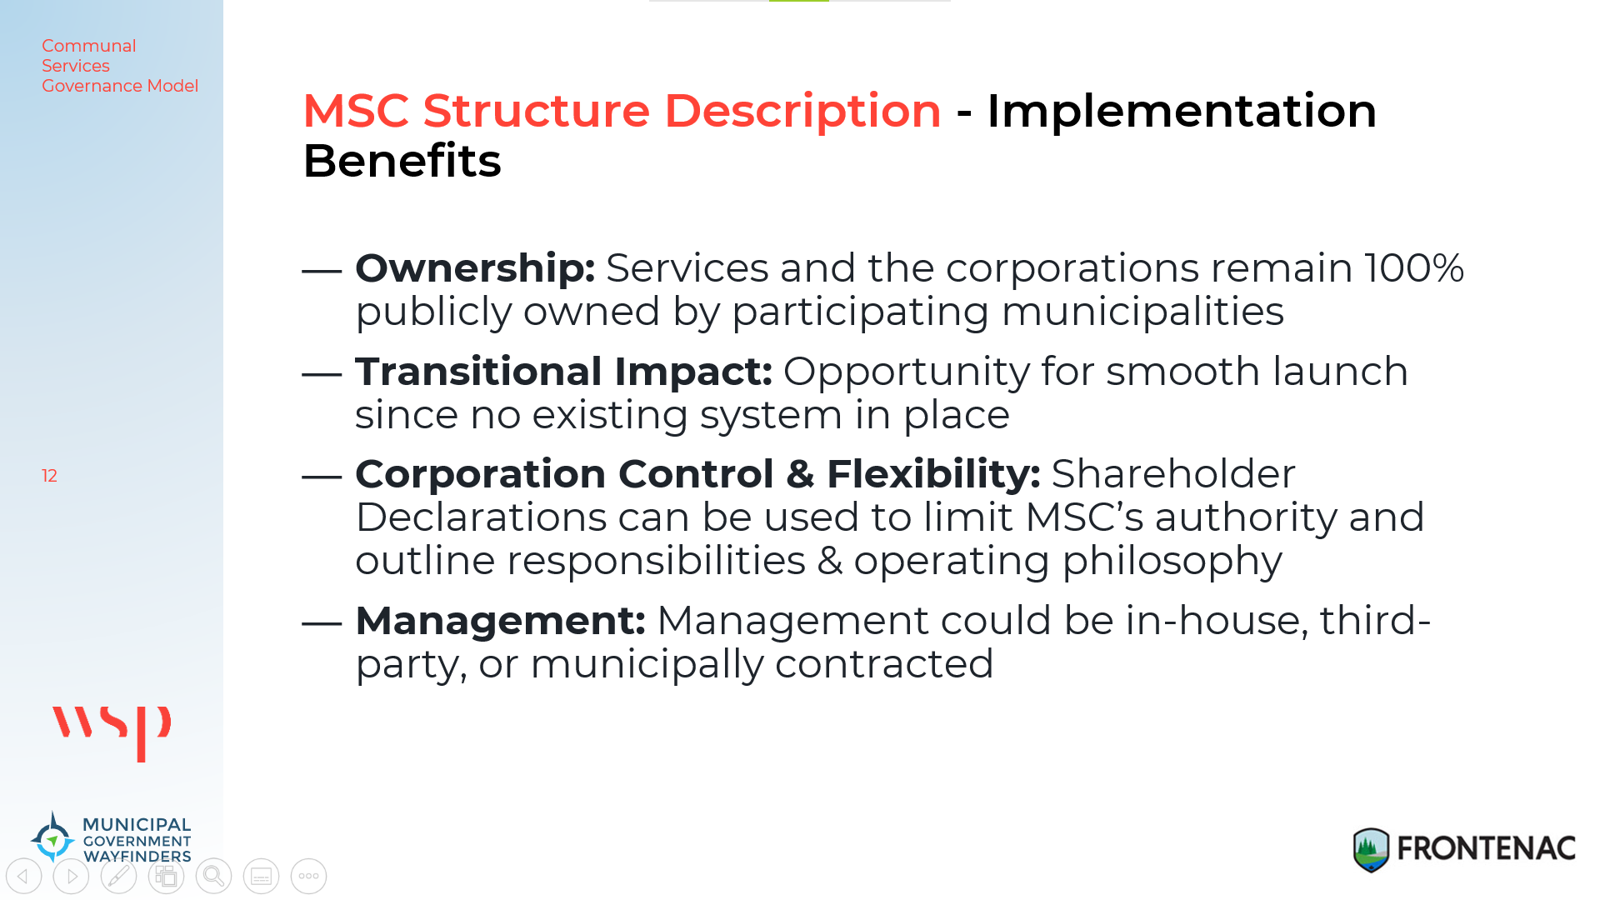

Slide 48
Why an MSC – Vehicle Insurance Analogy
If you self insure one car, you need $5M in the bank in the event of a catastrophic accident
If you insure a million cars, you don’t need 1M x $5M to ensure for catastrophic accidents
Same theory holds for communal services. Municipalities currently hold all 100% assurance for each system
  This creates an unfair burden for the developer and home owner and deters developers

Slide 49
Advantages
Communal services is the only economical way to service land in much of Frontenac County. It is modular (as little as five units at a time) and can be installed in difficult terrain.
Environmental Protection – fully regulated and fewer holes in the aquafers.
MSC brings consistent professional management to the system, rather than ad hoc management/oversight.
Each Township remains in full control of their planning process.
The MSC will speed up the approval process for appropriate development (e.g., pre-approved systems).
Aligns with the Provincial Housing Task Force recommendation #44 regarding regional utilities. (https://files.ontario.ca/mmah-housing-affordability-task-force-report-en-2022-02-07-v2.pdf) .
Removes liability from individual Townships and spreads the risk across participating municipalities.
MSC can borrow without affecting local taxes or local borrowing capacity.
The MSC will be eligible for grants.
The direction of MSC will be controlled by the Board of Directors (i.e., the Shareholders).
The potential for a Community Benefit/Dividend is possible in 7 years.

Slide 50
Where We Are Now
All 4 Townships and the County agreed to join the new municipal utility.
Utility incorporated November 2023
Board of Directors and Technical Group now working on ‘best practices’
County Official Plan Amendment to recognize communal services supported across Frontenac in place (October 2023)

Slide 51
Questions ? https://engagefrontenac.ca/communal-services

