Slide 1
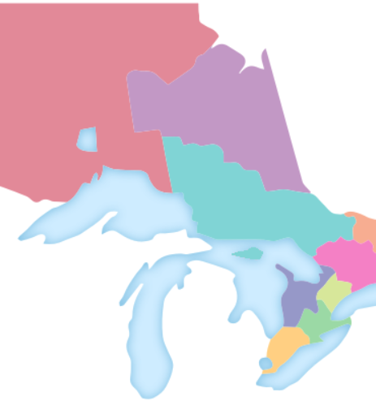
2025 Spring Zone Meetings
Association Update

Slide 2



Organizational Updates
Accomplishments
Recent & Ongoing Work
Looking Ahead
2024 Budget Results
While final budget numbers will be available following the audit, AMCTO has projected a surplus for the 2024 financial year
AMCTO-ICMA Alliance
Municipal Innovation Internship Program
2025-2026 Board of Directors
Elections in Zone 2 and Director at Large
Acclamations for VP, Zone 4,6, and 8
Voting will be on-line May 14-22.
2027-2030 AMCTO Strategic Plan Development
Rebranding discovery phase
DEIA Implementation
AGM: June 11
Helpful Resources
Board of Directors and Management Committee materials

Slide 3
Membership Updates
Accomplishments
Recent & Ongoing Work
Looking Ahead
New Members (as of Feb. 2025)
Since September 1, 2024, there has been a total of 184 new members joining the association.
Membership by the numbers
Full Members…………………1,613
New Professional
Members……………………......233
Associate Members…………......79
Retired Members……………….256
Members in Transition…………. 28
Student Members…………….....96
Honourary Members…………….22
Membership Renewals
90% of members have completed their annual membership renewals.
Improved Accreditation Process
Improvements to modernize and access accreditation programs through AMCTO Connect, streamline the registration, submission, and approval process.
Leadership Hub Affinity Program
Curated collection of leadership resources and services available exclusively to AMCTO members.
AMCTO-Local Government Promotion
Mentorship Program
Applications open in June.
New NCMC Committee
Virtual Town Halls

Slide 4
Policy & Government Relations Updates
Accomplishments
Recent & Ongoing Work
Looking Ahead
ROMA Conference Delegations
Successful delegations with NDP, Green Party and Liberal Party
Delegation request with Ministry of Education on MEA declined
Submissions
2025 Pre-Budget, Bill 241: Municipal Accountability Act, OMERS Review, Customer Service Standards Review
Provincial Election Priorities
Released Strong Mayor Authority Scan
Called for Third Party Review of Provincial Offences Act System
Issue Profile Update
Focus on MEA and MFIPPA with New Government
Ongoing Tracking & Analysis
Legislation, regulations, consultations, opportunities to engage government
AMO Conference
Delegations with government and Ministers
Municipal Act Review
LPAC is now PGRC

Slide 5
Education Updates
Accomplishments
Recent & Ongoing Work
Looking Ahead
Launched all Winter/Spring 2025 programs in Zoom and correspondence formats
Total of 1,000+ enrollments (3 terms in a row)
Updates to Course Materials
Updated version of MLP Unit 1 and MCI Level 1 launched
Updating course materials
Finalizing updates to MCI Level 2 and HR Program
Work started on next round of MAP and MAFP updates
Congratulating 2024 Graduates
In June we will acknowledge:
  44 DMA graduates
  49 EDMM graduates

Slide 6
Professional Development Updates
Accomplishments
Recent & Ongoing Work
Looking Ahead
Spring Forums:
Inspiring Women’s
Finance
Information, Access & Privacy
Workshops/Webinars Offered:
Civil Marriage Solemnization
Municipal Tax Applications Webinar Series
Records Management
Conference registration launched
Municipal elections calendar and upcoming training registration launched
Fall Forums:
Municipal Leaders – September 25
Clerks – October 23
Licensing & Law Enforcement – November 20
Upcoming Workshops/Webinars:
MFIPPA – April 15
Privacy and PHIPA – May 13
Bylaw Writing – May 22 and 30
AMCTO Conference:
June 8-11, 2025 @ Caesars Windsor
Elections Training:
Virtual & in-person component
In-Person training will be in all 9 Zones (connected with 2026 Zone meetings – dates available on website)
Fall Planning:
Seeking volunteers for the 2026 conference planning as well as fall forum focus group members

Slide 7
AMCTO Code of Ethics and Values
Service to the Community
  Promote community well-being
  Engage the community in decision-making
  Deliver public services effectively and efficiently
  Protect the legacy of future generations
  Protect confidential information
Service to Elected Officials
  Deliver objective advice to elected officials
  Serve elected councils in a dutiful manner
  Maintain political neutrality
  Protect the concept of a merit-based public service
Service to the Municipal Profession
  Maintain professionalism, integrity and trust
  Demonstrate commitment to professional development
  Develop future municipal professionals
  Code of Ethics and Values

Slide 8
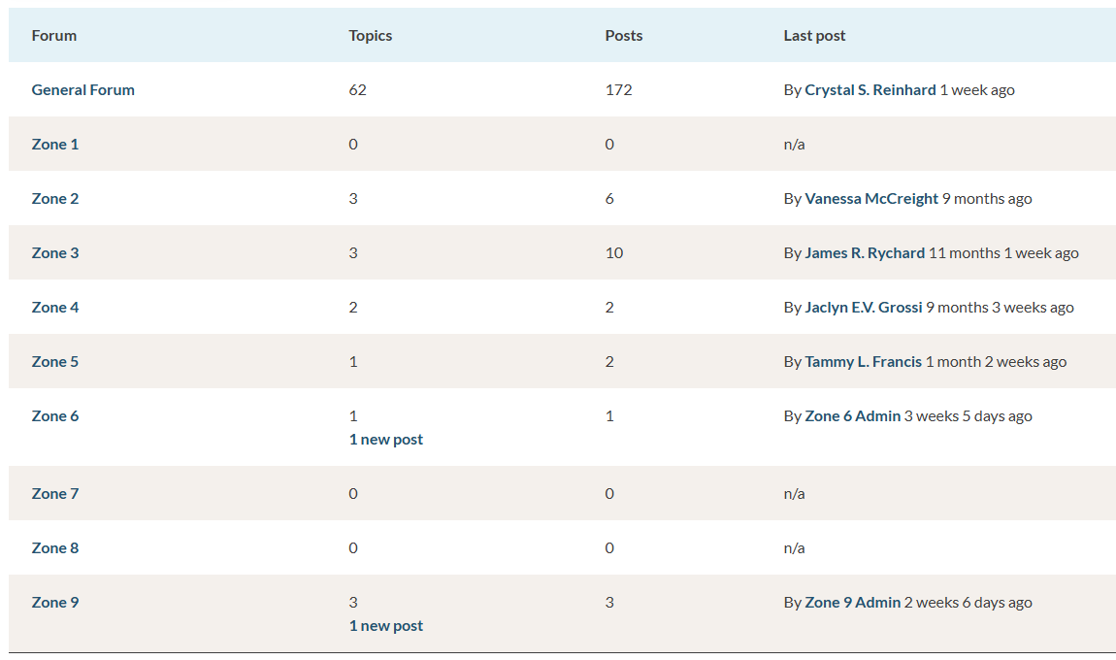

Connect with Your Zone
Discussion forums are a great way to stay connected with each other in between Zone meetings and our annual conference
Post about the latest happenings in your Zone
Ask questions, share resources, tools, templates and other tips with your fellow members in our General Forum or Zone-specific Forums
Available exclusively to AMCTO members as a space to continue conversations and virtual networking
More module updates and announcements in the works
amcto.com/forums
Connect with Us
facebook.com/municipal.experts
linkedin.com/company/amcto-policy
@amcto_policy on Instagram and X (formerly Twitter)

Slide 9

Questions?
Thank You

