Slide 1
An update from
Elections Ontario
Fall 2025

Slide 2

Agenda
Partnering with Elections Ontario
Election planning resources and activities
A look at 2026
Next Steps
Q&A

Slide 3

Your Voters’ List partner
  We’re here to work with you!
voterslist@elections.on.ca

Slide 4

Activate your Partnership with EO
Engage with Elections Ontario by May 29, 2026, to receive your PLE via the Election Portal

Slide 5
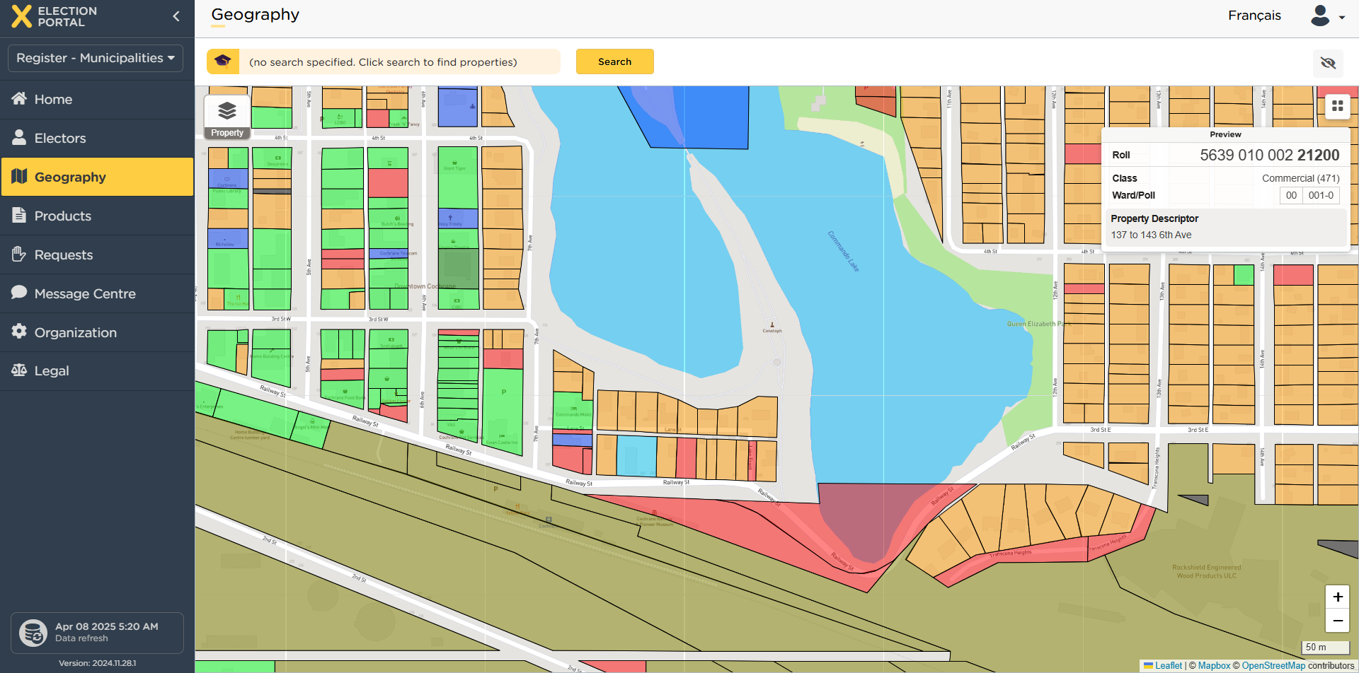
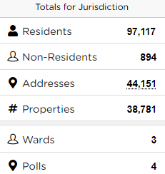
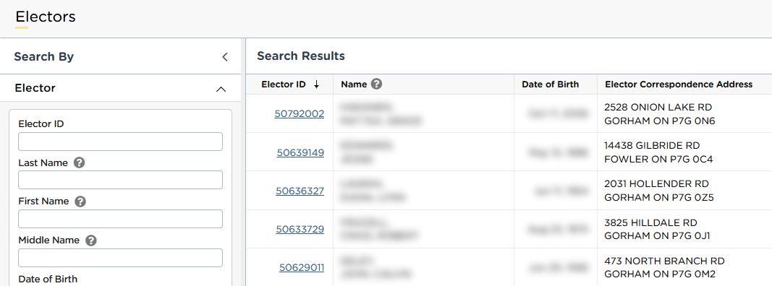
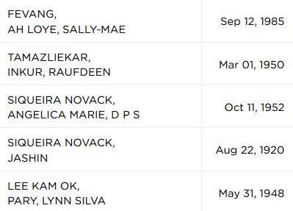
Election Portal
Town of Cochrane
Key Metrics
Email voterslist@elections.on.ca for onboarding and training

Slide 6
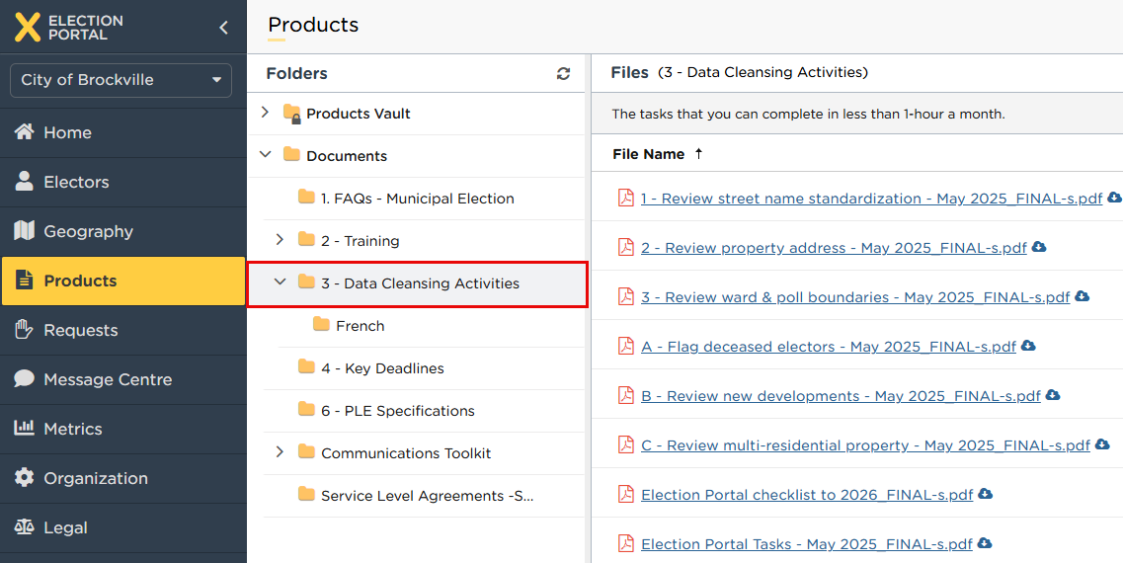

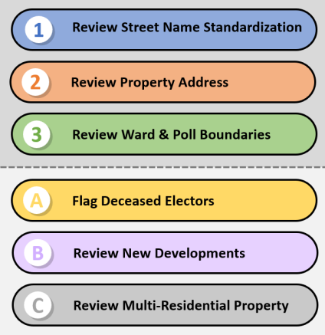
Data Cleansing Activities
To complete in 2025

Slide 7
Data cleansing activities in 2026

Slide 8
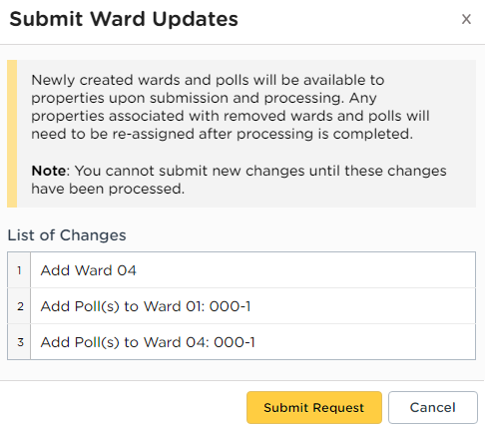
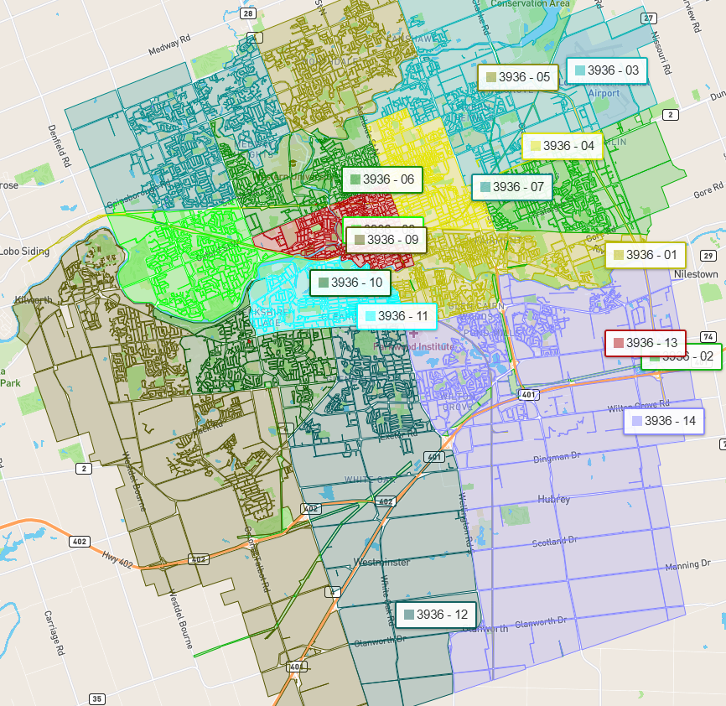
Electoral Boundaries
Legislated Deadlines:
Ward Boundary Changes – December 31, 2025
Subdivision Boundary Changes – March 31, 2026

Slide 9
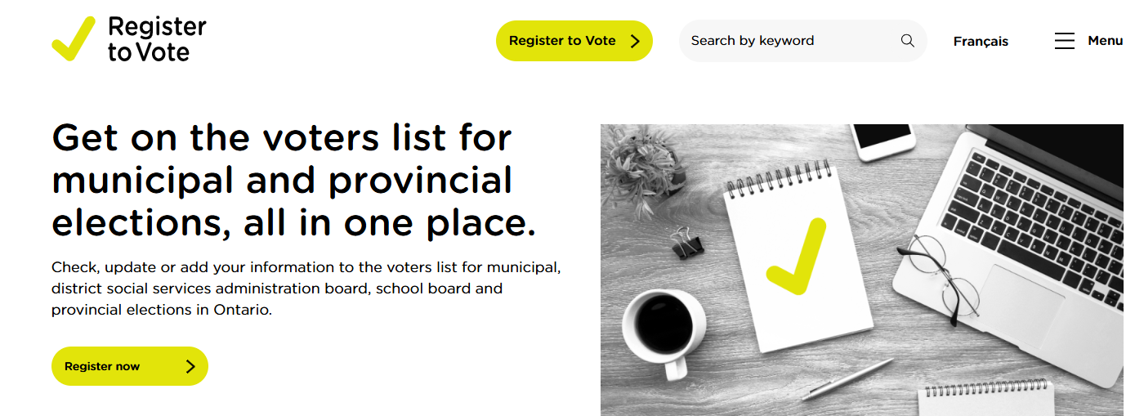
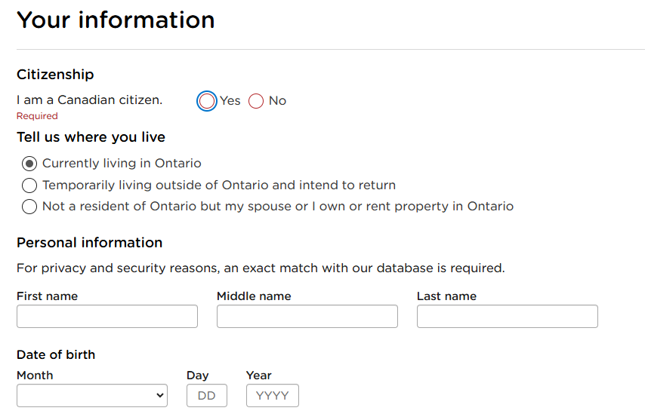
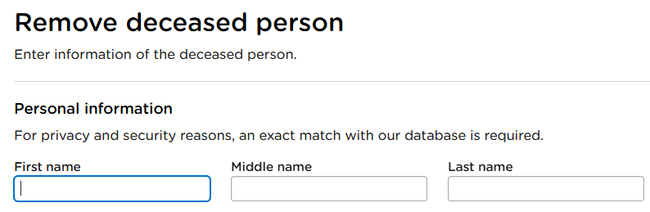
Register to Vote
https://vreg.registertovoteon.ca/

Slide 10
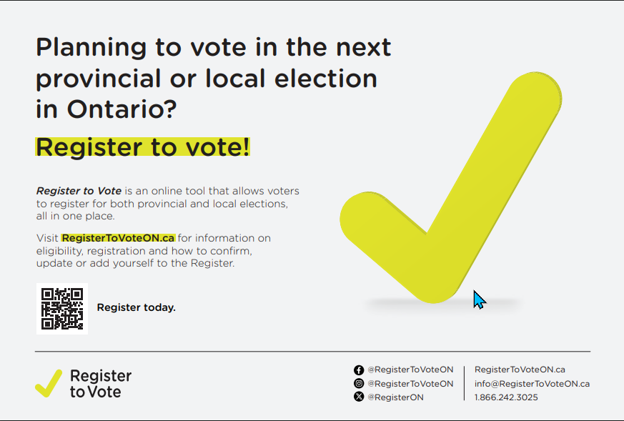
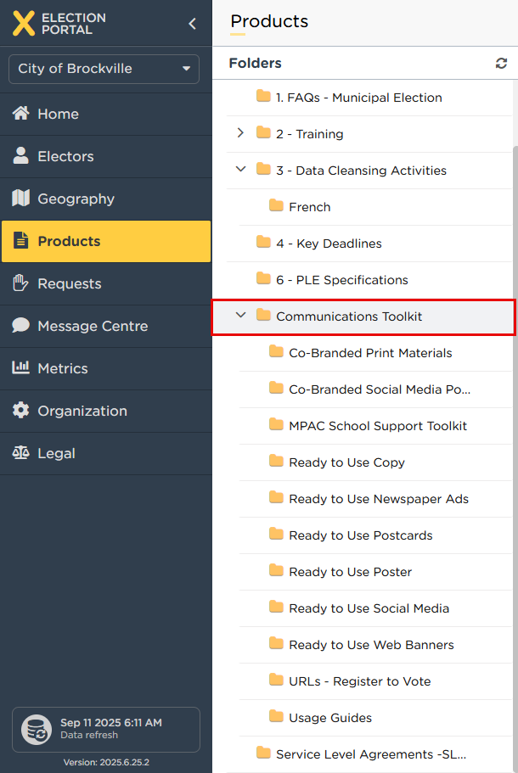
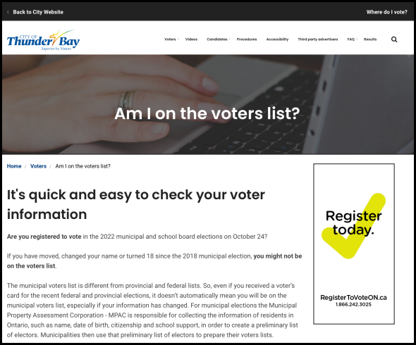
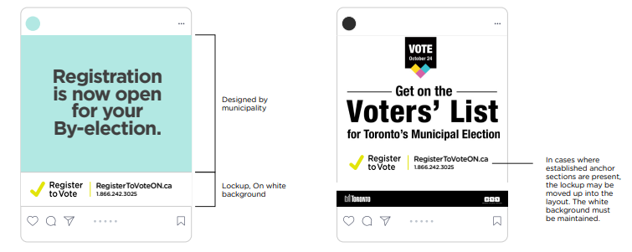
Communications Toolkit

Slide 11
A look at 2026

Slide 12
PLE Countdown
until PLE delivery on August 14, 2026
10 months

Slide 13
Key Dates
2025
December 31 | Official Streets & Address extract activities completed
 | Ward Boundary Changes legislated deadline
2026
March 31 | Subdivision Boundary Changes legislated deadline
May 29 | Last day to be onboarded in the Election Portal
July 31 | Last day to make changes in the Election Portal
August 12 | Last day for electors to register on Register to Vote site to be included in PLEs
August 13 | RTV website will redirect electors to register with their municipality
August 14 | Preliminary List of Electors delivery date
October 26 | Municipal Elections voting day
November 25 | Voters’ List Revisions legislated deadline

Slide 14
Contact our team in 2026
Send a message in the Election Portal via the Message Centre
Send an email to: voterslist@elections.on.ca
Send an email to your assigned coordinator
Call 1-888-812-8828
  Choice of language
  Each zone has an extension
  If the line is busy or it is after hours, voicemail will be available
Engagement in 2026
Training sessions
Onboarding
Questions answered
PLE support
Data cleansing activity support

Slide 15
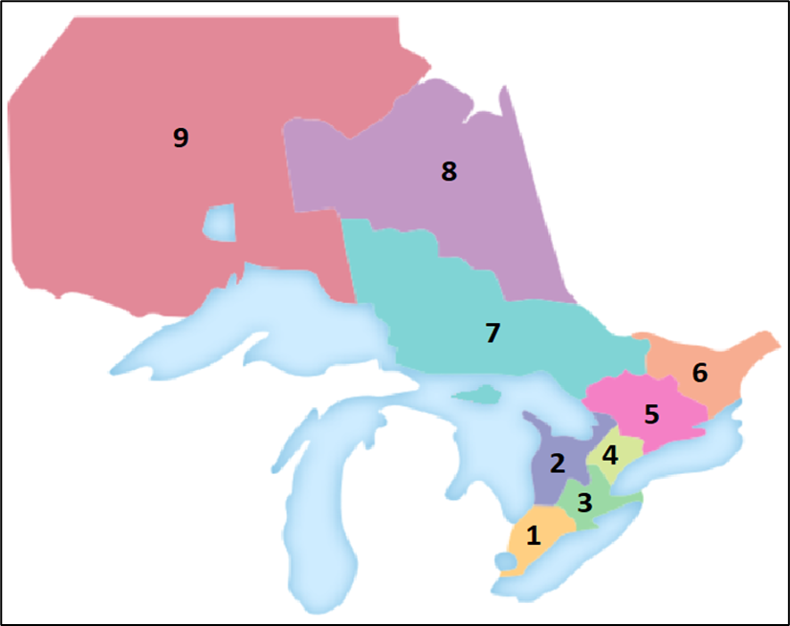
Municipal zones and their Coordinators
1 | Logan Norris
2 | Ann Butosi
3 | Shannon Talarico
4 | Kia Wilson
5 | Oriana Vella-Zarb
6 | Danielle Jewinski
7 | Dudley Campbell
8 | Deanna Singh
9 | Kevin Whelan

Slide 16


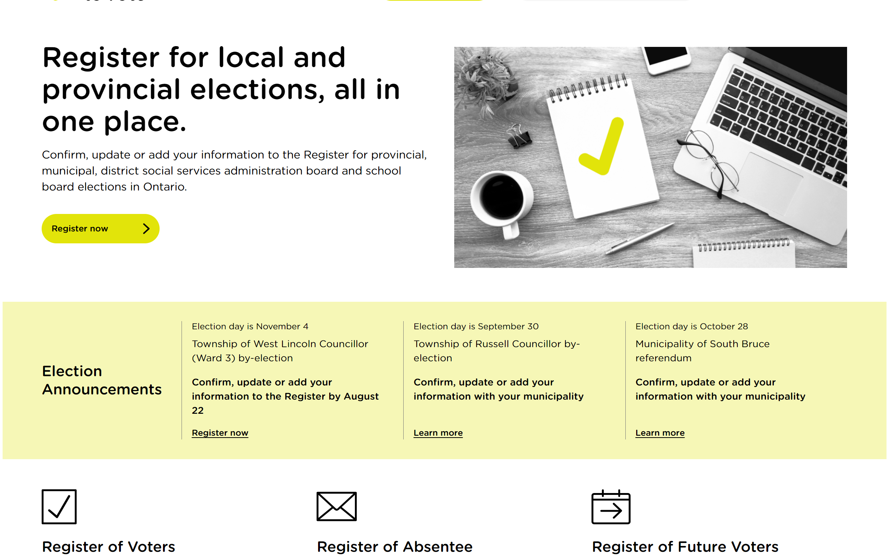



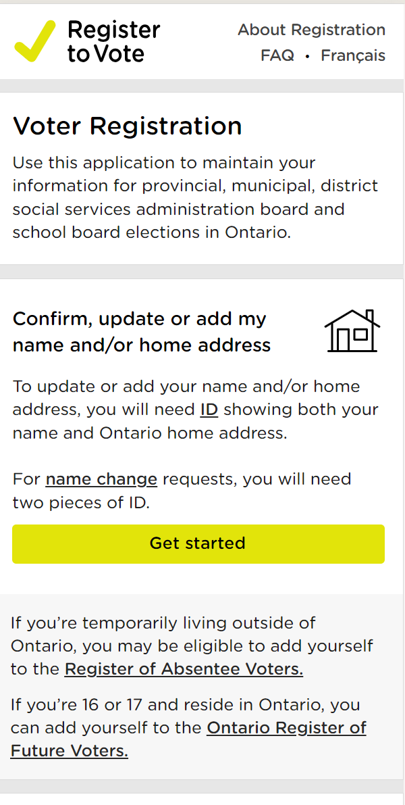


2026 Voter Registration Campaigns
In the Spring and Summer of 2026, Elections Ontario will launch province-wide voter registration campaigns to further improve the accuracy of the Register.
Tactic | Activities | Outcome
Drive voter registration through targeted multi-channel advertising campaign | Local TV, radio, digital, print Organic social media on RTV channels Drive electors to vReg Push to website for registration information | Voter registration RTV brand awareness
Outreach & Public Engagement
Providing toolkits to municipalities to leverage their local networks to provide information and educate electors on voter registration

Slide 17
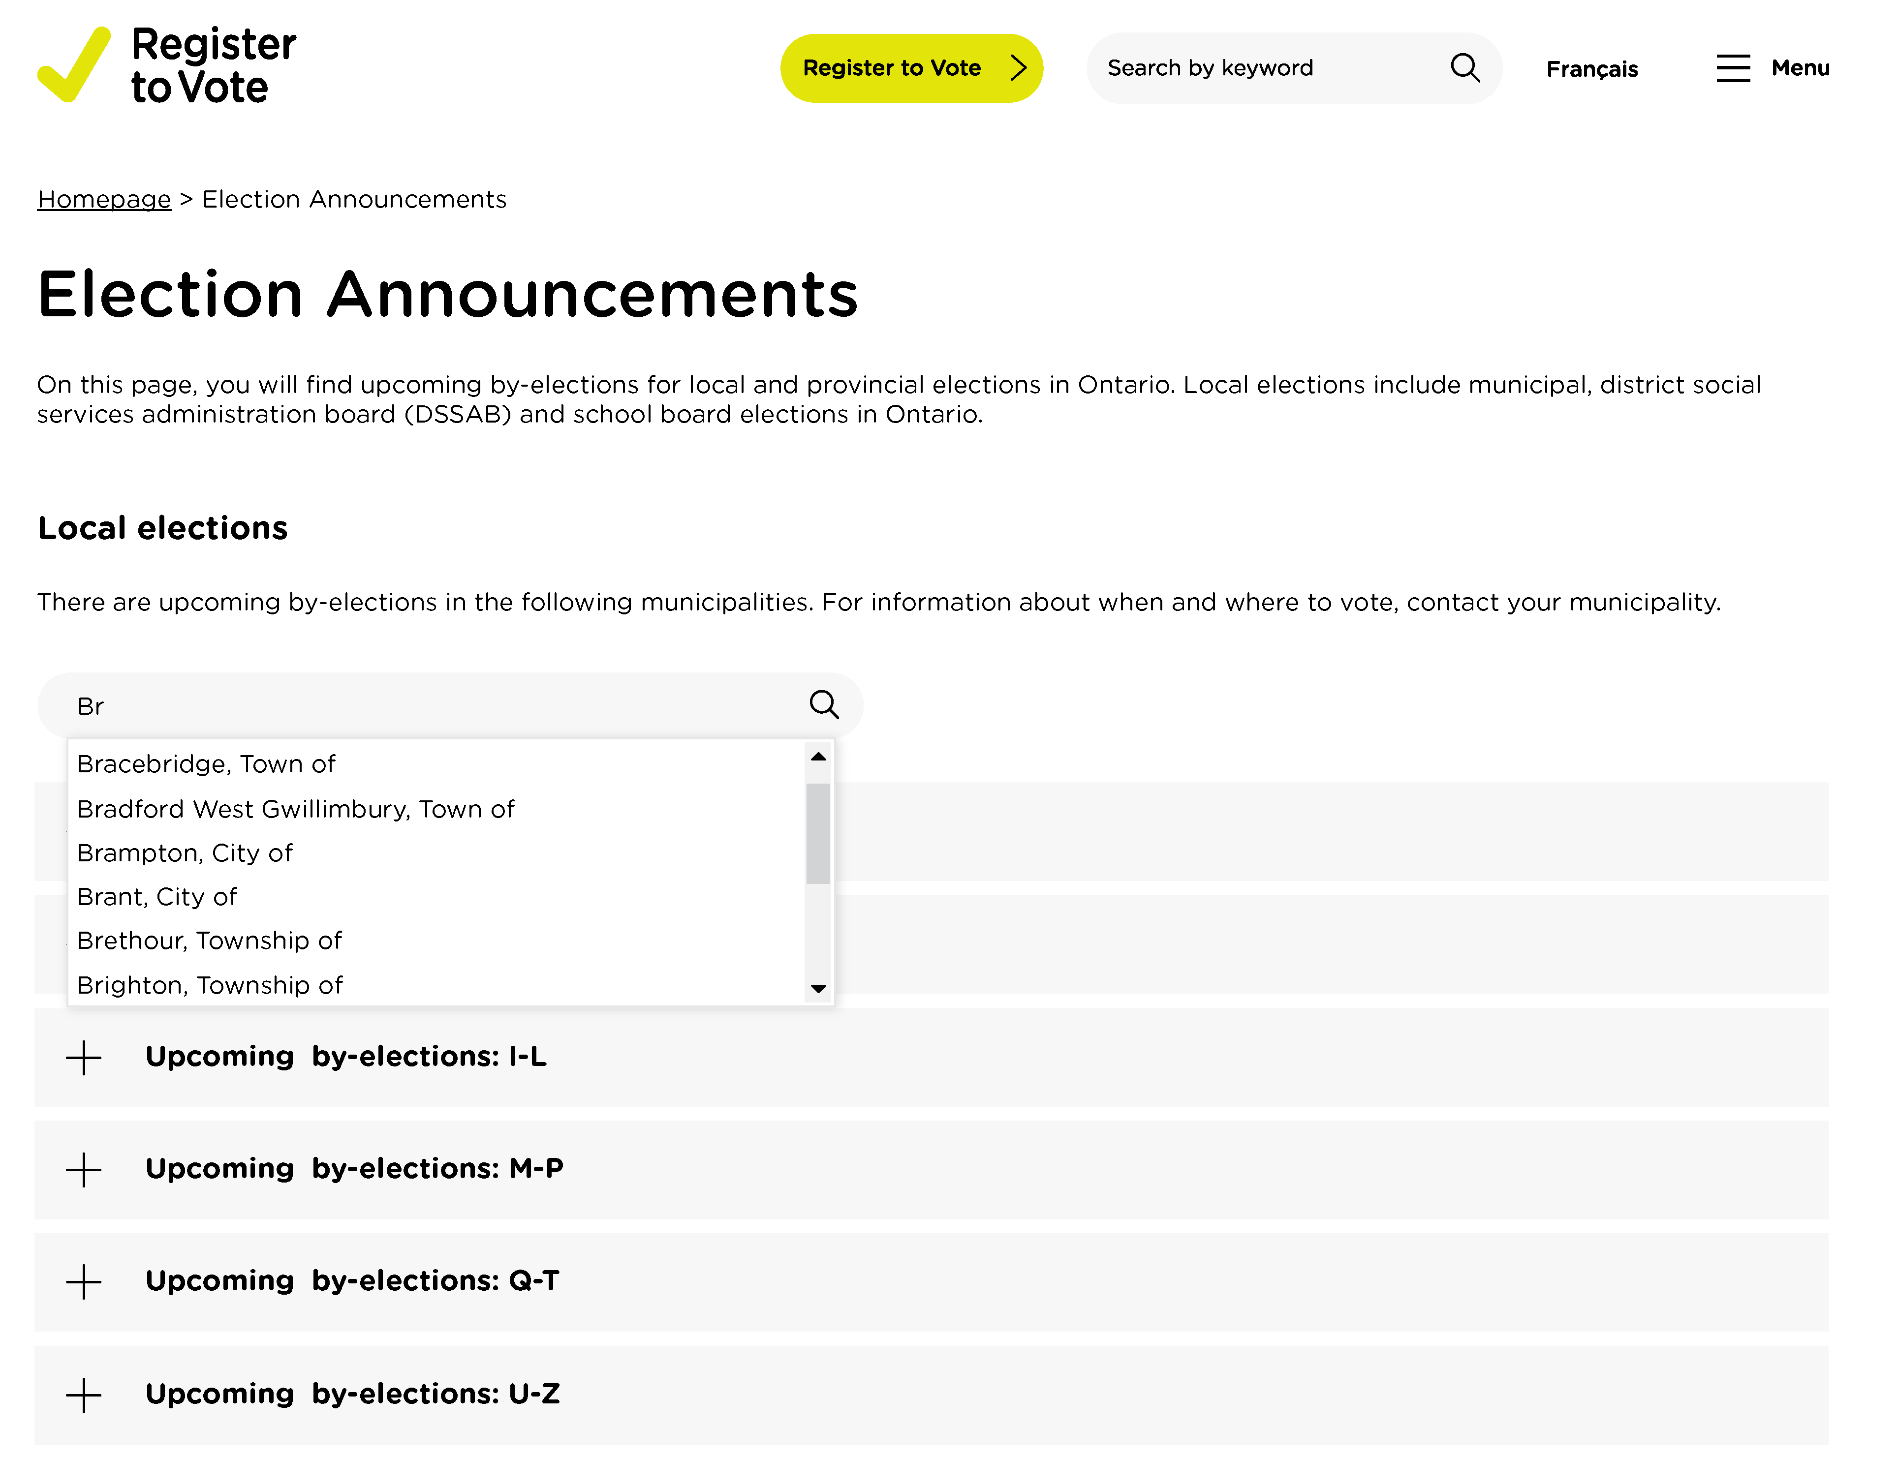
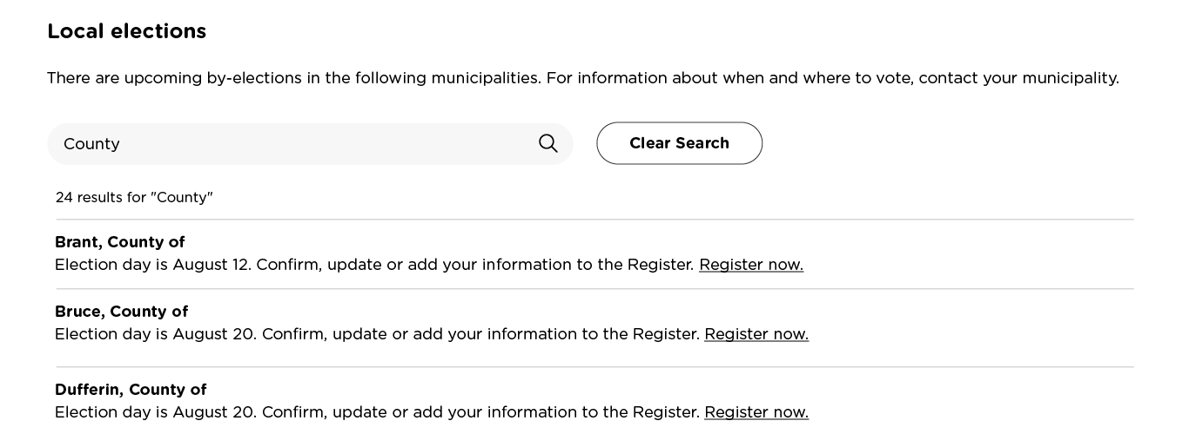
Getting Municipal Election Ready
Enhanced layout and structure of Voter Registration website
to support display of 444 municipalities:
We are getting ready to pass the Voters’ List baton to you—the municipalities!
Submit your municipal election website links and/or contact information by April 30, 2026.
Search bar
Contact information

Slide 18
Next steps

Slide 19
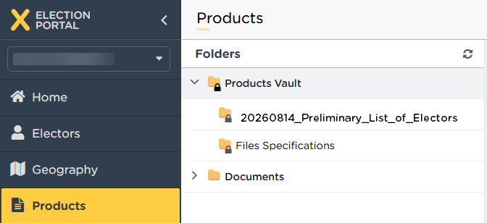
Receive your PLE via the Election Portal
Municipalities should initiate engagement with Elections Ontario by May 29, 2026, to receive the PLE via the Election Portal.
Municipalities who have not engaged with Elections Ontario will receive their PLE as a raw data file via email.

Slide 20
2025 Action Items
Engage with Elections Ontario via the Election Portal
Complete data cleansing activities:

Slide 21
2026 Action Items
Finalize ward and subdivision boundary changes in the Election Portal
Election Portal Data Cleansing Activities: A, B & C
Promote voter registration through municipal channels
  Use resources from the Communications Toolkit
Submit your 2026 website links and/or contact information
Activate your partnership with Elections Ontario
  Be onboarded to the Election Portal by May 29, 2026
  Access your PLE in the Election Portal on August 14, 2026
Return the revisions you’ve made to your Voters’ List to Elections Ontario by November 25, 2026

Slide 22
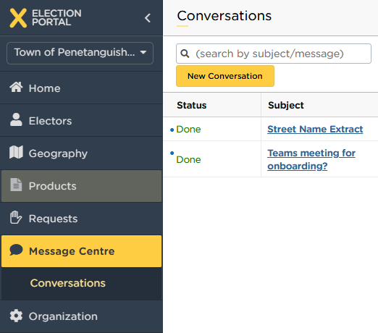
Engage with EO!
voterslist@elections.on.ca

Slide 23

Questions?
Ask now or email voterslist@elections.on.ca for onboarding and training

