Slide 1
Toronto Amalgamation
Jeff’s Megacity Experience

Slide 2
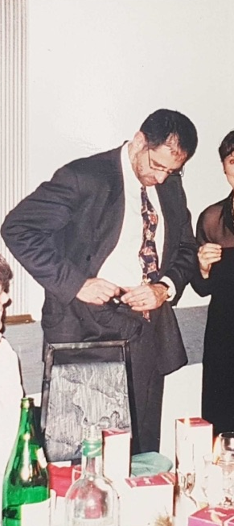
Background and Perspective
Preparing for Amalgamation
The Early Years
The Current State
Some Free Advice

Slide 3
Background and Perspective
“The net effect of the Golden Report was that it countered the Mike Harris pledge of "less government." The creation of a larger organizing body for the region ran counter to his party's advocacy of smaller government. Harris had felt that politicians, in particular lower level city councillors, were problematic to his party, and prevented free enterprise. The plan for reduced government might have emulated Margaret Thatcher's approach that eliminated democratically elected upper-tier city and metropolitan region governments, replacing them with a collection of more politically amenable appointed special-purpose bodies dominated by patronage. See Greater London Council."
Wikipedia – Common Sense Revolution

Slide 4
Background and Perspective
“While many suburban municipalities grew rapidly during Harris' first term (1995–1999), some, such as Opposition member Bud Wildman, have argued that the net effect of many CSR policies was to transfer wealth from urban to suburban areas and to refocus services to commuters and suburbs. In a highly controversial move, the City of Toronto was merged with the five surrounding cities of Metropolitan Toronto to form a new single-tier "megacity" (a term coined by the local media). The Harris government saw the megacity as a cost-cutting measure. The fact that the merger took place in Toronto, a region with a lower proportion Conservative MPPs, further polarized the debate on the merit of the merger. Some municipalities, particularly Toronto, also complained that the government was "downloading" the costs of services that the province had formerly paid for onto local city and municipal governments.”
Wikipedia – Common Sense Revolution

Slide 5
Background and Perspective
“The round-the-clock fight at Queen's Park lasted 10 days before the legislation was finally passed on April 21. On January 1, 1998, the new single-tier City of Toronto came into existence, superseding the former two-tier structure of Metropolitan Toronto, and the constituent cities of Toronto, York, North York, Etobicoke, Scarborough and the Borough of East York.”
Wikipedia – Common Sense Revolution

Slide 6
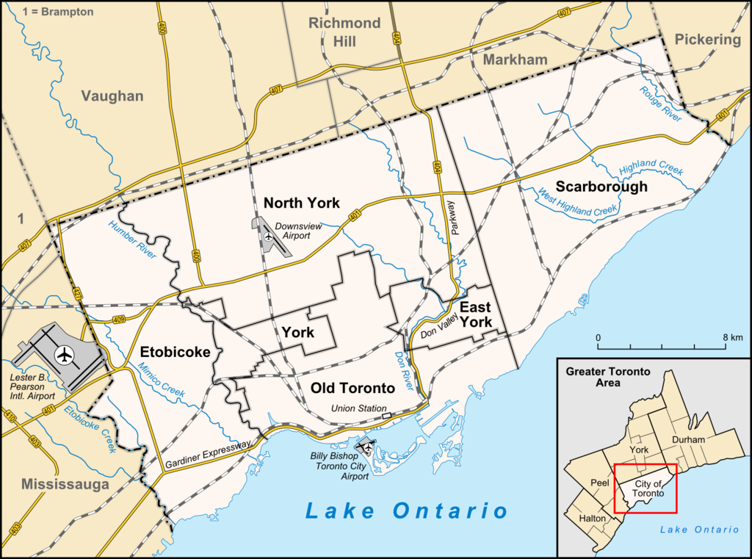
Background and Perspective
Pre-Amalgamation Metropolitan Toronto:
Toronto
North York
Scarborough
Etobicoke
York
East York

Slide 7
Background and Perspective
Jeff’s House

Slide 8

Background and Perspective
Jeff’s House

Slide 9

The flag displays the twin towers of the Toronto City Hall on a blue background, with the red maple leaf of the flag of Canada at its base, representing the Council Chamber at the base of the towers.^{[2]} The shape of the space above and between the towers suggests the letter 'T', the city's initial. - Wikipedia

Slide 10
Preparing for Amalgamation
Inventory
Establish Transition Teams (and transition leaders)
Beware the cross-pollination
Be (or find) a good leader
Prepare for Casualties

Slide 11

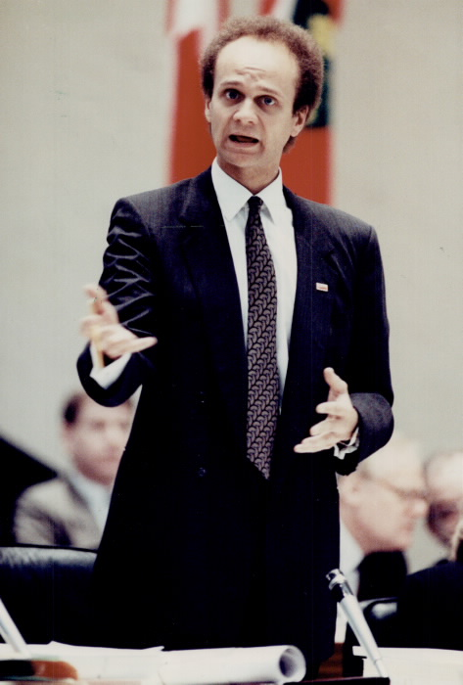

Preparing for Amalgamation

Slide 12
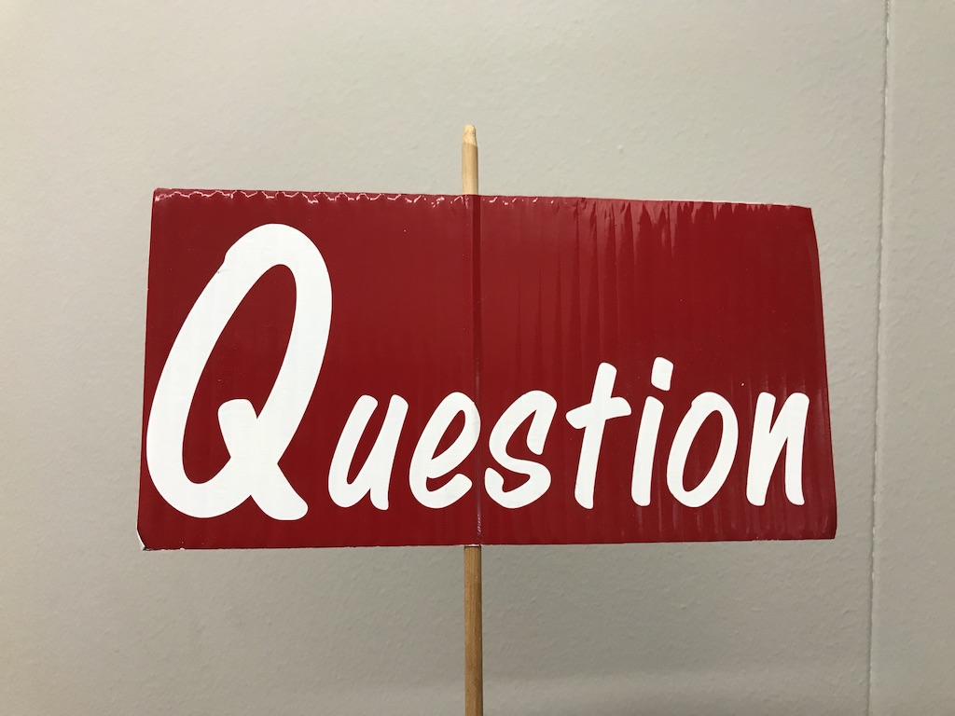
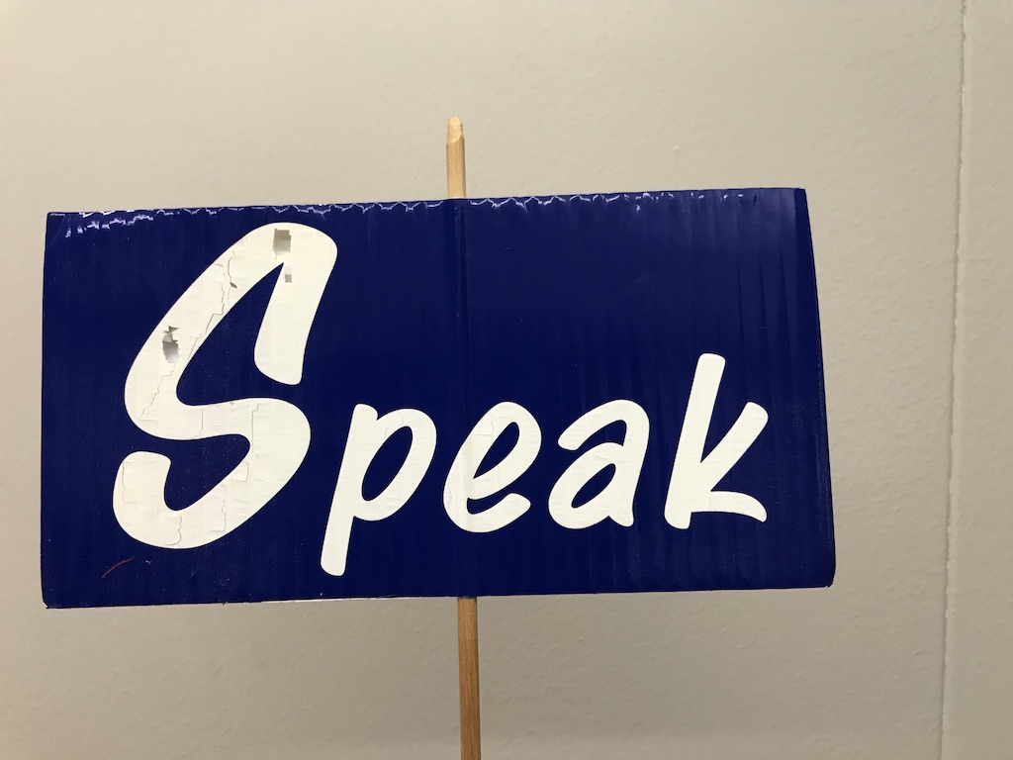
The Early Years
Lots to do
Us vs Them ; Us vs Us
Leadership Trends
Building Teams, Building Trust

Slide 13
The Current State
A view from a distance

Slide 14

The Current State
A View from Up Close

Slide 15
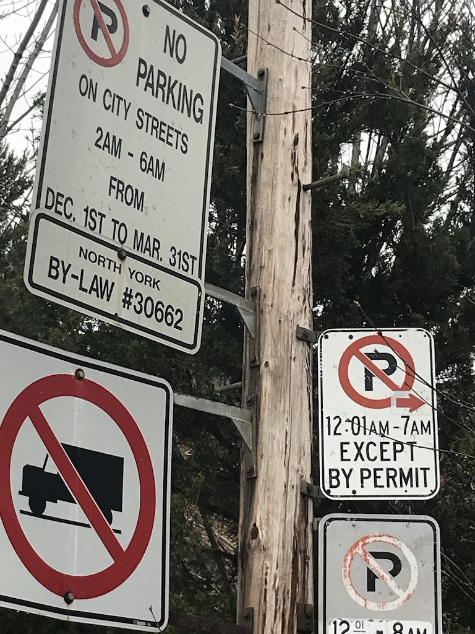
The Current State
A View from Up Close

Slide 16
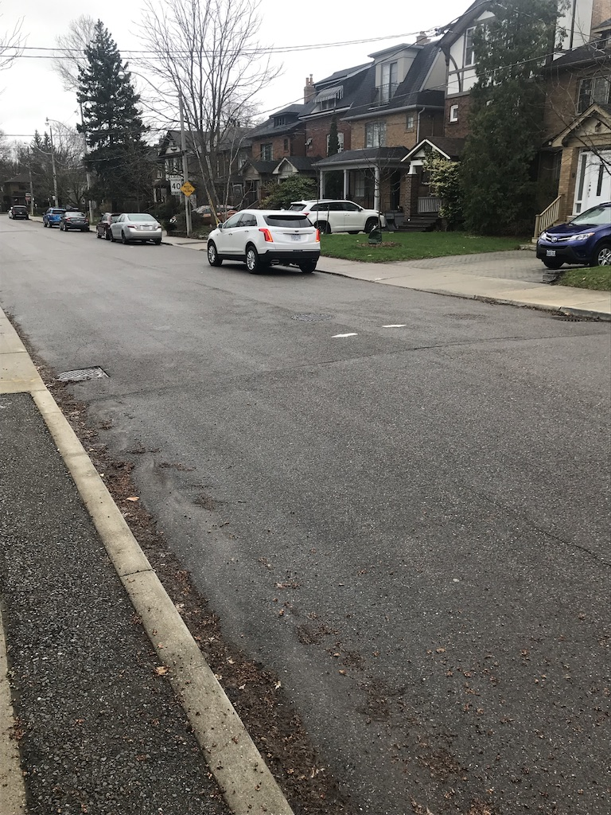
The Current State
A View from Up Close

Slide 17
The Free Advice
Focus on Service Delivery
  Innovations
  Partnerships
  PPs vs 3Ps
  Shared Services Agreements
  KISS as much as possible
  EOC Perspective
Notes:
Kiosks? Internal and external partnerships

Slide 18
F i n

