Slide 1
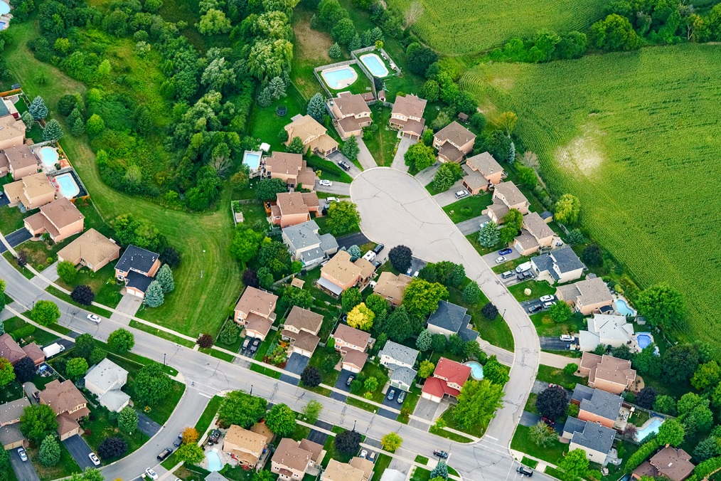
Bill 108: More Homes, More Choices Act, 2019
AMCTO Zone 2 Fall Meeting
October 18, 2019

Slide 2
Overview
introduction
transition provisions
key amendments to Planning Act and LPAT Act, 2017
in force and anticipated amendments to provincial policy
conclusions

Slide 3
Bill 139: Big News in 2017/2018
Building Better Communities and Conserving Watersheds Act, 2017 received Royal Assent on December 12, 2017
renamed and reconstituted the Ontario Municipal Board as the Local Planning Appeal Tribunal (“LPAT” or “Tribunal”)
made a number of significant changes to the Planning Act and land use planning approval process, including:
  establishing a new consistency/conformity test for OP, OPA, Zoning By-law, ZBA, Plan of Subdivision
  creating a new two-step appeal process for OP, OPA, Zoning By-law, ZBA, Plan of Subdivision
  lengthening the appeal period for private appeals based on an approval authority’s failure to make a decision
  preventing appeals where the Minister of Municipal Affairs was the approval authority of an OP or OPA

Slide 4
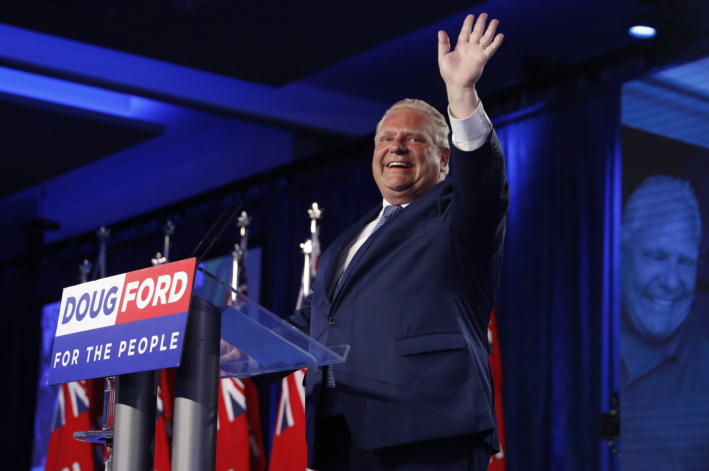
Change in Government – June 7, 2018

Slide 5
Bill 108: More Homes, More Choices Act, 2019
More Homes, More Choices Act, 2019 received Royal Assent on June 6, 2019
amends key legislation in the land use planning regime in Ontario, including:
  Planning Act
  Local Planning Appeal Tribunal Act, 2017
  Development Charges Act, 1997
  Ontario Heritage Act, 2006
repeals many (but not all) of the amendments introduced through Bill 139 (the Building Better Communities and Conserving Watersheds Act, 2017) in 2017
majority of amendments came into effect on September 3, 2019, but a number of amendments will not come into effect until a later date
stated objective to increase affordable housing in the province

Slide 6
Transition Highlights – Planning Act
general rule: everything is transitioned into the new Bill 108 regime unless there is a specific section in the Regulation that provides otherwise
in the case of an existing appeal of an OP, OPA, ZB or ZBA:
  where the appeal was already transitioned from the application of the Bill 139 regime (i.e. pre-Dec. 2017), the appeal will continue and be disposed of under the pre-Bill 139 regime
  where the appeal is commenced after September 3, 2019, the appeal will be continued and disposed of in accordance with the Bill 108 regime
  where the Bill 139 regime applied to an existing matter or proceeding, the question becomes whether the LPAT had yet scheduled a hearing on the merits of the appeal:
    if a hearing of the merits has been scheduled, the matter will remain within and be disposed of in accordance with the Bill 139 regime
    if a hearing of the merits has not been scheduled, the matter will be transitioned into the new Bill 108 regime.

Slide 7
Transition Highlights – LPAT Act
O. Reg. 102/18 - revoked
  previously prescribed timelines for the LPAT to render its decisions (6 months – 1 year)
  previously prescribed time limit on oral submissions
  previously prescribed restrictions on calling evidence and cross-examination
LPAT Rules of Practice and Procedure
  new as of September 3, 2019
  Part II procedures (Enhanced Municipal Records, Appeal Records, Case Synopses) only apply to matters that remain within the Bill 139 regime
  procedurally, Rules are largely back to pre-Bill 139 (i.e. OMB)

Slide 8
Key Amendments: Returning to pre-Bill 139 Regime
grounds for appeal
  no more requirement that appeals be exclusively on the basis that approval of the instrument is inconsistent with the Provincial Policy Statement, fails to conform or conflicts with a provincial plan or fails to conform with an Official Plan
  appellants can still raise these grounds of appeal (and provide supporting reasons), but are no longer limited to those grounds

Slide 9
Key Amendments: Returning to pre-Bill 139 Regime
no two-step appeal process
  return to single hearing where the LPAT would have the power to make a final determination approving, refusing to approve or modifying all or part of the instrument under appeal

Slide 10
Key Amendments: Returning to pre-Bill 139 Regime
return of the former motion to dismiss “test” that:
  the reasons set out in the notice of appeal do not disclose any apparent land use planning ground upon which the plan or part of the plan that is the subject of the appeal could be approved or refused by the Tribunal…
(Planning Act, ss. 17(45), 34(25), 51(17))

Slide 11
What’s New: Shorter Timelines for Appeals of Non-Decision
the time-frames for municipal processing of development applications (before a right to appeal arose), which had been extended in Bill 139, are now shorter than the pre-Bill 139 Planning Act:
(Planning Act, ss. 17(40), 34(11), 50(34))
Instrument | Pre-Bill 139 | Bill 139 | Bill 108
Official Plan/ Official Plan Amendment | 180 days | 210 days | 120 days
Zoning By-law Amendment | 120 days | 150 days | 90 days
Draft Plan of Subdivision | 180 days | 180 days | 120 days

Slide 12
What’s New: Restriction on third party appeals of plans of subdivision
only the applicant, municipality, Minister, public body or prescribed list of persons have the right to appeal an approval authority’s decision on a draft plan or subdivision, lapsing provision or any condition of draft plan approval
third parties no longer have the right to appeal a draft plan approval, draft plan conditions or changed draft plan conditions to the LPAT
affects property owners abutting or adjacent to draft plans of subdivision
(Planning Act, ss. 51(39), 51(43) and 51(48))

Slide 13
What’s New: Role of Participants
participants may only file written submissions and are no longer provided the opportunity to make oral submissions to the Tribunal
(LPAT Act, 2017, s. 33.2)

Slide 14
What’s New: No More Stated Cases
LPAT no longer has the authority to pose a legal question in writing for the opinion of the Divisional Court
(see for example the Rail Deck Park case - Canadian National Railway Company v Toronto (City))

Slide 15
What Remains the Same
mandatory Case Management Conferences (“CMC”)
two-year freeze on secondary plan amendments, zoning by-law amendments and minor variances
only the Minister can appeal an interim control by-law
no appeals of Minister’s decision if the Minister is the approval authority of an official plan or official plan amendment, including in the case of municipal comprehensive reviews and official plan review

Slide 16
Bill 108 Revisions Not Yet Proclaimed in Force
density bonus by-laws (s. 37) and parkland dedication (s. 42) still in force…for now
the new Community Benefits Charges by-law regime and s. 37 transition rules not yet in force
changes to the Development Charges Act, 1997, the Conservation Authorities Act and the Ontario Heritage Act are the subject of ongoing additional stakeholder consultation, with Proclamation expected early next year

Slide 17
A Place to Grow: Growth Plan for the Greater Golden Horseshoe, 2019
introduced on May 2, 2019
adjusts minimum density and intensification targets for a number of single- and upper-tier municipalities
permits municipalities to adjust settlement area boundaries outside of a municipal comprehensive review as long as certain criteria are met
directs municipalities to establish development criteria when employment lands proposed to be redeveloped are outside of a designated employment area
introduces Provincially Significant Employment Zones

Slide 18
Provincial Policy Statement
anticipated revisions to the Provincial Policy Statement forthcoming
draft revisions circulated in July 2019
comment period closes October 21st

Slide 19
Conclusions
more flexibility for appellants
repeal of the two-step appeal process
return to a single hearing
restrictions on third party appeals of plans of subdivision
restrictions on participation of non parties in LPAT proceedings
reduction in decision timelines for approval authorities, but no more time limit for LPAT decisions
amendments to Growth Plan and anticipated amendments to PPS
ongoing consultation regarding amendments to Development Charges Act, 1997, section 37 bonusing, parkland dedication and community benefits charge
return (for the most part) to pre-Bill 139 procedures

Slide 20

Meaghan Barrett
Email: mbarrett@airdberlis.com
Direct Line: 416.865.3064

