Slide 1
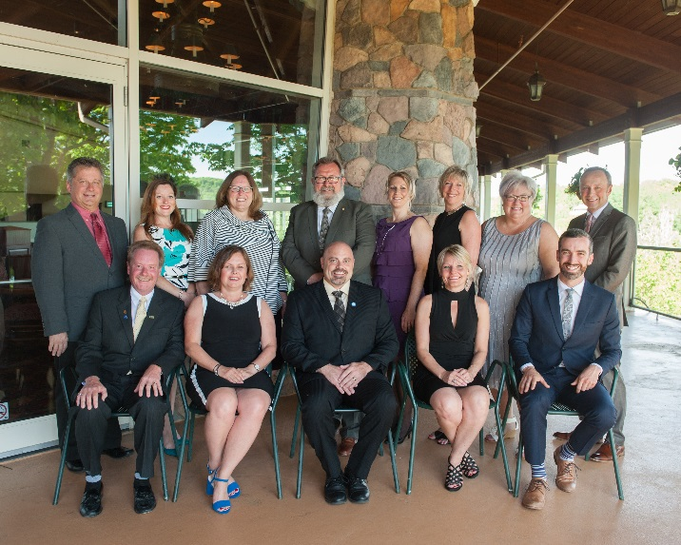
AMCTO Zone Meeting Presentation
Spring 2018

Slide 2
Topics for Today
Engagement Working Group – Survey Results/Lessons Learned
Proposed Changes to AMCTO By-laws re Board Composition
Program Pricing & Discount Structures – Seeking Input
AMCTO Annual Conference

Slide 3

Engagement Working Group – Survey Results/Lessons Learned
Notes:
In late September, the AMCTO Board of Directors received a report from the Board Governance Review Engagement Working Group regarding the results of the various engagement activities undertaken by the Group in accordance with their Terms of Reference. In the report, it was noted that the Working Group had one remaining task as per their Terms of Reference – soliciting feedback from members regarding the engagement processes undertaken and providing advice to the Board on the potential use or refinement of these engagement processes for future AMCTO engagement efforts.
To fulfill this task, the Working Group issued a survey to all AMCTO members and subsequently met via teleconference to discuss the survey responses and any resulting observations or recommendations.

Slide 4
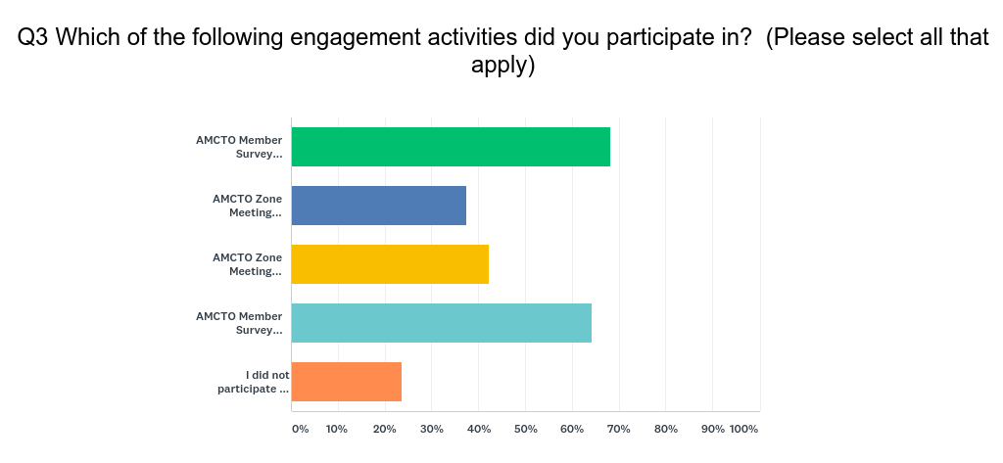
Engagement Working Group – Survey Results/Lessons Learned
Notes:
A total of 126 AMCTO members participated in the Working Group survey with responses coming from all 9 AMCTO Zones. Most respondents were FULL members of the Association.
When asked about their participation in the various engagement activities related to the Board Governance review, responses showed that:
About 68% participated in the AMCTO Member Survey regarding the use of voting technology
64% participated in the July 2017 survey regarding the potential qualifications for the position of AMCTO Vice-President
42% participated in the related AMCTO Zone meeting presentation about Vice-President qualifications
And 37% participated in the Zone Meeting presentation regarding the results of the voting technology survey.
However, about 24% of the survey respondents noted that they did not participate in any of the engagement activities listed.

Slide 5
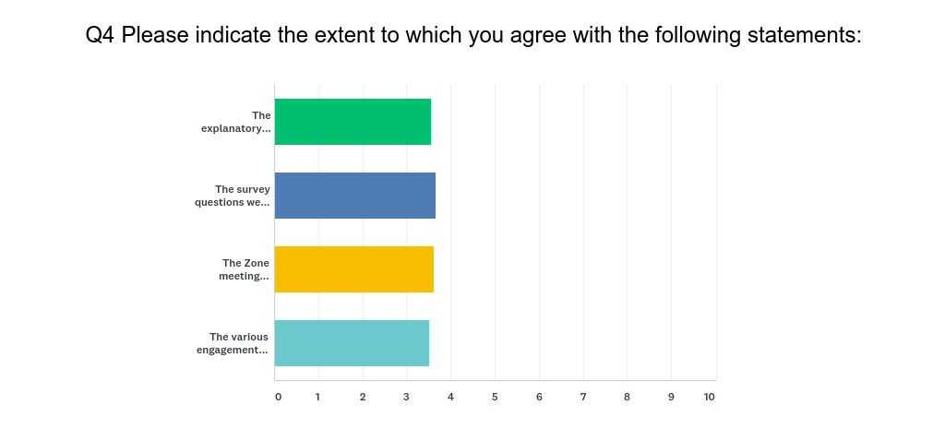
Engagement Working Group – Survey Results/Lessons Learned
Notes:
In examining the survey results, the Working Group members noted that responses were generally as expected. They also noted that the respondents were generally quite satisfied with the engagement activities undertaken and the amount of information provided before and during the various engagement processes.
In particular:
Almost 90% of the individuals who responded to the question about information provided and opportunities to provide input strongly agreed that the explanatory background provided during the engagement process was easy to understand and the survey questions used were quite clear.
88% of the respondents also agreed strongly that the engagement activities provided ample opportunities to provide input or feedback on the matters under consideration.
Support for the opportunities provided through the Zone meetings was more muted; however, 49% of the respondents to the question noted that they had not attended either of the Zone meetings described.

Slide 6
Direct and personal engagement would probably work best with a membership so diverse as AMCTO.
I am satisfied with the engagement
Surveys should provide sufficient opportunity for comment boxes to address answers that may not fit into pre-set categories.
Keep up the good work!
Continue to use short online surveys. Also, where possible, updates and input opportunity at zone meetings. For larger issues focus groups might be beneficial.
Good start to utilizing this type of engagement
I just love these easy, quick and clear surveys
Share the results with members, show members what others are saying about the surveys.
Continue to leverage IT opportunities for member engagement
Shorter, simpler surveys that clearly outline the time required to complete it.
I believe that we get somewhat bogged down in the concept of engagement and at sometimes it is considered to be a make work program instead of dealing actual issues.
Because I cannot attend all zone meetings, I found online surveys work best.
Brief follow up report is available to members to summarize engagement activity.
Notes:
When asked for suggestions for how the Association could improve its engagement activities in the future, a number of constructive responses were provided. Given these responses, the Working Group noted the following four key lessons learned and recommendations for the future:
The use of Zone meetings for engagement purposes is an effective tool but should not be the only means by which members are engaged on key Association activities;
The use of member surveys to gather input proved to be effective and was regarded positively by members;
The membership values being engaged by the Association and is interested in more opportunities for such engagement;
It is important for the Association to ensure that members are provided with feedback regarding the results of surveys and other engagement activities undertaken and any corresponding Board action.
It is anticipated that the Board will take the above-noted observations into consideration with respect to future engagement activities.

Slide 7

Proposed Changes to AMCTO By-laws Board Composition
Notes:
In Fall 2017, the AMCTO Board of Directors approved a series of recommendations from the Board Governance Review Engagement Working Group regarding the qualification criteria to be met by future potential candidates for the position of AMCTO Vice-President and the implementation of electronic voting for the position of Zone representative on the Board of Directors.
More specifically, the Board approved the following qualification criteria for future potential candidates for the position of AMCTO Vice-President:
Candidates must hold one of the Association’s recognized accreditations (AMCT, AMP, AOMC, CMO);
Candidates must be individuals who have been FULL members of the Association for a minimum of three years.
Candidates must have either current or past experience serving on the AMCTO Board of Directors.
In addition, the use of electronic voting for the position of Zone representative will occur in conjunction with the current electronic voting process for Directors-at-Large. This has historically occurred in late May/early June with results being confirmed at the Annual General Meeting.
Both of these changes have an impact on the current provisions set out in the Association’s Constitution & By-laws regarding the composition and election of the Board of Directors.

Slide 8
Proposed Changes to AMCTO By-laws
Board Composition
ARTICLE IV – OFFICERS
Section 1 – Officers
The Board shall appoint the Association President as Chair and may appoint any other person to be treasurer and secretary at its first meeting following the annual meeting of the Corporation. The office of treasurer and secretary may be held by the same person and may be known as the secretary-treasurer. At this same meeting, the Board will also appoint a member of the Board of Directors as Vice-President for a one-year term as elected by the membership prior to the Annual General Meeting.
Notes:
Since the qualification criteria for future candidates for the position of Vice-President do not include a requirement that the individual be a current member of the Board of Directors, the composition of the Board must be altered in order to accommodate the potential election/appointment of a non-Board member.
The first required change pertains to the appointment of officers. More particularly, there is a need to amend Article IV, Section 1 to provide that the Board appointment of a Vice-President does not have to involve an individual already on the Board of Directors.

Slide 9
Proposed Changes to AMCTO By-laws
Board Composition
ARTICLE V – DIRECTORS
Section 2 – Board of Directors
The Board shall consist of fifteen (15) sixteen (16) Directors.
Section 3 – Quorum
Eight (8) Nine (9) Directors shall constitute a quorum at any meeting of the Board.
Notes:
Secondly it is being recommended that the size of the current Board be increased from 15 to 16 Directors as set out in Article V, Section 2. In determining this proposed change consideration was given to the opportunity to maintain the current Board size by eliminating one other Director position (i.e. Immediate Past President position or one of the Director-at-Large positions). However, previous feedback from the Board members and Association membership during the initial Board governance review process indicated that such potential changes were not particularly palatable.
With an increase in the size of the Board, there is a corresponding requirement to amend the quorum requirements as noted in Article V, Section 3.

Slide 10
Proposed Changes to AMCTO By-laws
Board Composition
ARTICLE V – DIRECTORS
Section 2 – Board of Directors
(c) The thirteen (13) Directors shall be elected for a two-year term on a staggered basis as set out in this Section. In addition, the President, Vice-President and Immediate Past President shall be Directors by virtue of their offices. The term of office for the President, Vice-President and Immediate Past President shall be one year each.
Notes:
And finally, an amendment to Article V, Section 2(c) is required to reflect that the Vice-President is a Director by virtue of their appointed office.
Should these proposed changes be accepted, it should also be noted that in a situation where a current member of the Board of Directors is elected/appointed to the position of Vice-President, their Zone Director or Director-at-Large position would be vacated. The Board would then proceed with the appointment of a new Director to fill the remainder of the term for the vacated position.

Slide 11
Proposed Changes to AMCTO By-laws
Board Composition
ARTICLE V – DIRECTORS
Section 2 – Board of Directors
(a) Nine (9) Directors who are Full Members shall be elected, one from each Zone, at a regularly scheduled Zone meeting preceding the Annual General Meeting by the eligible voting members within the Zone and their election shall be ratified at the Annual General Meeting.
(d) For the purpose of staggering the election of Zone representatives to the Board of Directors, Zones 1, 3, 5, 7 and 9 will elect representatives on the even-numbered years, and Zones 2, 4, 6 and 8 will elect representatives on the odd-numbered years. Two Director-at-Large positions representatives shall be filled elected annually and ratified at the Annual General Meeting.
Notes:
The current By-laws note that the Zone representatives on the Board of Directors will be elected at a regularly scheduled Zone meeting preceding the Annual General Meeting and their election shall be ratified at the Annual General Meeting. With the use of electronic voting, an amendment is required to eliminate the reference to location of voting and replace with a reference to voting being by eligible voting members within the Zone.
It is also recommended that the provisions describing the process for electing Directors-at-Large also be amended slightly to reflect that these Directors are elected annually and that their election is ratified at the Annual General Meeting. This housekeeping amendment reflects the process that is already in place.

Slide 12
Proposed Changes to AMCTO By-laws
Board Composition
ARTICLE VI – NOMINATIONS
Section 3 – Restriction
If an eligible Member of the Corporation who has been nominated for a position on the Board of Directors is nominated for another position on the Board, the first nomination shall be deemed to have been withdrawn at the time the second nomination is filed.
Notes:
Lastly, it has been observed that no provisions currently are in place which would prohibit an individual from being nominated for more than one Board position at the same time (i.e. Zone representative, Director-at-Large, or Vice-President). The Board believes that an individual should only be able to seek election for one Board position in any particular election. Therefore the Board is recommending that a clause be added to the current By-laws similar to the provision set out in the Municipal Elections Act regarding nominations for a municipal election.
Next Steps
The various proposed amendments outlined to you will be presented to the membership at the 2018 Annual General Meeting in June. Information regarding these proposed changes will also be presented to members through a general communication to members through the Association e-mail broadcast service. Any feedback received from the membership in advance of the Annual General Meeting will be shared with the Board at the June Board meeting taking place immediately prior to the start of the annual Conference. At that time, if necessary, the Board can consider amendments that they may wish to propose based on the feedback received.

Slide 13

Program Pricing & Discount Structures
Seeking Input
Notes:
Last November the AMCTO Board of Directors received a report regarding the results of recent research undertaken with respect to the current rates and related pricing models utilized by various municipal staff Associations in Ontario and across Canada that have some similarities to AMCTO. General information was also provided about trends in participation levels and levels of satisfaction across AMCTO’s primary education and professional development programs.
From this research, it was clear that the Association’s current approach to pricing its programs and services and the resulting prices being charged are not out-of-line with most other similar municipal staff associations both in Ontario and across Canada. This observation was further reinforced by the constant participation rates being seen across the suite of programs being offered and by the satisfaction levels described through various post-event surveys and through the most recent AMCTO State of the Membership survey.
However the Board also agreed that they cannot ignore the concerns expressed by members from time to time about the continued affordability of AMCTO programs and services in an era of continuing municipal budget constraint.
Given these observations, the Association is embarking on a Key Strategic Action Item to:
Investigate financially sustainable opportunities to address the affordability concerns of members regarding current pricing for education and professional development programs without compromising the Association’s overall revenue structure.
As a first step in this process, the Association is seeking member input, through the Spring Zone meetings and through a planned member survey, on various pricing and discount related topics. Your input today will be very helpful to us.

Slide 14
Professional Development Workshops | 2017 Member Rate (per event day)
AMCTO | $305
Association of Municipal Administrators – NB (AMANB) | $75-$100
Association of Municipal Administrators – NS (AMANS) | $292
Association of Ontario Roads Supervisors (AORS) | Variable
Canadian Association of Municipal Administrators (CAMA) | N/A
Economic Development Council of Ontario (EDCO) | $50 - $100
Local Government Administrators – NT (LGANT) | N/A – included in price of annual conference
Local Government Management Association – BC (LGMA) | $258 - $280
Manitoba Municipal Administrators Association (MMAA) | $249
Municipal Finance Officers Association (MFOA) | $319 - $329
Ontario Building Officials Association (OBOA) | $105
Ontario Municipal Human Resources Association (OMHRA) | $250
Ontario Professional Planners Institute (OPPI) | $400 - $675
Professional Management Association – NL (PMA) | $150
Notes:
To provide some brief context around this matter, the next couple of slides outline the information received from the various associations from Ontario and other parts of the country that were surveyed. The associations selected had a similar membership make-up to AMCTO and, to ensure better comparability, all had at least one full-time Association staff member.
It should be noted that the pricing for the Association’s various continuing education programs (like the Municipal Administration Program) and the annual Forums were not included in this survey since there were no real comparable programs among the other Associations being surveyed.
As will be noted on this slide, the fees that AMCTO charges for professional development workshops generally fall within the upper part of the fee range identified through the survey. While there are a number of associations that charge a lower “per event day” fee, AMCTO’s current fees are not at the top of the range.

Slide 15
Annual Conference | 2017 Member Rate (per event day)
AMCTO | $243
Association of Municipal Administrators – NB (AMANB) | $136
Association of Municipal Administrators – NS (AMANS) | $132
Association of Ontario Roads Supervisors (AORS) | N/A
Canadian Association of Municipal Administrators (CAMA) | $290
Economic Development Council of Ontario (EDCO) | $270
Local Government Administrators – NT (LGANT) | $25
Local Government Management Association – BC (LGMA) | $280
Manitoba Municipal Administrators Association (MMAA) | $138
Municipal Finance Officers Association (MFOA) | $383
Ontario Building Officials Association (OBOA) | $162
Ontario Municipal Human Resources Association (OMHRA) | $160
Ontario Professional Planners Institute (OPPI) | $253
Professional Management Association – NL (PMA) | $120
Notes:
Similar to the information outlined on the previous slide, the fees that AMCTO charges for the annual conference also generally fall within the upper part of the fee range identified through the survey. But again, AMCTO’s current fees are not at the top of the range.

Slide 16
Webinars | 2017 Member Rate (per hour)
AMCTO | $86
Association of Municipal Administrators – NB (AMANB) | N/A
Association of Municipal Administrators – NS (AMANS) | N/A
Association of Ontario Roads Supervisors (AORS) | N/A
Canadian Association of Municipal Administrators (CAMA) | N/A – offered through ICMA
Economic Development Council of Ontario (EDCO) | $12
Local Government Administrators – NT (LGANT) | N/A – third party source
Local Government Management Association – BC (LGMA) | $78
Manitoba Municipal Administrators Association (MMAA) | $73
Municipal Finance Officers Association (MFOA) | N/A
Ontario Building Officials Association (OBOA) | N/A
Ontario Municipal Human Resources Association (OMHRA) | N/A
Ontario Professional Planners Institute (OPPI) | N/A
Professional Management Association – NL (PMA) | N/A – third party source
Notes:
With respect to the fees currently charged for webinars, comparable data was limited since most of the associations surveyed do not currently offer webinars or else offer them through a third party source. When compared to those associations that are offering webinars directly, the AMCTO fees (per hour) are currently the highest although not markedly so.

Slide 17
 | 2014 | 2015 | 2016 | 2017
Annual conference (full registrations) | 375 | 273 | 395 | 383
Continuing education courses (total students) | 1,191 | 1,276 | 1,116 | 1,386
Forums (avg. per event) | 100 | 110 | 96 | 109
PD Workshops (avg. per event) | 58 | 52 | 74 (excl. Elections) | 60 (excl. Elections)
Webinars (avg. per event) | 24 | 44 | 39 | 74
Notes:
Based on information contained in the Association’s membership database and also supplied by our current webinar provider, this table summarizes the participation levels for the past four years in each of the Association’s main education and professional development areas. As you can see, the participation levels across all of the different program areas have remained fairly constant. There has, however, been notable growth in the participation rates for webinars.

Slide 18
Program Pricing & Discount Structures
Seeking Input
In terms of affordability concerns, which AMCTO programs are the most problematic?
Other than the specific price for registration, are there other cost barriers that need to be taken into consideration in assessing affordability concerns?
Notes:
Given the information outlined on the previous four slides, the Association is interested in your observations on the following two questions:
In terms of affordability concerns, which AMCTO programs are the most problematic?
Other than the specific price for registration, are there other cost barriers that need to be taken into consideration in assessing affordability concerns?
Gather and record responses from participants.

Slide 19
Program Pricing & Discount Structures
Seeking Input
Sliding scales
Program bundling
Multiple registration
Preferential pricing
Early registration
Targeted servicing
Notes:
From the association survey, it was noted that while almost all of the survey respondents charged premium rates for non-members to participate in education and professional development events, the use of pricing discounts that benefit members was much less evident. There was some discounting offered for multiple registrations and/or early registration but these were only offered by a small group of associations.
Given the limited examples from other organizations, we are interested in your thoughts on the positive and negative aspects of the following list of discounting approaches that have been identified in some of the literature about not-for-profit organizations:
Sliding scales (where larger organizations pay a higher rate than smaller organizations for the same service)
Program bundling (where a lower total price is charged for a group of similar services compared to purchasing each service individually)
Multiple registration discounts (where 2nd and subsequent registrants from the same organization pay a lower fee than the first registrant)
Preferential pricing (where members of an organization or particular target audiences are charged lower rates for a particular service)
Early registration discounts (where a lower rate is charged prior to a certain specified registration date)
Targeted servicing discounts (where members of an organization are charged a lower rate if that organization acts as host for a particular event)
Gather and record responses from participants.

Slide 20
Program Pricing & Discount Structures
Seeking Input
Other input/feedback
Next steps
Notes:
Before we conclude this part of the presentation, are there any other topics that you feel we’ve overlooked or which you’d like to comment on?
Gather and record responses from participants.
Over the next couple of months, we will continue to gather member input on this topic through the various Zone meetings and through a member survey which we are hoping to launch in June. Staff will then take all this input and combine it with research on current pricing practices in the not-for-profit sector over the summer to identify options regarding future pricing, discounts, etc.
Based on the work completed over the summer, a report to the Board will be considered in September 2018 which will outline some proposed options for implementation. The outcome of the Board’s discussions in September will then be communicated to all members over the Fall (likely via a member survey and electronic communications) to get feedback on the Board’s preferred options.
A final Board decision will be made in November 2018, taking into consideration the member feedback received over the Fall. And finally, the Board’s final recommendations will be shared with all members prior to the end of the year.
Your input today was very helpful. Thank you.

Slide 21
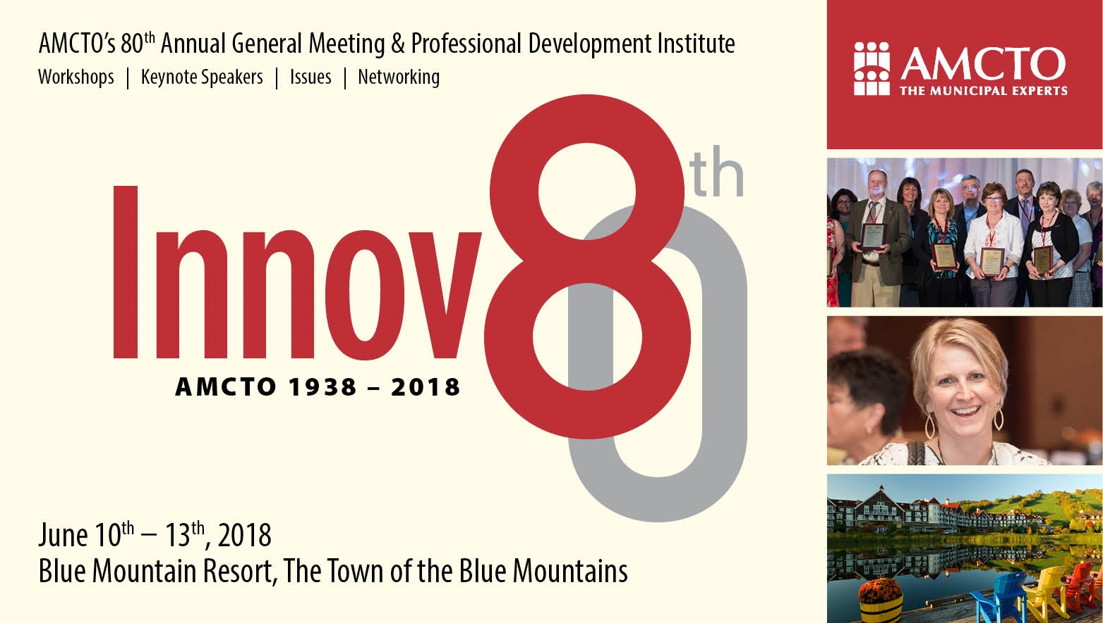
Notes:
The 2018 Conference Committee and AMCTO Staff are continuing the work to put the finishing touches on this year’s hallmark 80th Anniversary conference. As you will have seen from the Conference Insert that was included with the most recent edition of the Municipal Monitor, attending this year’s conference will give you the opportunity to hear two excellent keynote speakers and also participate in a wide array of concurrent sessions focusing on current municipal topics.
Special features this year include our Amazing Race Team Adventure challenge on Sunday afternoon along with a Mentoring/Networking session later that same afternoon. For those of you on the Zone Executive, we will again be hosting a Zone Executive Networking/Information event on Monday evening which will allow you to meet your peers from the other Zones to discuss the work to-date being undertaken by the Zone Executive Engagement Working Group.
New for this year will be our AMCTO Accredited Members’ Information and Education session that will target those AMCTO members who hold one of our four professional accreditations. And for the first time, we are also offering a Question Box Networking Session where participants will be able to get their questions answered by expert practitioners.
If you haven’t already registered, we encourage you to do so as soon as possible. Further details can be found on the AMCTO website.
We look forward to seeing you there.

Slide 22

AMCTO Zone Meeting Presentation
Spring 2018

