Slide 1
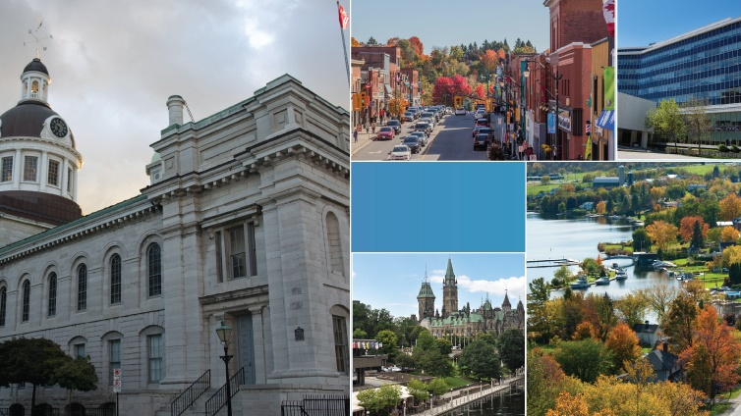

Fall Zone
Meeting -
AMCTO Update
Notes:
Good Morning/Afternoon:
It is a pleasure to be here and provide an update from AMCTO on some exciting initiatives ahead.

Slide 2

AMCTO Constitution & Bylaws
Pre-requisites
Completed MAP
Why Member Pursue?
Learn more online
To advance career prospects or pursue more progressive roles.
Continuing one’s professional development and growth.
- To be recognized by senior staff and elected council for your competence.
Are you ready? Check out our new webpage today!
Revised materials and handbooks will guide you through the process.
AMCTO is recognized as sector leading for municipal accreditation across Canada.
3 Years Relevant Experience
Member in
Good Standing
Notes:
We would like to start this presentation by committing ourselves to a discussion around AMCTO and its accreditation portfolio. Since 2015, significant reforms have bolstered our leading edge program, created new ones and made the value proposition around attaining a professional accreditation higher than ever.
We offer the CMO, AMP and AOMC programs by making our designations fully inclusive to rapidly evolving AMCTO membership.
We understand that improving career prospects is the primary driver for members. Attainment can lead to increased upward opportunities and we also know that members utilize our competency based process to reflect on their career accomplishments. By doing so, there is a fairly strong recognition process that is involved with attainment within the sector, your organization and personally. To that end, AMCTO is increasingly looking to new methods for recognizing and celebrating members for these professional achievements.
Finally, we note that pursuit of a designation is somewhat intrinsic and personal. So whatever your motivation, we definitely encourage you to check out the improved accreditation webpage with newly updated resources. The website will get you on the right path and inform any discussions you have with AMCTO staff or assigned accreditation mentors.
At this time, I want to show you a short accreditation video including testimonials from AMCTO members holding each of our designations.

Slide 3

Notes:
Play the video – ensure sound is appropriate.

Slide 4

152
120
32
Accreditation Candidates
Registered
CMO & AMP
AOMC
43% of the AMCTO membership hold at least one designation
Key Statistics
50% of designation holders have a university degree.
Over half of CMO holders earn over $100k annually.
AMCTO ranked highest in Dr. Zac Spicer’s research report on Perceptions of Municipal Accreditations in Ontario.
This includes AMCT, CMO, AMP and AOMC holders.
AMCTO has a long history of promoting professionalism, development and excellence.
Notes:
We hope you enjoyed that video and are motivated by hearing from members the value they derived from pursuing a designation with AMCTO.
To add to the video, some relevant data points include:
We currently have 152 candidates registered and working on pursuing their designation. Some a ready to submit and others are working on achieving the necessary competencies through their municipal roles. Nonetheless, the pipeline is healthy but can and should grow with your involvement.
As you can see, the strongest interest rests with the CMO and AMP – our competency based designation s. The AOMC program is picking up steam and its scoring method is easy for you to self assess. We expect Clerks to carry the weight of this designation as their opportunity to have the profession accredited like many others in the sector.
Some additional stats:
43% of AMCTO members hold a voluntary professional designation with the association. For comparison purposes, that is extremely high for voluntary accreditation programs and speaks volumes about the ambition and commitment of our members to professional growth.
Over half of CMO holders hold university degrees – refuting the fact that education precludes pursuit of a professional accreditation. Especially for a wide ranging field like municipal government.
Additionally, over half CMO holders earn a salary over 100k annually. CMO holders noted that their career and salary both improved following being granted the designation.

Slide 5
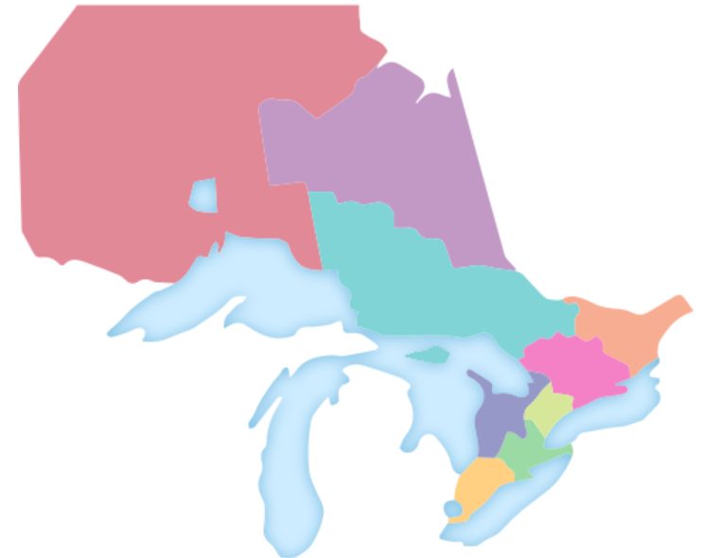
2019-20 Accreditation Zone Challenge
Contest Rules
Defending champs
Tabulate % and total number of designations earned from June 2019 to June 2020.
Zone 6 and Zone 8 have bragging rights
GUARANTEED RESULT & OPTIMIZED
How to get involved
Track the Challenge online
FREE CONSULTATION IN A MONTH
Register today or mentor others to build their professional portfolio.
AMCTO has developed a zone tracking webpage to provide real-time updates on designations granted.
AD STABILIZING TOOLS
Notes:
So how do we encourage you to get involved?
We wanted to sweeten the pot a little by launching a new AMCTO Accreditation Zone Challenge.
This challenge WILL INCLUDE ALL designations and the rules are simple.
The zone that garners the most new designations AND the highest % from June this year to June next year will win a free workshop from AMCTO for its members. So to be clear there is two opportunities to win.
It is worth noting that Zone 6 and Zone 8 are defending champions of the last Zone Challenge and word has it they plan to retain their title. (Adjust based on zone). Dean and Rob may wish to brag about their Zone here.
To keep track, AMCTO wants to make this challenge a bit more fun and interactive – as such, we will have a live tracker and webpage which will allow you to follow progress and it will be updated regularly to show not only attainment but enrollment from each zone!
The tracker will count down until the March 15th submission deadline to submit for review ahead of the final approvals. We then celebrate the professional accomplishments of these new holders at our Annual Conference in Blue Mountain next June.

Slide 6

Accreditation Zone Challenge
Time to Get Involved!
What You Can Do:
Self Assess or Mentor
Designations advance careers and you might be ready to get one or to help others.
Build a plan
Commit to the idea of earning a professional designation and develop a plan of action.
Get recognized
Start your accreditation and grow your career!
AMCTO will proudly recognize your achievement with your peers, management and council.
Notes:
How can you today get involved?
Well each of you can quickly self assess for any designation and begin by registering (there is no cost) to gain access to program materials.
If you can’t do it or already hold a designation, we ask you to serve as a accreditation champion by encouraging or mentoring someone or a group of individuals and further build the professionalism of our great association!
Once you commit, then it is really important to build a plan – and really think about how you will tackle this opportunity.
We get it, members have busy lives and having a solid plan of action will assist in tackling the work to needed to earn a designation while balancing your work load, family and life in general.
When it is all said and done…the reward that awaits you is gratifying and professionally advantageous to you. You can then be recognized for your efforts in front of your peers at the annual conference..
If you have been thinking about getting involved or we have peaked your interest, please do visit the website and/or get in touch with Nikki Gaudon at the AMCTO offices.

Slide 7
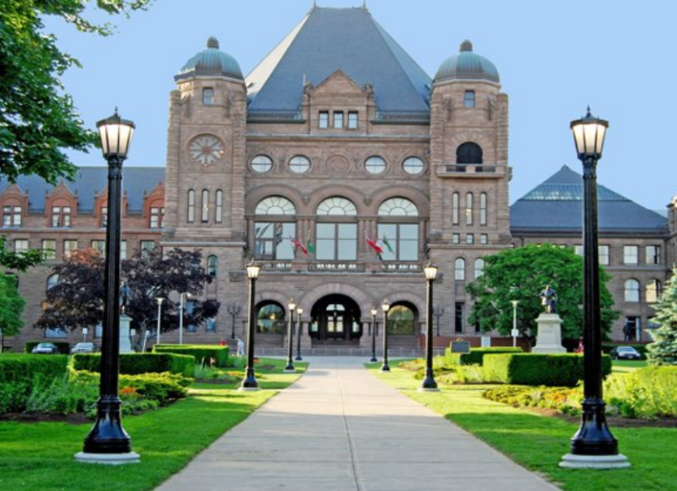

Key Policy Updates
1
Public Affairs Priorities
What have we done
2019 Pre-Budget Submission
Managed Municipal Reporting Burden Effort
Post-Election Survey Review & Analysis
Minister Clark Addresses AMCTO Delegates
2
Current files
MEA Submission
Voters’ List Position Paper & Advocacy
Joint & Several Liability Consultation
Delivering Success
3
On the horizon
2020 Pre-Budget Submission
Municipal Act Review
Government Burden Reduction Efforts
Municipal Management Internship Program
Public Affairs
Notes:
Shifting Gears:
It has been a busy and successful year for AMCTO on the public affairs front.
Since early January when our Pre-Budget submission was released, AMCTO has seen the government act on two of our primary recommendations. First, joint and several liability consultations were announced by Premier Ford at this year’s ROMA conference and secondly, it was welcomed news to hear that fiscal sustainability in the sector was being protected as OMPF funding will remain stable at $505 million over 2020 to municipalities to budget confidently for the year ahead.
While these two items only scratch the surface of activity as this new government has been busy focusing much attention on our sector. Over the next couples slides, we will discuss some priority files for AMCTO.

Slide 8
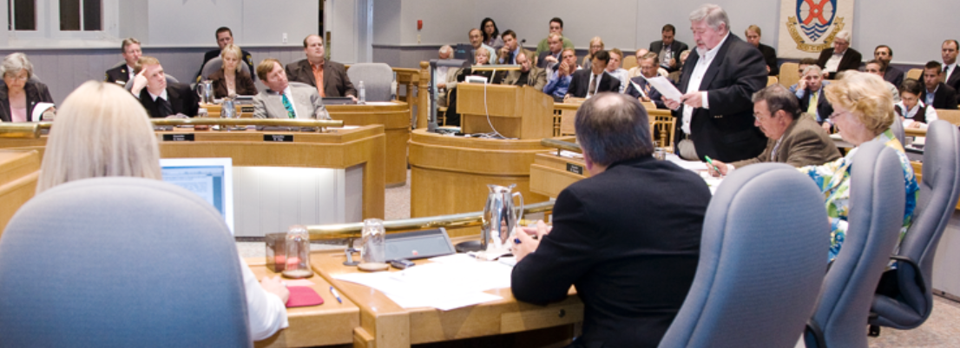
Municipal Reporting Burden
1
3
2019 AMO Conference
AMCTO validation
The Premier of Ontario cited municipal reporting reduction figures in his keynote address at the AMO Conference.
AMCTO participated in 7 reduction meetings and involved key experts from across the municipal sector.
The association has requested a list of reduced or eliminated reports. Ministry is waiting to reveal the list.
2
4
Reduction to date
Next steps
The government has announced 94 municipal reports eliminated and 27 have been consolidated or simplified.
AMCTO will continue to work with MMAH and the government on ongoing reporting reduction efforts.
Minister Clark indicated this work is only just beginning.
Notes:
Late in 2018, the Ministry of Municipal Affairs and Housing began to examine the Municipal Reporting Burden. As you know, the 2017 AMCTO released its report and inventory that is now a government priority.
Since December, AMCTO has leveraged sector expertise to guide discussions with various Ministries on problematic municipal reporting areas. These meetings represented the first time government officials have been educated on the scale of this problem. To tackle it, each municipal service area/theme had its own meeting whereby potential reporting burden reductions could occur.
At this year’s AMO Conference, both Premier Ford and Minister Clark addressed the AMCTO reporting burden file in their respective speeches. They announced that the government had eliminated 94 municipal reports and either simplified or consolidated 27 more. While we applaud this effort, AMCTO has adopted a “wait-and-see” approach as the reduction list is still to be provided. Until we have further analysis, it is difficult to assess whether municipalities will in fact, experience or feel a real reporting burden reduction.
The positive news is that Minister Clark indicated that this is just the beginning. He wants to continue to work with key stakeholders like AMCTO to ensure ongoing efforts are meaningful and sustained. The association plans to continue to provide leadership on this file over the coming months ahead.

Slide 9
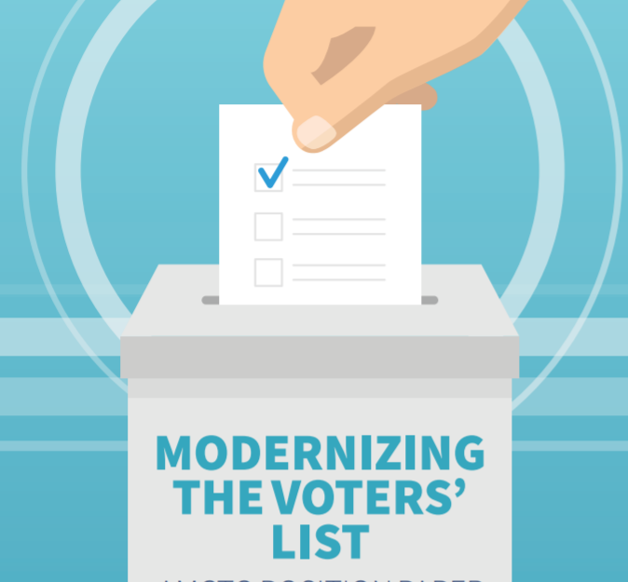
Voters’ List Advocacy
Current Status
Elections Ontario awaits a decision on its recommendations when the House resumes sitting. Minister Clark is currently reviewing the file.
AMCTO has briefed Minister Clark, Attorney General Doug Downey & the Ministry of Finance on the importance of Fixing the Voters’ List for our members.
Sector involvement
AMCTO encourages members to let key Ministers and your local MPPs know of the support behind the proposed reforms to the Voters’ List in Ontario.
Notes:
Next up is the Voters’ List File:
We have also seen some success on the Voters’ List file. In April, Elections Ontario submitted recommendations to the Ontario Legislature that, if adopted, would see responsibility for the municipal voters’ list move from MPAC to Elections Ontario. We are awaiting word on whether the government will accept these recommendations, but in the meantime we have continued our advocacy work in support of our position.
Along with our position paper, AMCTO has ensured that both Minister Clark, the Minister of Finance and the Attorney General understand the importance of fixing this list.
As we move closer to a decision, AMCTO is keen to seek your involvement to let Minister Clark, the Minister of Finance, Attorney General and your local MPPs know how important a fix to the voters’ list and that they should endorse Election’s Ontario’s recommendations to assume control ahead of the 2022 municipal elections. Please stay tuned as AMCTO will organize a broader call to action on this matter in the weeks ahead.

Slide 10

AMCTO - MEA Review & Submission
AMCTO Post Election Survey
Formal submission and policy work
Deeper analysis ensures AMCTO submission is data driven.
In September, members received a summary of the post-election survey findings and access to a cleaned dataset.
AMCTO Submission will reflect key policy reforms and a evidence based policy rationale to help improve election administration.
Technical amendments will be discussed with MMAH policy staff.
MEA Advisory Groups
Being prepared
MEA Advisory Group is reviewing policy and technical amendments.
Stephen O’Brien – Guelph City Clerk is the Chair.
More detailed survey work forthcoming.
AMCTO will look to represent members key concerns on the MEA this Fall.
Member updates will be provided regularly as this process gets underway.
Notes:
Finally, AMCTO is getting an early start on pulling together our review of the MEA.
This review started with some analysis of the 2018 post-election survey. This material was made available to members via a summary deck and access to a cleaned up dataset (member access only).
Following this, AMCTO pulled together the MEA Advisory Group which has been deliberating over a series of policy positions and technical amendments. This group is chaired by Stephen O’Brien - City Clerk in Guelph.
The plan for AMCTO is to have a draft submission in the Fall with the opportunity to discuss technical amendments with Ministry staff. This advanced effort seeks to build upon our success in 2015 whereby 75% of our recommendations were adopted as part of the MEA review and sustain the strong and informed voice of municipal election administrators.

Slide 11

AMCTO Policy and Legislative Services Resources
Issue at a glance – briefing note series
AMCTO Policy blog
AMCTO Municipal minute E-Newsletter
Municipal monitor Magazine
Municipal google search tool
Member Access to key datasets
AMCTO Events & forums
Notes:
Finally, beyond our active files we have a number of ways to keep members informed. If you are not aware, please do check out the following:
Our Issue at a Glance series takes some of our more prominent policy files and distills them into short but meaningful briefing notes for members
Our Policy Blog is the most active policy resource in the sector. Subscribe today and you won’t miss a single post where we provide a snapshot of issues, key government news releases, media stories, legislative reviews and relevant information for the municipal sector.
The Municipal Minute is a weekly round-up of items important to the municipal sector: news, events, legislative updates, resources, and career postings. You can subscribe through the Municipal Minute link on our website.
For longer reads, the Municipal Monitor is our quarterly magazine featuring in-depth articles on many different management and leadership topics. Recent issues have included articles on the regional governance review, impacts of cannabis legalization, and ransomware attacks on municipalities.

Slide 12


2019 AMCTO State of the
Membership Survey
470+ Responses
2015 & 2017
The SOTM Survey gauges members experiences, satisfaction and key demographic information in order to help inform and improve programming, benefits, and services to members.
.
Your opinion and input matters
Analyzed data is presented to the Board of Directors after each SOTM survey.
Feedback guides program development and service delivery
Benchmarking captures the changing membership over time.
LAUNCHES THIS FALL
Notes:
Shifting over to membership, the AMCTO State of the Membership Survey is set to go out to members this Fall. This survey done every two years has received great uptake in 2015 and 2017. We hope it continues to be an avenue for members to provide input about AMCTO, it’s mandate, services, and overall perceptions of the association.
The data is analyzed deeply by the association and presented to the Board of Directors. The data also drives reforms to programming and services along with the fact that benchmarking allows the association to more accurately track the changing membership needs/expectations at AMCTO.
We hope you look out for the SOTM survey this Fall and take the time to complete it in full.

Slide 13
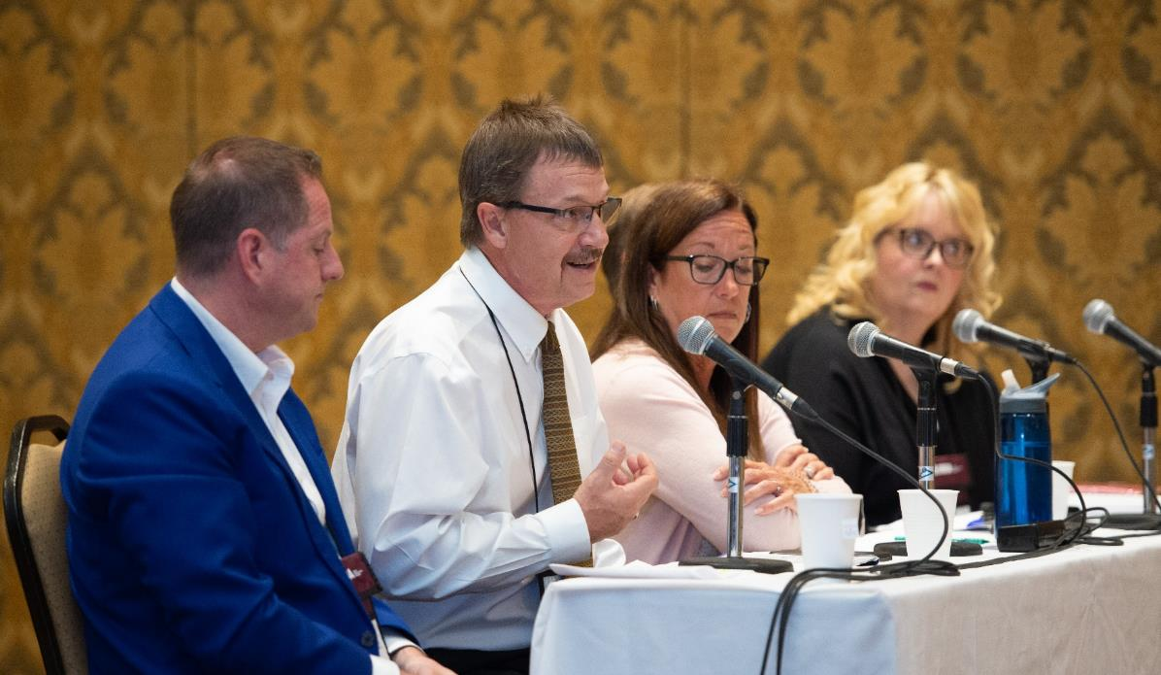
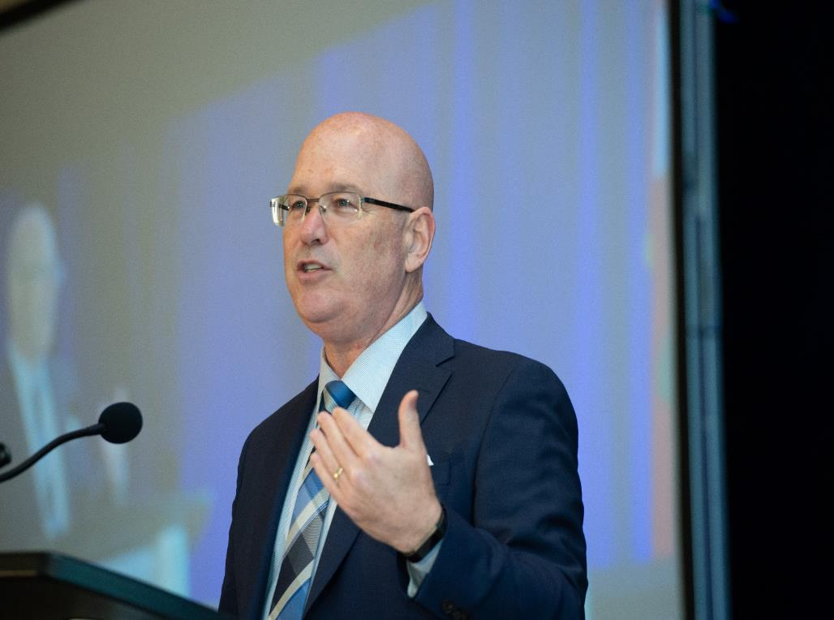


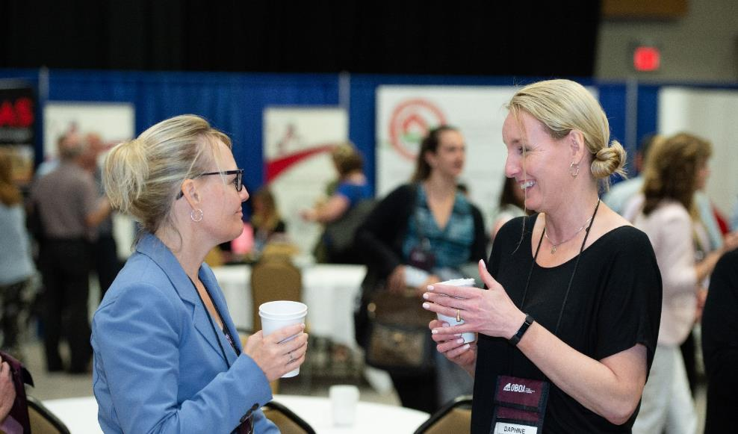
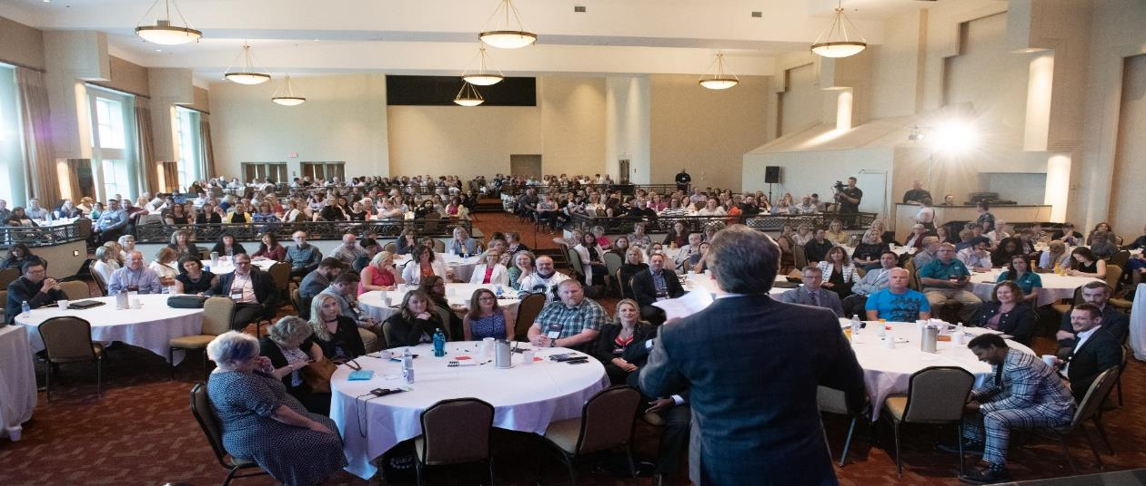
2020 AMCTO Conference
June 7th – 10th 2020
Blue Mountain Resort
We want to hear from you
What parts of the current AMCTO conference program do you like the most?
What do you think is missing from the current AMCTO conference program?
If you could change one thing about the conference program or structure, what would you change?
Notes:
After a successful 2019 Annual Conference, work is already underway with our 2020 Conference Planning Committee to prepare for our next conference taking place at the Blue Mountain Resort. We had a great response to our call for workshop presentations and the Committee is working to ensure that the proposals accepted are geared to the most pressing needs of our conference attendees. The Committee members have also been providing input on the overall theme for the conference and on keynote speakers that might fit with our theme.
This year, the Committee has also been tasked with providing some input on the overall structure and content of the conference program. While our current structure works well, there is always a benefit in looking at what might be changed to keep the program fresh and interesting for our frequent conference attendees.
Today we would like to also gather your input on the AMCTO conference program. So we’d like to ask you the following three questions:
What parts of the current AMCTO conference program do you like the most?
What do you think is missing from the current AMCTO conference program?
If you could change one thing about the AMCTO conference program or structure, what would you change?
Solicit input from attendees for each of the three questions. Staff will record responses.
Thank you for this input.
I hope that many of you will be able to attend the conference. If you are planning to attend, a link is already available on the AMCTO website ‘Conference’ page, to book your accommodations at Blue Mountain. And watch for the launch of our online conference registration later this year.

Slide 14
AMCTO Organizational Review
2014
AMCTO last underwent an organizational review in 2014.
2014-19
Membership and sector needs are changing quickly.
2020
Align services and resources to future member and business needs.
Notes:
Like any organization, from time to time, AMCTO needs to pause and reflect on the organizational structure and how it relates to the environment in which the Association operates. With the last major organizational review occurring five years ago, the Board of Directors has decided to initiate another review which should be completed by early 2020.
As all of you know, there have been a lot of changes in the municipal sector over the past five years. These changes in the municipal environment, coupled with the significant change in municipal staffing over this same timeframe, have led to significant changes in the programs and services needed by municipal professionals across the province. While AMCTO has worked hard to successfully meet these program and service needs, we have done so without making any significant changes to our basic organizational structure.
The primary goal of this Organizational Review will be to ensure that AMCTO is properly positioned and structured to continue delivering the programs and services that are needed by our members and others working in the municipal sector in the most effective way possible. Through this Review, we also want to capitalize on our existing dedicated Staff team and take full advantage of the capabilities and skill-sets that they possess.
The Board will be retaining an external consultant to undertake this Review and to make recommendations. The review’s major emphasis will be on organizational design with consideration given to current issues and anticipated future strategic focus. Once the Review has been completed, we will be sharing details of any significant changes arising from the recommendations.

Slide 15




Follow us on Social Media
We Create Something Cool Everyday
We Help Small Company Grow
Steady
98% of Our Clients Get Opt. Result
SOCIALIZE YOUR PRODUCT
SOCIALIZE YOUR PRODUCT
SOCIALIZE YOUR PRODUCT
AMCTO Facebook Page
@amcto_policy
AMCTO LinkedIn Page
@amcto_policy
Notes:
A reminder – please follow us on Social Media. There is lots of good content there and plenty more to come!

Slide 16
Thank you
questions?
PRESENTATION TEMPLATE
Notes:
Thank you, any questions?

